Slide 1
Unit 1: Chemathematics
1.1
Aim: How can I measure
everyday things in Chemistry?
Objective:
I will be able to identify the most common units of measurement in Chemistry.
AGENDA
Do Now
Introduction
Mini-Lesson
Summary
Work Period
Do Now:
(You have 5 minutes)
Take out lab safety handout and complete Broken Scenarios sheet on pgs. 3-4
Exit Slip

Slide 2
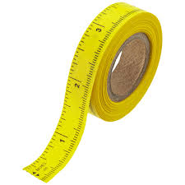
Unit 1: Chemathematics
1.1
Aim: How can I measure
everyday things in Chemistry?
Real-world connection
Business, Money, Cooking, Clothing, Building
Vocabulary
*SI Unit * Unit * Meter * Gram * Second * Kelvin * Celsius * * Liter *
AGENDA
Do Now
Introduction
Mini-Lesson
Summary
Work Period
Exit Slip

Slide 3
Unit 1: Chemathematics
1.1
Aim: How can I measure
everyday things in Chemistry?
Announcements
Please bring $3 for binder materials
Alchemy sheet due
Papers past due:
FB profile
Lab Safety Contract
Course contract
Parent Questionaire
Text Message Service
AGENDA
Do Now
Introduction
Mini-Lesson
Summary
Work Period
Exit Slip

Slide 4
Unit 1: Chemathematics
1.1
Aim: How can I measure
everyday things in Chemistry?
Look at this…
On my way home yesterday, I walked 70 stones to the store. I had 3 slices of chicken to eat. I was so hungry, it took me 9 tons to eat it. Outside it was so cold, only 50 days. I needed a hat and scarf so I went to another store and bought a scarf for 5 pens. I returned home and slept for 8 cups.
AGENDA
Do Now
Introduction
Mini-Lesson
Summary
Work Period
Exit Slip

Slide 5
Unit 1: Chemathematics
1.1
Aim: How can I measure
everyday things in Chemistry?
Pair-share
Discuss with a partner what is wrong with this scenario.
AGENDA
Do Now
Introduction
Mini-Lesson
Summary
Work Period
Exit Slip

Slide 6
Unit 1: Chemathematics
1.1
Aim: How can I measure
everyday things in Chemistry?
Do Now
Introduction
Mini-Lesson
Summary
Work Period
Exit Slip

Slide 7
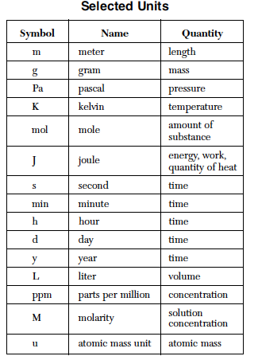
Unit 1: Chemathematics
1.1
Aim: How can I measure
everyday things in Chemistry?
The Fundamental Units
To find the Selected Units used in chemistry, we can look at _______________ in the reference table
Do Now
Introduction
Mini-Lesson
Summary
Work Period
Exit Slip

Slide 8
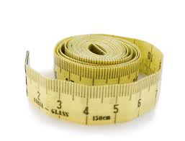
Unit 1: Chemathematics
1.1
Aim: How can I measure
everyday things in Chemistry?
To Measure: Distance
Unit: __________
Symbol: _______
Instrument:
_________________
Examples of things to measure?
Do Now
Introduction
Mini-Lesson
Summary
Work Period
Exit Slip

Slide 9
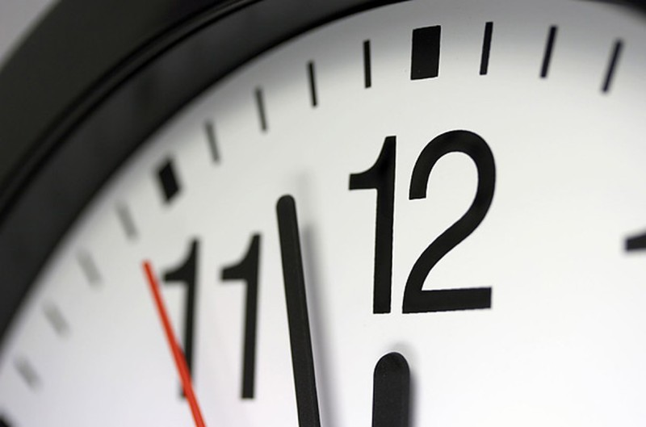
Unit 1: Chemathematics
1.1
Aim: How can I measure
everyday things in Chemistry?
To Measure: Time
Unit: __________
Symbol: _______
Instrument:
_________________
Examples of things to measure?
Do Now
Introduction
Mini-Lesson
Summary
Work Period
Exit Slip

Slide 10
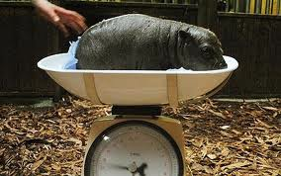
Unit 1: Chemathematics
1.1
Aim: How can I measure
everyday things in Chemistry?
To Measure: Mass
Unit: __________
Symbol: _______
Instrument:
_________________
Examples of things to measure?
Do Now
Introduction
Mini-Lesson
Summary
Work Period
Exit Slip

Slide 11
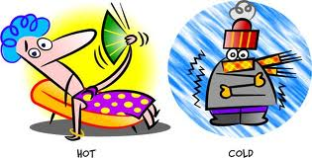
Unit 1: Chemathematics
1.1
Aim: How can I measure
everyday things in Chemistry?
To Measure: Temperature
Unit: __________
Symbol: _______
Instrument:
_________________
Examples of things to measure?
Do Now
Introduction
Mini-Lesson
Summary
Work Period
Exit Slip

Slide 12
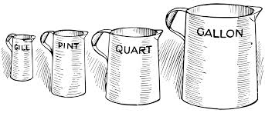
Unit 1: Chemathematics
1.1
Aim: How can I measure
everyday things in Chemistry?
To Measure: Volume
Unit: __________
Symbol: _______
Instrument:
_________________
Examples of things to measure?
Do Now
Introduction
Mini-Lesson
Summary
Work Period
Exit Slip

Slide 13
Unit 1: Chemathematics
1.1
Aim: How can I measure
everyday things in Chemistry?
Do Now
Introduction
Mini-Lesson
Summary
Work Period
Exit Slip

Slide 14
Unit 1: Chemathematics
1.1
Aim: How can I measure
everyday things in Chemistry?
Johanna has a mass of 60 kilograms.
W: U: S:
Christina took a shower for 15 minutes.
W: U: S:
Daniel walked for a really long time. He walked for 6.8 kilometers.
W: U: S:
Do Now
Introduction
Mini-Lesson
Summary
Work Period
Exit Slip

Slide 15
Unit 1: Chemathematics
1.1
Aim: How can I measure
everyday things in Chemistry?
Summary
Why is it important to use the proper units of measurement?
Do Now
Introduction
Mini Lesson
Summary
Work Period
Exit Slip

Slide 16
Unit 1: Chemathematics
1.1
Aim: How can I measure
everyday things in Chemistry?
Work period
Odd One Out: Circle which one is the one out. Then explain why that term is the odd one out AND how are the other terms related to each other.
NOTE: Work together in groups to discuss
Do Now
Introduction
Mini-Lesson
Summary
Work Period
Exit Slip

Slide 17
Unit 1: Chemathematics
1.1
Aim: How can I measure
everyday things in Chemistry?
EXAMPLE:
Do Now
Introduction
Mini-Lesson
Summary
Work Period
Exit Slip

Slide 18
Unit 1: Chemathematics
1.1
Aim: How can I measure
everyday things in Chemistry?
CLASSWORK QUESTIONS:
Do Now
Introduction
Mini-Lesson
Summary
Work Period
Exit Slip

Slide 19
Unit 1: Chemathematics
1.1
Aim: How can I measure
everyday things in Chemistry?
CLASSWORK QUESTIONS:
Do Now
Introduction
Mini-Lesson
Summary
Work Period
Exit Slip

Slide 20
Unit 1: Chemathematics
1.1
Aim: How can I measure
everyday things in Chemistry?
CLASSWORK QUESTIONS:
Do Now
Introduction
Mini-Lesson
Summary
Work Period
Exit Slip

Slide 21
Unit 1: Chemathematics
1.1
Aim: How can I measure
everyday things in Chemistry?
CLASSWORK QUESTIONS:
Do Now
Introduction
Mini-Lesson
Summary
Work Period
Exit Slip

Slide 22
Unit 1: Chemathematics
1.1
Aim: How can I measure
everyday things in Chemistry?
HOMEWORK:
Finish 1.1 for homework
Do Now
Introduction
Mini-Lesson
Summary
Work Period
Exit Slip

Slide 23
Unit 1: Chemathematics
1.1
Aim: How can I measure
everyday things in Chemistry?
Exit Slip
Make sure you get your trackers checked!
Do Now
Introduction
Mini-Lesson
Summary
Work Period
Exit Slip

