Slide 1
Unit 1: Chemathematics
1.3
Aim: How can two units of measurement be equal to each other?
Objective:
I will identify the conversion factor between units.
AGENDA
Do Now
Introduction
Mini-Lesson
Summary
Work Period
QUIZ:
(You have 10 minutes)
TAKE QUIZ AND START
Exit Slip

Slide 2
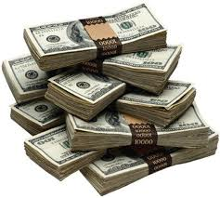
Unit 1: Chemathematics
1.3
Aim: How can two units of measurement be equal to each other?
Real-world connection
Money, Cooking, Building
Vocabulary
Conversion * Dimension * Dimensional analysis * Base
AGENDA
Do Now
Introduction
Mini-Lesson
Summary
Work Period
Exit Slip

Slide 3
Unit 1: Chemathematics
1.3
Aim: How can two units of measurement be equal to each other?
DO NOW
AGENDA
Do Now
Introduction
Mini-Lesson
Summary
Work Period
Exit Slip

Slide 4
Unit 1: Chemathematics
1.3
Aim: How can two units of measurement be equal to each other?
Announcements
….
AGENDA
Do Now
Introduction
Mini-Lesson
Summary
Work Period
Exit Slip

Slide 5
Unit 1: Chemathematics
1.3
Aim: How can two units of measurement be equal to each other?
CONVERSION/DIMENSIONS
Quantities can be expressed in many ways.
For example, $1 = ______ quarters = ________ dimes = _______ nickels
Whenever two measurements are equal to each other, a ratio of the two conversions will cancel out to equal 1 (one).
Do Now
Introduction
Mini-Lesson
Summary
Work Period
Exit Slip

Slide 6
Unit 1: Chemathematics
1.3
Aim: How can two units of measurement be equal to each other?
Do Now
Introduction
Mini-Lesson
Summary
Work Period
Exit Slip

Slide 7
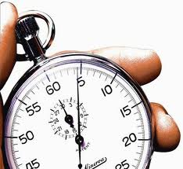
Unit 1: Chemathematics
1.3
Aim: How can two units of measurement be equal to each other?
Think about it…
When do we use dimensional analysis?
Scenario: Suppose someone said you ran for 3600 seconds. How would you respond? Do you know how many minutes or hours 3,600 seconds really is?
What would you do to solve this?
Do Now
Introduction
Mini-Lesson
Summary
Work Period
Exit Slip

Slide 8
Unit 1: Chemathematics
1.3
Aim: How can two units of measurement be equal to each other?
How do we convert from one unit to another?
There are different methods to convert:
Moving decimal
Divide/multiply
Conversion factor
NOTE: We will use the decimal and divide/multiply method for now.
Do Now
Introduction
Mini-Lesson
Summary
Work Period
Exit Slip

Slide 9
Unit 1: Chemathematics
1.3
Aim: How can two units of measurement be equal to each other?
Do Now
Introduction
Mini-Lesson
Summary
Work Period
Exit Slip

Slide 10
Unit 1: Chemathematics
1.3
Aim: How can two units of measurement be equal to each other?
Other base words include:
Liter
Gram
Seconds
(A prefix comes before a base word. The SI prefixes come before the base units.)
Do Now
Introduction
Mini-Lesson
Summary
Work Period
Exit Slip

Slide 11
Unit 1: Chemathematics
1.3
Aim: How can two units of measurement be equal to each other?
To remember the order of major prefixes:
(large) King Barely Drinks Chocolate Milk (small)
King – Kilo = 1000 base
Barely – Base (meter or gram or Liter or second…)
Drinks – Deci = 1/10 base
Chocolate – Centi = 1/100 base
Milk – Milli = 1/1000 base
(*Replace “base” with either gram, meter, Liter, or second)
Do Now
Introduction
Mini-Lesson
Summary
Work Period
Exit Slip

Slide 12
Unit 1: Chemathematics
1.3
Aim: How can two units of measurement be equal to each other?
RULES:
Negative exponent = move decimal to the left
Positive exponent = move decimal to the right
Larger → smaller (multiply)
Smaller → Larger (Divide)
Do Now
Introduction
Mini-Lesson
Summary
Work Period
Exit Slip

Slide 13
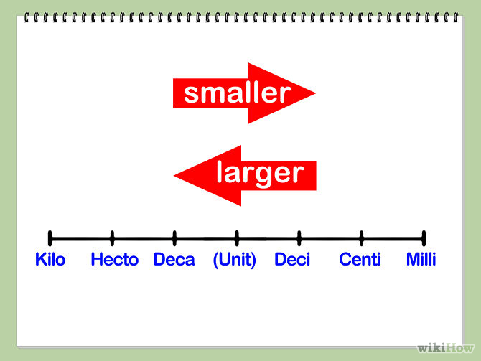
Unit 1: Chemathematics
1.3
Aim: How can two units of measurement be equal to each other?
Do Now
Introduction
Mini-Lesson
Summary
Work Period
Exit Slip

Slide 14
Unit 1: Chemathematics
1.3
Aim: How can two units of measurement be equal to each other?
SAMPLE QUESTION #1
Diana drank 0.67 liters of her soda? How many milliliters did she drink?
Divide/Multiply Way
Decimal Way
Do Now
Introduction
Mini-Lesson
Summary
Work Period
Exit Slip

Slide 15
Unit 1: Chemathematics
1.3
Aim: How can two units of measurement be equal to each other?
SAMPLE QUESTION #2 (Regents)
How many joules are equivalent to 35 kilojoules?
0.035 joules
0.0035 joules
3500 joules
35000 joules
Divide/Multiply Way
Decimal Way
Do Now
Introduction
Mini-Lesson
Summary
Work Period
Exit Slip

Slide 16
Unit 1: Chemathematics
1.3
Aim: How can two units of measurement be equal to each other?
Summary
Summary: Explain two methods we commonly use to convert units.
Do Now
Introduction
Mini Lesson
Summary
Work Period
Exit Slip

Slide 17
Unit 1: Chemathematics
1.3
Aim: How can two units of measurement be equal to each other?
Do Now
Introduction
Mini-Lesson
Summary
Work Period
Exit Slip

Slide 18
Unit 1: Chemathematics
1.3
Aim: How can two units of measurement be equal to each other?
Work period
SHOW WORK FOR RECIPE HERE:
Question #1: .120 kg of flour = __________________________
Divide/Multiply Way
Decimal Way
Do Now
Introduction
Mini-Lesson
Summary
Work Period
Exit Slip

Slide 19
Unit 1: Chemathematics
1.3
Aim: How can two units of measurement be equal to each other?
HOMEWORK:
Complete rest of 1.3 for homework
Do Now
Introduction
Mini-Lesson
Summary
Work Period
Exit Slip

Slide 20
Unit 1: Chemathematics
1.3
Aim: How can two units of measurement be equal to each other?
Exit Slip
Make sure you get your trackers checked!
Do Now
Introduction
Mini-Lesson
Summary
Work Period
Exit Slip

