Slide 1
Unit 1: Chemathematics
1.4
Aim: How can we round and calculate using significant figures?
Objective:
I will round and calculate
using significant figures.
AGENDA
Do Now
Introduction
Mini-Lesson
Summary
Work Period
DO NOW:
(You have 5 minutes)
TAKE DO NOW AND START
Exit Slip

Slide 2
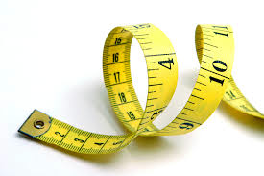
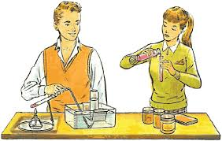
Unit 1: Chemathematics
1.4
Aim: How can we round and calculate using significant figures?
Real-world connection
Measurements
Vocabulary
Significant figures
AGENDA
Do Now
Introduction
Mini-Lesson
Summary
Work Period
Exit Slip

Slide 3
Unit 1: Chemathematics
1.4
Aim: How can we round and calculate using significant figures?
DO NOW
AGENDA
Do Now
Introduction
Mini-Lesson
Summary
Work Period
Exit Slip

Slide 4
Unit 1: Chemathematics
1.4
Aim: How can we round and calculate using significant figures?
anouncements
Quiz #2 on 1.4-1.6 changed to Tues 9/23
Packet #1 due Fri 9/19
AGENDA
Do Now
Introduction
Mini-Lesson
Summary
Work Period
Exit Slip

Slide 5
Unit 1: Chemathematics
1.4
Aim: How can we round and calculate using significant figures?
SEATING CHARTS—PERIOD 2
GROUP 1: GROUP 3:
Jewel Applewhite 1. Keya Gill
Madison Durham 2. Pamela Smith
Robinson Louis 3. Marlwin Hernandez
Mohamed Jalloh 4. Fatouma Kone
Shari Blackman 5. Joel McCulskie
Marie-Michelle Cajou 6. Anbessa Sam
GROUP 2: GROUP 4:
Makonenn Sam 1. Aneisha Richards
Saidou Ly 2. Warrell Biggs
Brandon Hewitt 3. Emilio Lopez
Christa Spencer 4. Javarie Simpson
Wens Kelly Vallon 5. Tasianna Joseph
Tamiann Palmer 6. Kodel Maloney
AGENDA
Do Now
Introduction
Mini-Lesson
Summary
Work Period
Exit Slip

Slide 6
Unit 1: Chemathematics
1.4
Aim: How can we round and calculate using significant figures?
SEATING CHARTS—PERIOD 2
GROUP 5:
Kenly Garcia
Brandon Pierre
Brandley Pierre
Aissatou Diallo
Karen Owosu-Ansah
AGENDA
Do Now
Introduction
Mini-Lesson
Summary
Work Period
Exit Slip

Slide 7
Unit 1: Chemathematics
1.4
Aim: How can we round and calculate using significant figures?
SEATING CHARTS—PERIOD 4
GROUP 1: GROUP 3:
Makeeda Alexander 1. Nathifa Delisser
Mackenson Desty 2. Joseph Greenwood
Dante Mitchell 3. Jada McFarlane
Odane Potts 4. Keino Harris
Bartolo Osario 5. Julia Lawrence
GROUP 2: GROUP 4:
Omari Blount 1. Jania Nelson
Rodney Smokes 2. Sashell Francis
Kimmornie Sylvester 3. Brianna Christopher
Saleh Ahmed 4. Jessy Royer
Dequon Banner 5. Jessica Royer
AGENDA
Do Now
Introduction
Mini-Lesson
Summary
Work Period
Exit Slip

Slide 8
Unit 1: Chemathematics
1.4
Aim: How can we round and calculate using significant figures?
SEATING CHARTS—PERIOD 7
GROUP 1: GROUP 3:
Miquasha Jenner 1. Desron Wilson
Jade Davis 2. Naquarn Charlemagne
Tyriek Craddock 3. Ayanna Thomspn
Emmanuel Blackman 4. Inchez Devalsaint
Amadou Diop 5. Justin Williams
GROUP 2: GROUP 4:
Jameeka Beauvil 1. Tracy Peprah
Ragina Regis 2. Zaire Leon
Vanessa Jean Baptiste 3. Genesis Morrison
Dachmeide Luma 4. Keion Harris
Lamore Weems 5. Keith Alloway
AGENDA
Do Now
Introduction
Mini-Lesson
Summary
Work Period
Exit Slip

Slide 9
Unit 1: Chemathematics
1.4
Aim: How can we round and calculate using significant figures?
SEATING CHARTS—PERIOD 7
GROUP 5:
Johnnie Gaitlin
Naheim Fuller
Angel Carlisle
Shyann Brooks
GROUP 6:
Dasia Carter
Rasheim Harris
Xoe Scott
Richard Payne
AGENDA
Do Now
Introduction
Mini-Lesson
Summary
Work Period
Exit Slip

Slide 10
Unit 1: Chemathematics
1.4
Aim: How can we round and calculate using significant figures?
TURN AND TALK
What is the difference among
these numbers?
1.00
1.0
1
Do Now
Introduction
Mini-Lesson
Summary
Work Period
Exit Slip

Slide 11
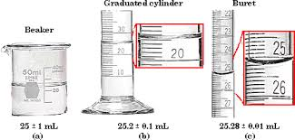
Unit 1: Chemathematics
1.4
Aim: How can we round and calculate using significant figures?
Why we use significant figures?
What is the difference between these pictures?
Do Now
Introduction
Mini-Lesson
Summary
Work Period
Exit Slip

Slide 12
Unit 1: Chemathematics
1.4
Aim: How can we round and calculate using significant figures?
Significant figures
DEFINITION: includes all digits of a number that is known with certainty and one digit known with uncertainty
Do Now
Introduction
Mini-Lesson
Summary
Work Period
Exit Slip

Slide 13
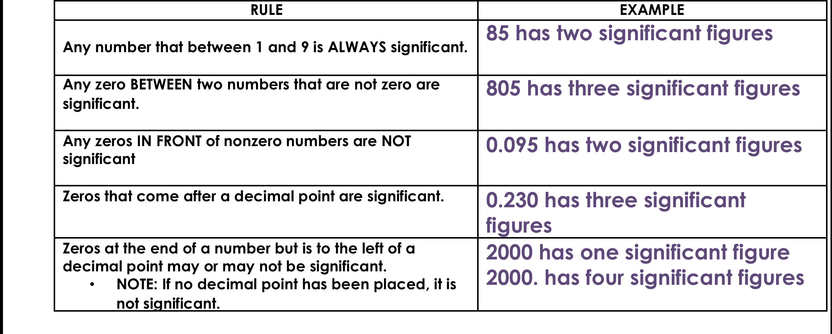
Unit 1: Chemathematics
1.4
Aim: How can we round and calculate using significant figures?
Rules of Significant figures
Do Now
Introduction
Mini-Lesson
Summary
Work Period
Exit Slip

Slide 14
Unit 1: Chemathematics
1.4
Aim: How can we round and calculate using significant figures?
Sample problems
Identify the number of significant digits show in each of the following examples. Also list which numbers are significant.
# of significant figures Numbers that are significant
A) 400 ____________________ _______________________
B) 200.0 ___________________ _______________________
C) 0.0001 ___________________ _______________________
D) 320 ___________________ _______________________
E) 0.00530 ___________________ _______________________
Do Now
Introduction
Mini-Lesson
Summary
Work Period
Exit Slip

Slide 15
Unit 1: Chemathematics
1.4
Aim: How can we round and calculate using significant figures?
Sample regents question
ANNOTATE THE QUESTION:
Do Now
Introduction
Mini-Lesson
Summary
Work Period
Exit Slip

Slide 16
Unit 1: Chemathematics
1.4
Aim: How can we round and calculate using significant figures?
How do we calculate using significant figures?
MULTIPLICATION/DIVISION:
The number of significant figures are determined by the number that has the LEAST number of significant figures
SAMPLE QUESTIONS
93.4/12 =
YOU TRY: 8.032 X 0.591 =
Do Now
Introduction
Mini-Lesson
Summary
Work Period
Exit Slip

Slide 17
Unit 1: Chemathematics
1.4
Aim: How can we round and calculate using significant figures?
How do we calculate using significant figures?
ADDITION/SUBTRACTION:
The number of significant figures is determined by the number that has the LEAST number of the significant figures to the RIGHT of the decimal point.
7.623 + 85.0 + 9.815 =
YOU TRY: 5.5 - 3.325 =
Do Now
Introduction
Mini-Lesson
Summary
Work Period
Exit Slip

Slide 18
Unit 1: Chemathematics
1.4
Aim: How can we round and calculate using significant figures?
Work period
Complete pages 23 and 24
Do Now
Introduction
Mini-Lesson
Summary
Work Period
Exit Slip

Slide 19
Unit 1: Chemathematics
1.4
Aim: How can we round and calculate using significant figures?
HOMEWORK:
Complete rest of 1.4 for homework
Do Now
Introduction
Mini-Lesson
Summary
Work Period
Exit Slip

Slide 20
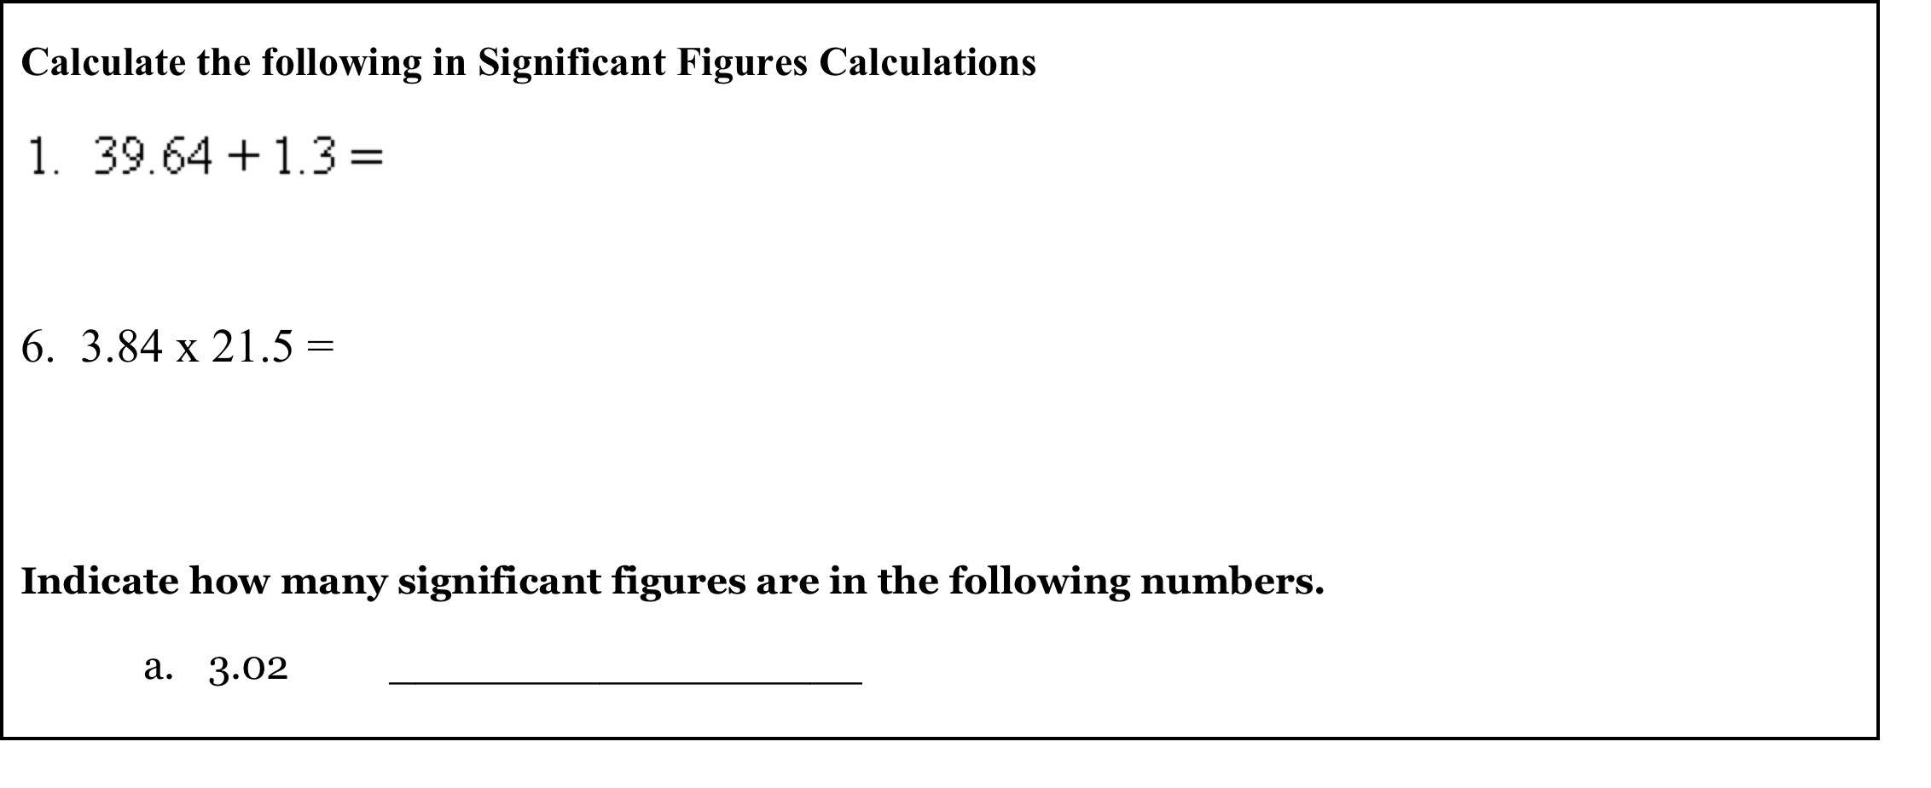
Unit 1: Chemathematics
1.4
Aim: How can we round and calculate using significant figures?
Exit Slip
Make sure you get your trackers checked!
Do Now
Introduction
Mini-Lesson
Summary
Work Period
Exit Slip

