Slide 1
Happy First Day of School!
0.1
Aim: How can we set ourselves up for success during the school year?
Objective:
I will be able to identify the rules and expectations for Ms. Francois’ class to succeed this school year.
AGENDA
Do Now
Introduction
Syllabus
Handouts
Icebreakers
Do Now: (You have 5 minutes)
On Do Now slip: What comes to mind when you think of Chemistry? Write 3 things you associate with Chemistry.
Summary
Start HW!

Slide 2
Happy First Day of School!
0.1
Aim: How can we set ourselves up for success during the school year?
Aim: How is pressure and volume of a gas related to each other?
SONG LYRICS playing…
10% luck
20% skill
15% concentrated power of will
5% pleasure, 50% pain
100% reason to study tonight
(From Fort Minor ft. Eminem, “Remember the Name”)
AGENDA
Do Now
Introduction
Syllabus
Handouts
Icebreakers
Summary
Start HW!

Slide 3
Happy First Day of School!
0.1
Aim: How can we set ourselves up for success during the school year?
Aim: How is pressure and volume of a gas related to each other?
About Me:
Born & raised in Brooklyn
Half-Haitian & Half-Indian
Attended Columbia University for undergrad (Go Lions!) → Studied Pre-Med & History
Attended Hunter College for my first Masters
Attending Bank Street College for my second Masters right now
Random Facts:
Love Caribbean, Dominican, Soul & Italian food
Love Reggae/Soca/Calypso music
Love to travel (goal: to see all 50 states and 1 country a year)
Didn’t always love science
AGENDA
Do Now
Introduction
Syllabus
Handouts
Icebreakers
Summary

Slide 4
Happy First Day of School!
0.1
Aim: How can we set ourselves up for success during the school year?
Aim: How is pressure and volume of a gas related to each other?
Also I’m Dorky…
Mad Minute Monday: have 2 minute drills (either verbal or written)
Turn Up Tuesday: The first person who gets to class will get to choose the song played during the do now
Wacky Wednesday: For extra credit, bring in a joke related to Chemistry (you must be able to explain it)
Therapy Thursday: Express how you are feeling either in your free-write or in our check-in
Frantic Friday: Quiz
AGENDA
Do Now
Introduction
Syllabus
Handouts
Icebreakers
Summary

Slide 5
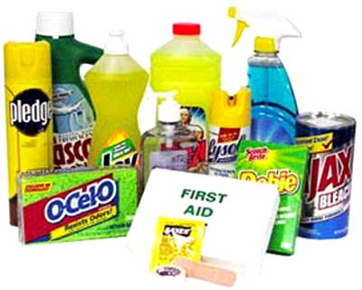
Happy First Day of School!
0.1
Aim: How can we set ourselves up for success during the school year?
Aim: How is pressure and volume of a gas related to each other?
“Chemistry is not only matter;
it is matter”
Do Now
Introduction
Mini-Lesson
Summary
Work Period
Exit Slip

Slide 6
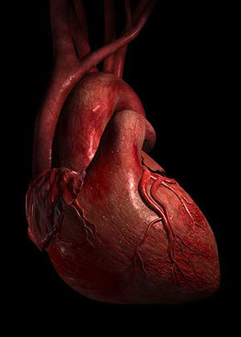
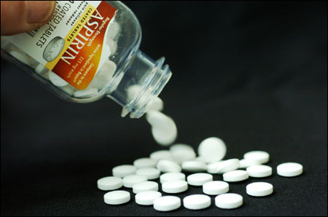
Happy First Day of School!
0.1
Aim: How can we set ourselves up for success during the school year?
Aim: How is pressure and volume of a gas related to each other?
Chem is important for…
Everyday living
Careers
Politics
Research
Do Now
Introduction
Mini-Lesson
Summary
Work Period
Exit Slip

Slide 7
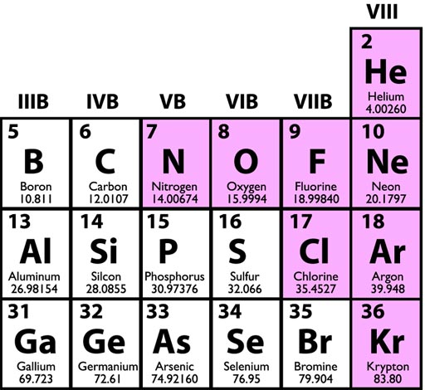
Happy First Day of School!
0.1
Aim: How can we set ourselves up for success during the school year?
Aim: How is pressure and volume of a gas related to each other?
Chem is…
A physical science
A language with its own
vocab & symbols
A way of thinking
Do Now
Introduction
Mini-Lesson
Summary
Work Period
Exit Slip

Slide 8
Happy First Day of School!
0.1
Aim: How can we set ourselves up for success during the school year?
Aim: How is pressure and volume of a gas related to each other?
We will cover…
Chemathematics
Matter: It All Matters!
A World of Particles: An Atom & Its Components
Nuclear Quest
Cracking the “Chemists’ Bible” Code: Periodic Table
Chemical Bonding: The “Glue” Between Atoms
Mole-sanity: The Rule of Numbers & Solutions
Atomic Action: Chemical Reactions & Kinetics/Equilibrium
Carbons, Carbons Everywhere: Study of Organic Chemistry
Keeping it Neutral—Acids & Bases
Its Electric—Oxidation & Reduction
Do Now
Introduction
Mini-Lesson
Summary
Work Period
Exit Slip

Slide 9
Happy First Day of School!
0.1
Aim: How can we set ourselves up for success during the school year?
Aim: How is pressure and volume of a gas related to each other?
BIG CLASS GOAL
Master 80% or higher on 100% of objectives
Do Now
Introduction
Mini-Lesson
Summary
Work Period
Exit Slip

Slide 10
Happy First Day of School!
0.1
Aim: How can we set ourselves up for success during the school year?
Aim: How is pressure and volume of a gas related to each other?
expectations
Respect yourself
Respect each other
Respect the classroom
Respect your teacher
Respect your work
Complete all assignments on your own
Do Now
Introduction
Mini-Lesson
Summary
Work Period
Exit Slip

Slide 11
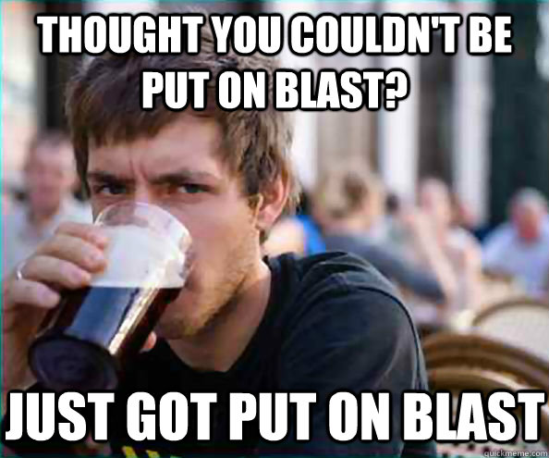
Happy First Day of School!
0.1
Aim: How can we set ourselves up for success during the school year?
Aim: How is pressure and volume of a gas related to each other?
In other words…
Do Now
Introduction
Mini-Lesson
Summary
Work Period
Exit Slip

Slide 12
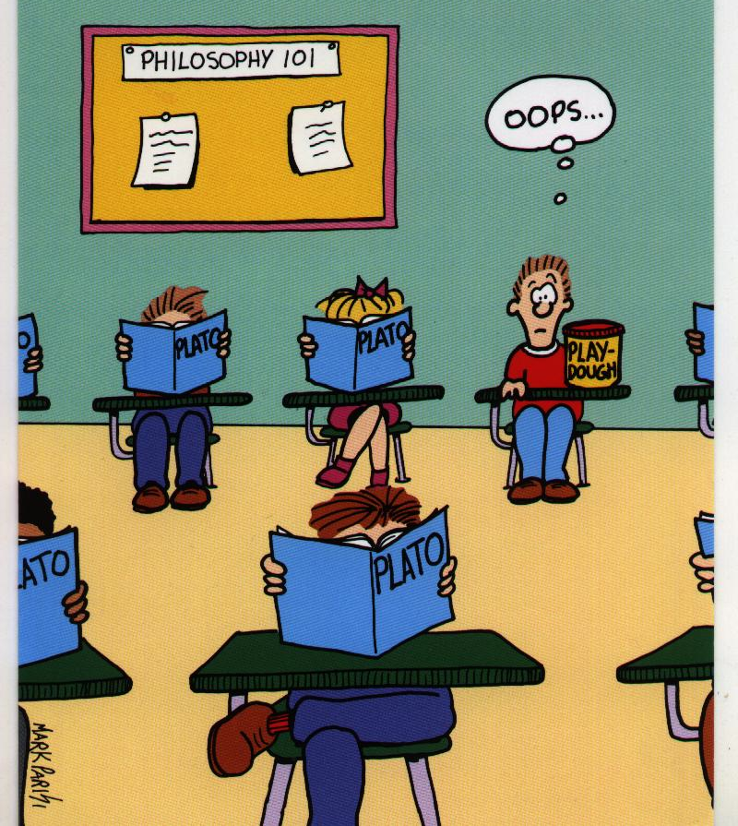
Happy First Day of School!
0.1
Aim: How can we set ourselves up for success during the school year?
Aim: How is pressure and volume of a gas related to each other?
Expectations
Come prepared to learn
Do Now
Introduction
Mini-Lesson
Summary
Work Period
Exit Slip

Slide 13
Happy First Day of School!
0.1
Aim: How can we set ourselves up for success during the school year?
Aim: How is pressure and volume of a gas related to each other?
Expectations
This includes having a pen & your packet.
If you are missing or lost something…it is a PERSONAL PROBLEM (a P-P) so solve it! (That means do not ask me!)
Do Now
Introduction
Mini-Lesson
Summary
Work Period
Exit Slip

Slide 14
Happy First Day of School!
0.1
Aim: How can we set ourselves up for success during the school year?
Aim: How is pressure and volume of a gas related to each other?
Expectations
…and dress appropriately
I do not need or want to see your underwear.
Do Now
Introduction
Mini-Lesson
Summary
Work Period
Exit Slip

Slide 15
Happy First Day of School!
0.1
Aim: How can we set ourselves up for success during the school year?
Aim: How is pressure and volume of a gas related to each other?
Expectations
It also means be here every day.
Which of these are really working?
Do Now
Introduction
Mini-Lesson
Summary
Work Period
Exit Slip

Slide 16
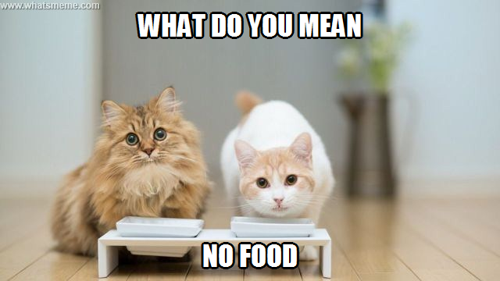
Happy First Day of School!
0.1
Aim: How can we set ourselves up for success during the school year?
Aim: How is pressure and volume of a gas related to each other?
In room 308…
One of our class rules is to respect the classroom.
This means…
NO Food
No Writing on desks
No papers, etc on the floor
No Cell phones, CD players, & iPods
(Please turn off and put away)
No Profanity, insults, and other disrespectful or rude remarks.
No cheating/stealing of people’s work
Do Now
Introduction
Mini-Lesson
Summary
Work Period
Exit Slip

Slide 17
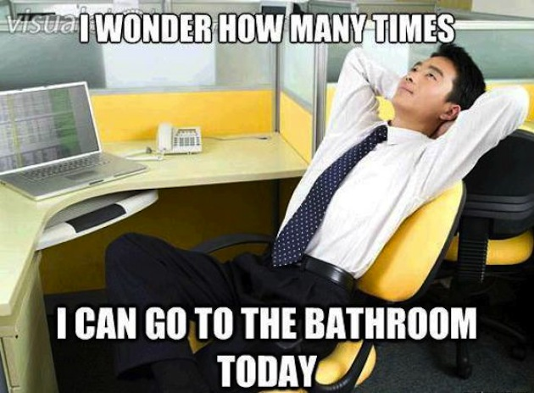
Happy First Day of School!
0.1
Aim: How can we set ourselves up for success during the school year?
Aim: How is pressure and volume of a gas related to each other?
Bathroom policy
You cannot use the bathroom during my mini-lesson.
You will only be allowed to use it after you completed half of your classwork.
I can tell you yes or no about the bathroom whenever I want.
Do Now
Introduction
Mini-Lesson
Summary
Work Period
Exit Slip

Slide 18
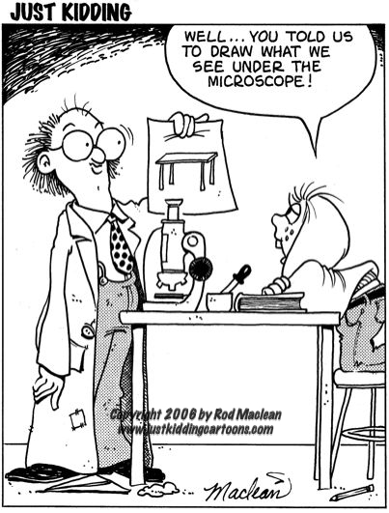
Happy First Day of School!
0.1
Aim: How can we set ourselves up for success during the school year?
Aim: How is pressure and volume of a gas related to each other?
Follow DIRECTIONS…
But don’t try to be “smart” about it
Do Now
Introduction
Mini-Lesson
Summary
Work Period
Exit Slip

Slide 19
Happy First Day of School!
0.1
Aim: How can we set ourselves up for success during the school year?
Aim: How is pressure and volume of a gas related to each other?
consequences
If there is a problem of these expectations being met, there will be a series of consequences:
Verbal Warning
No check for expectation being broken (or serious behavior issues = no checks at all)
Call home
Timed owed in tutoring
Do Now
Introduction
Mini-Lesson
Summary
Work Period
Exit Slip

Slide 20
Happy First Day of School!
0.1
Aim: How can we set ourselves up for success during the school year?
Aim: How is pressure and volume of a gas related to each other?
To be prepared
The following is a list of supplies you must have to fully participate in this class
(DUE MONDAY 9/8/14)
Pen or pencil
Folder
Calculator
1 three-ring binder (3.0” wide min.) → Get it yourself, make an exchange or pay $3
5 subject dividers. Please label them: Classwork, Quizzes, Exams/Interims, Review, and Other Handouts → Buy it or get it from me (Part of your $3 will include the tabs)
Your weekly packet (I will give you)
Reference table ( I will give you)
Do Now
Introduction
Mini-Lesson
Summary
Work Period
Exit Slip

Slide 21
Happy First Day of School!
0.1
Aim: How can we set ourselves up for success during the school year?
Aim: How is pressure and volume of a gas related to each other?
Grading
Do Nows & Exit Slips 10%
Weekly Quizzes 15%
Exams 30%
Classwork + Homework 25%
Projects + Lab Reports 15%
Preparedness 5%
LATENESS: Points will be deducted. Will not accept work past ONE week due unless I have a note from home. Otherwise you get a 0 after 1 week late.
Do Now
Introduction
Mini-Lesson
Summary
Work Period
Exit Slip

Slide 22
Happy First Day of School!
0.1
Aim: How can we set ourselves up for success during the school year?
Aim: How is pressure and volume of a gas related to each other?
When you
submit things…
Please write your name & period on every paper.
MY PHILOSOPHY:
“if you can’t be bothered to write your name, I can’t be bothered to grade it”
I will throw it out.
Do Now
Introduction
Mini-Lesson
Summary
Work Period
Exit Slip

Slide 23
Happy First Day of School!
0.1
Aim: How can we set ourselves up for success during the school year?
Aim: How is pressure and volume of a gas related to each other?
HOMEWORK
Turn in all homework on time so it does not pile up.
MY PHILOSOPHY:
“I get zero, you get zero.”
Do Now
Introduction
Mini-Lesson
Summary
Work Period
Exit Slip

Slide 24
Happy First Day of School!
0.1
Aim: How can we set ourselves up for success during the school year?
Aim: How is pressure and volume of a gas related to each other?
attendance
Consequences for being absent:
You do not get credit for Do Now or Exit Slip (No makeups!)
You will miss a row of checks on your tracker, meaning your grade will reduce on your packet (unless you have a signed note)
You miss valuable information
If you have to miss class, on the day of your return:
Check class handout folder in front of room for any extra copies
Check the class website for PowerPoints to get some missing notes
Find out about missed notes and announcements from a classmate.
Do Now
Introduction
Mini-Lesson
Summary
Work Period
Exit Slip

Slide 25
Happy First Day of School!
0.1
Aim: How can we set ourselves up for success during the school year?
Aim: How is pressure and volume of a gas related to each other?
Get help/reach me
Come to my Tutoring Sessions to be announced
Arrange an appointment with me.
E-mail me at pfrancois@hs-gc.org
Check out here for other resources:
msfrancoischem.weebly.com
Do Now
Introduction
Mini-Lesson
Summary
Work Period
Exit Slip

Slide 26
Happy First Day of School!
0.1
Aim: How can we set ourselves up for success during the school year?
Aim: How is pressure and volume of a gas related to each other?
When you enter
What do I do when I enter class?
As song is playing, pick up Do Now
Place HW in blue bin at front table.
Be seated quickly and silently.
Complete the Do Now in 5 minutes (timer will go off).
Take out packet & copy down that day’s Objective and other info.
Be ready to learn and have fun!
Do Now
Introduction
Mini-Lesson
Summary
Work Period
Exit Slip

Slide 27
Happy First Day of School!
0.1
Aim: How can we set ourselves up for success during the school year?
Aim: How is pressure and volume of a gas related to each other?
Do not be late
People who are always late are usually slow, the last one’s to know and the first one’s to go.
If you are late though…
Bring a note explaining why you were late with date, time, reason, and signature from an adult
Sit down quietly
Take out your work immediately
Results:
You miss content information.
You interrupt the class process.
You get on my nerves (when it happens a lot).
You lose points for every lateness.
Do Now
Introduction
Mini-Lesson
Summary
Work Period
Exit Slip

Slide 28
Happy First Day of School!
0.1
Aim: How can we set ourselves up for success during the school year?
Aim: How is pressure and volume of a gas related to each other?
When you exit
What do I do at the end of class?
Wrap up work when instructed.
Straighten up chair & make sure desk and floor are clean.
Complete exit slip that is handed out 5 minutes before period ends.
Get Daily Tracker of expectations checked in your packet.
Do Now
Introduction
Mini-Lesson
Summary
Work Period
Exit Slip

Slide 29
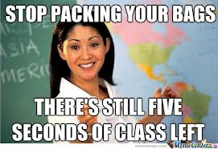
Happy First Day of School!
0.1
Aim: How can we set ourselves up for success during the school year?
Aim: How is pressure and volume of a gas related to each other?
When you exit
Stay in your seats until you are dismissed
Do Now
Introduction
Mini-Lesson
Summary
Work Period
Exit Slip

Slide 30
Happy First Day of School!
0.1
Aim: How can we set ourselves up for success during the school year?
Aim: How is pressure and volume of a gas related to each other?
handouts
You should have received:
Syllabus brochure
Lab Safety Contract
Parent Letter
Course Contract
FB Survey
Parent Questionaire
Instructions for text message list serv
Do Now
Introduction
Mini-Lesson
Summary
Work Period
Exit Slip

Slide 31
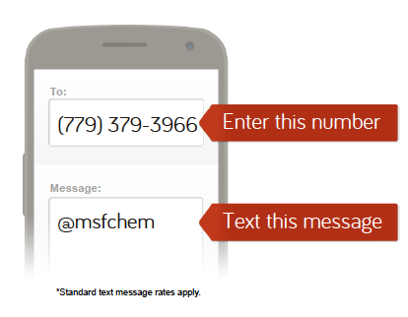
Happy First Day of School!
0.1
Aim: How can we set ourselves up for success during the school year?
Aim: How is pressure and volume of a gas related to each other?
Text message reminder service
NOTE: If YOU and a PARENT/GUARDIAN signs up, you will get 1 point extra (ex. If 9/10, get 10/10) on the first quiz
Send a text message to:
(779) 379-3966
With the message:
@msfchem
Do Now
Introduction
Mini-Lesson
Summary
Work Period
Exit Slip

Slide 32
Happy First Day of School!
0.1
Aim: How can we set ourselves up for success during the school year?
Aim: How is pressure and volume of a gas related to each other?
deadlines
Things due back to me:
Things to Do | Deadline Date
1. Fill out & return FB survey | Mon 9/8/14
2. Bring back parent questionaire filled out by parent | Mon 9/8/14
3. Course Contract | Mon 9/8/14
4. YOU & Parent sign-up for text message service | Mon 9/8/14
5. School supplies | Mon 9/8/14
6. Read through handouts + look at class website | Mon 9/8/14
Do Now
Introduction
Mini-Lesson
Summary
Work Period
Exit Slip

Slide 33
Happy First Day of School!
0.1
Aim: How can we set ourselves up for success during the school year?
Aim: How is pressure and volume of a gas related to each other?
Summary
What are some class expectations?
What do you NOT do in Room 308?
How do you enter the classroom?
How do you leave the classroom?
What do you need to turn in on Thursday? Friday?
Do Now
Introduction
Mini Lesson
Summary
Work Period
Exit Slip

Slide 34
Happy First Day of School!
0.1
Aim: How can we set ourselves up for success during the school year?
Aim: How is pressure and volume of a gas related to each other?
Summary
Do Now
Introduction
Mini Lesson
Summary
Work Period
Exit Slip

Slide 35
Happy First Day of School!
0.1
Aim: How can we set ourselves up for success during the school year?
Aim: How is pressure and volume of a gas related to each other?
Getting To Know You
Personal Bingo Rules:
Talk to each other to find someone who can sign for each category below.
You MUST fill each box with a different name/signature.
When you complete a row or in any direction, bring it up to teacher to cross out for “BINGO”.
The first person to get one horizontal (across), one vertical (up and down) AND one diagonal wins the game!
Do Now
Introduction
Mini-Lesson
Summary
Work Period
Exit Slip

Slide 36
Happy First Day of School!
0.1
Aim: How can we set ourselves up for success during the school year?
Aim: How is pressure and volume of a gas related to each other?
GET A HEAD START!
Start to fill out survey
Do Now
Introduction
Mini-Lesson
Summary
Work Period
Exit Slip

Slide 37
Happy First Day of School!
0.1
Aim: How can we set ourselves up for success during the school year?
Aim: How is pressure and volume of a gas related to each other?
Exit Slip
Do Now
Introduction
Mini-Lesson
Summary
Work Period
Exit Slip

