Slide 1


Unit 2: Matter & Energy—It All Matters
2.1
Aim: How is matter classified?
How pure is pure?
Objective:
I will be able to classify matter into elements and compounds
AGENDA
Do Now
Introduction
Mini-Lesson
Summary
Work Period
Do now:
(You have 5 minutes)
Exit Slip

Slide 2


Unit 2: Matter & Energy—It All Matters
2.1
Aim: How is matter classified?
How pure is pure?
Real-world connection
Oxygen vs. water
Vocabulary
elements, compounds, atoms, matter, mass, chemical symbols, chemical formulas
AGENDA
Do Now
Introduction
Mini-Lesson
Summary
Work Period
Exit Slip

Slide 3
Unit 2: Matter & Energy—It All Matters
2.1
Aim: How is matter classified?
How pure is pure?
Announcements
SI Unit Project due Tues 10/14/14
Chemistry in the News due Wed 10/15/14
Lab Report due Fri 10/17/14
AGENDA
Do Now
Introduction
Mini-Lesson
Summary
Work Period
Exit Slip

Slide 4
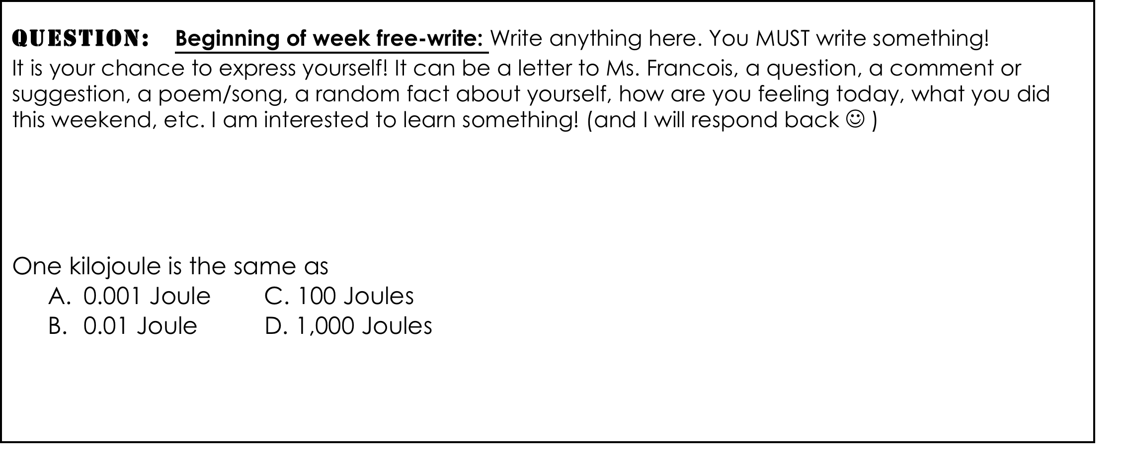
Unit 2: Matter & Energy—It All Matters
2.1
Aim: How is matter classified?
How pure is pure?
Do now
AGENDA
Do Now
Introduction
Mini-Lesson
Summary
Work Period
Exit Slip

Slide 5
Unit 2: Matter & Energy—It All Matters
2.1
Aim: How is matter classified?
How pure is pure?
Think ink…
On the PowerPoint there are a variety of items. Please categorize them appropriately. Write down these categories. Then, explain how you developed your system:
Categories:
Explanation:
Do Now
Introduction
Mini-Lesson
Summary
Work Period
Exit Slip

Slide 6
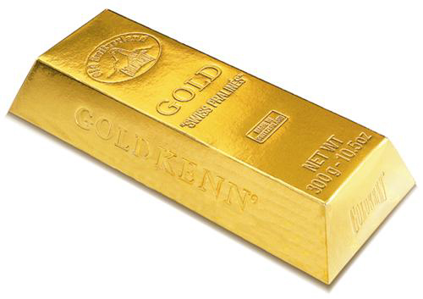
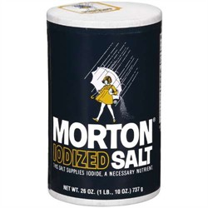


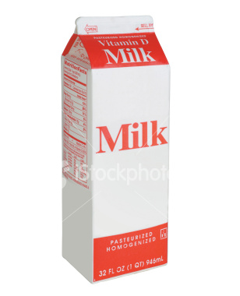

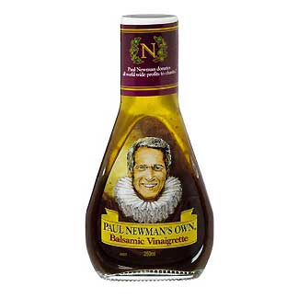

Unit 2: Matter & Energy—It All Matters
2.1
Aim: How is matter classified?
How pure is pure?
Categorize…
Do Now
Introduction
Mini-Lesson
Summary
Work Period
Exit Slip

Slide 7
Unit 2: Matter & Energy—It All Matters
2.1
Aim: How is matter classified?
How pure is pure?
Pair share…
After discussing your classification scheme with your partner, describe any changes you have made and why. Write out your new classification scheme.
Changes/explanation:
New System:
Do Now
Introduction
Mini-Lesson
Summary
Work Period
Exit Slip

Slide 8
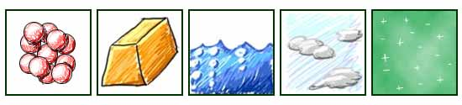
Unit 2: Matter & Energy—It All Matters
2.1
Aim: How is matter classified?
How pure is pure?
matter…
  How are these matter?
Do Now
Introduction
Mini-Lesson
Summary
Work Period
Exit Slip

Slide 9
Unit 2: Matter & Energy—It All Matters
2.1
Aim: How is matter classified?
How pure is pure?
matter…
  Fill this out!!!!
Do Now
Introduction
Mini-Lesson
Summary
Work Period
Exit Slip

Slide 10
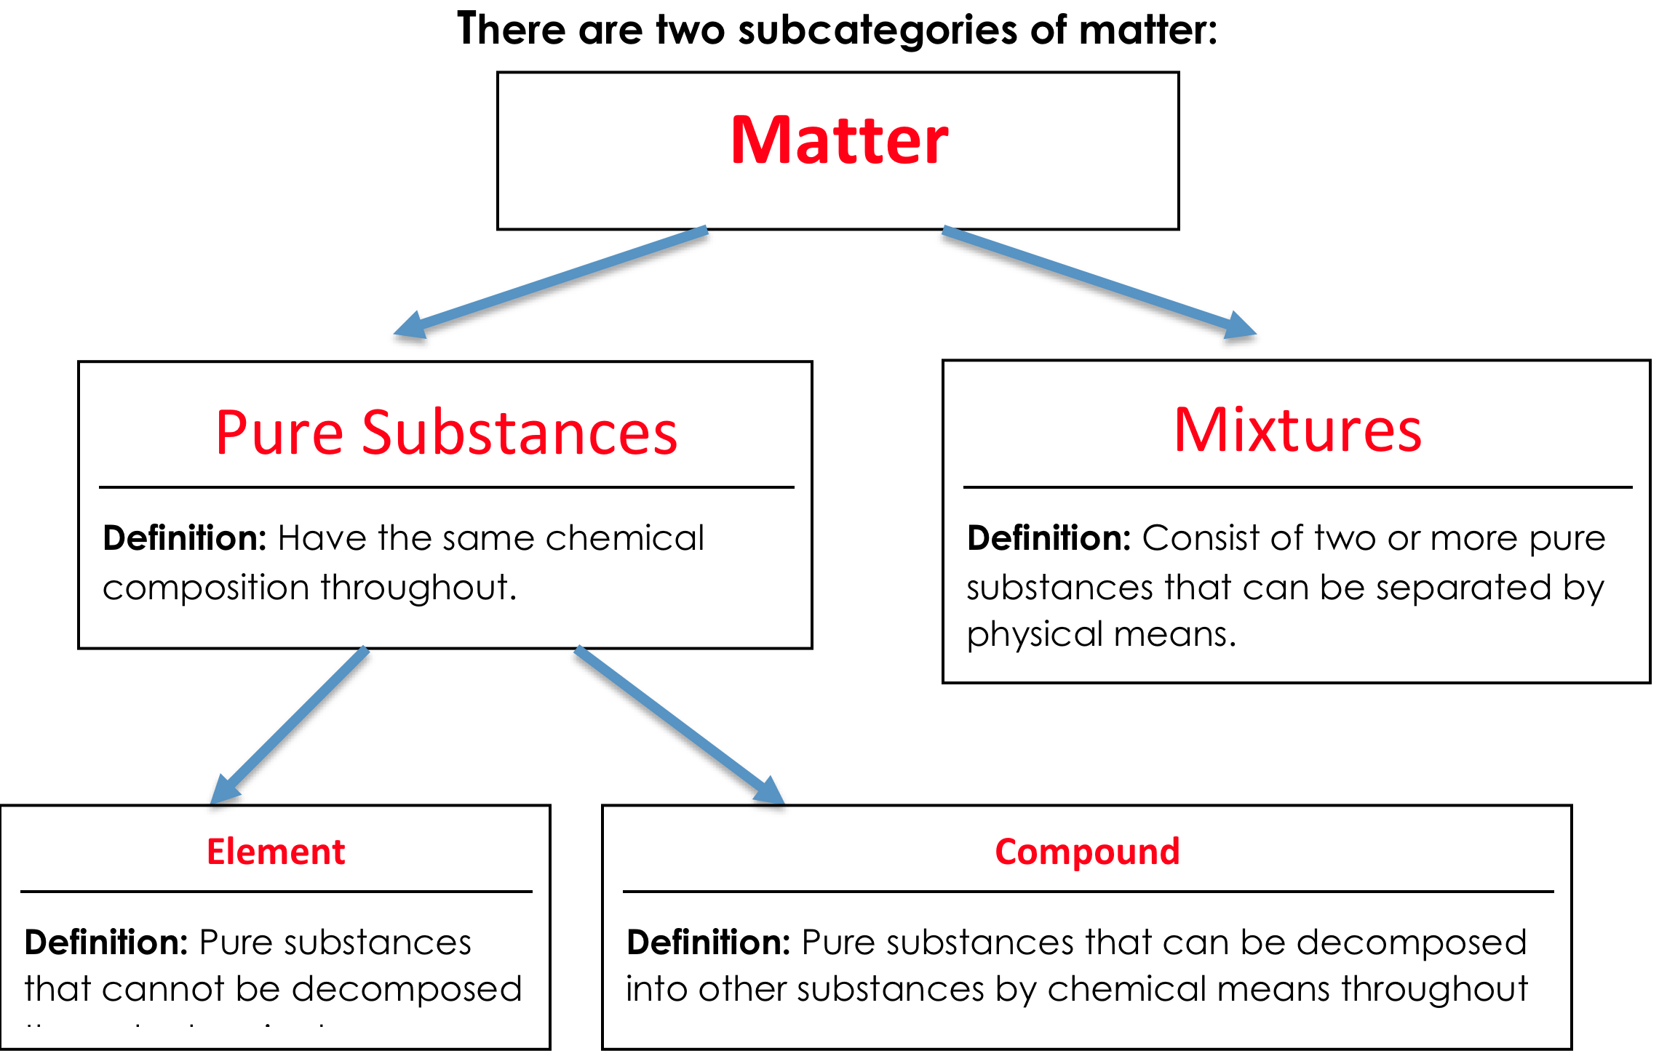
Unit 2: Matter & Energy—It All Matters
2.1
Aim: How is matter classified?
How pure is pure?
Do Now
Introduction
Mini-Lesson
Summary
Work Period
Exit Slip

Slide 11
Unit 2: Matter & Energy—It All Matters
2.1
Aim: How is matter classified?
How pure is pure?
Video
https://www.youtube.com/watch?v=D6Zz0daxZ9Y
Do Now
Introduction
Mini-Lesson
Summary
Work Period
Exit Slip

Slide 12
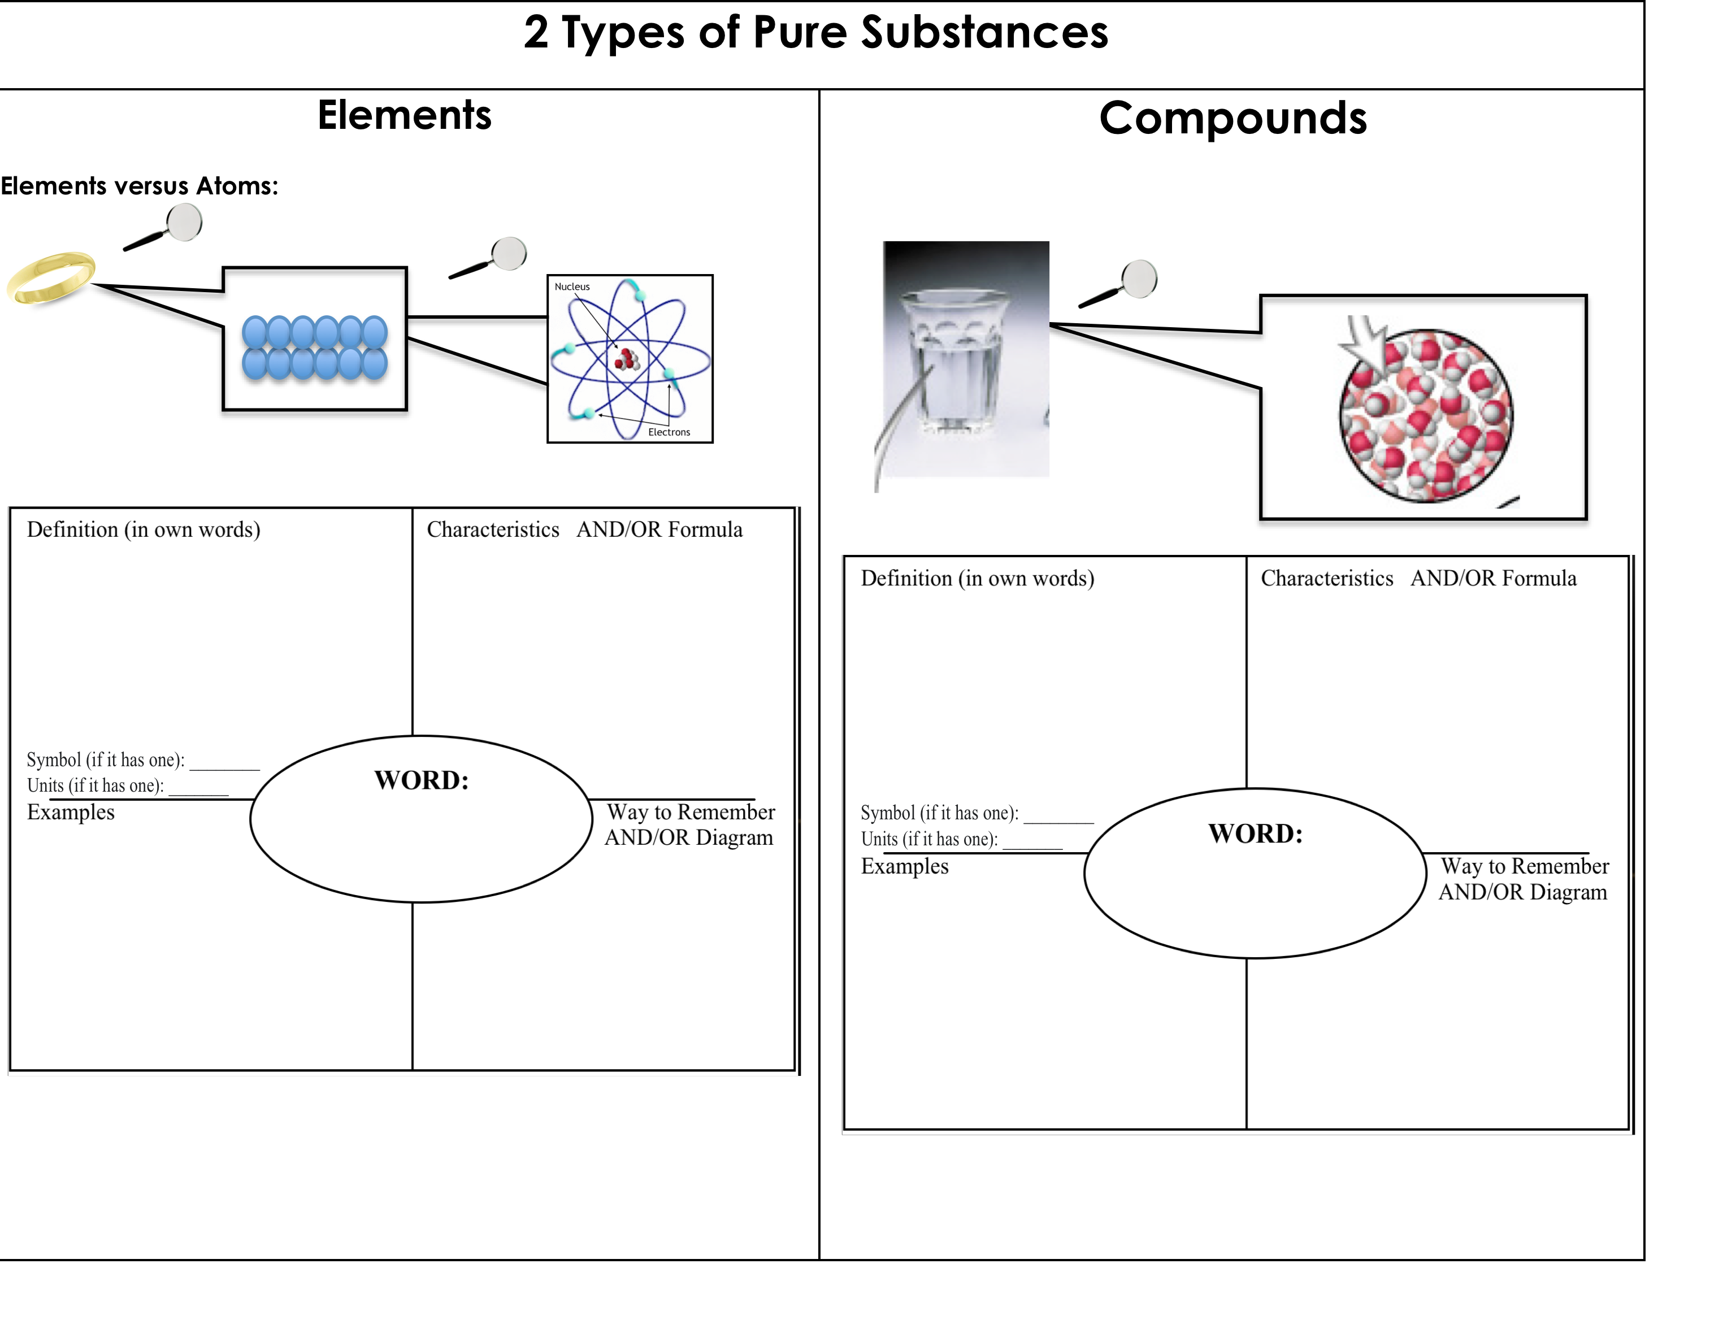
Unit 2: Matter & Energy—It All Matters
2.1
Aim: How is matter classified?
How pure is pure?
Do Now
Introduction
Mini-Lesson
Summary
Work Period
Exit Slip

Slide 13
Unit 2: Matter & Energy—It All Matters
2.1
Aim: How is matter classified?
How pure is pure?
4 corners
You have 45 seconds to walk to the answer you believe is correct.
You will have 45 seconds to discuss with your group on why you guys chose that answer.
Someone in the group will be asked to share out.
Do Now
Introduction
Mini-Lesson
Summary
Work Period
Exit Slip

Slide 14
Unit 2: Matter & Energy—It All Matters
2.1
Aim: How is matter classified?
How pure is pure?
Annotating questions
Box any Chemistry terms—write a quick definition
Circle any numbers with units. Above write down what the number represents
Put a ?? Above something you are confused
Underline what the question is
Do Now
Introduction
Mini-Lesson
Summary
Work Period
Exit Slip

Slide 15
Unit 2: Matter & Energy—It All Matters
2.1
Aim: How is matter classified?
How pure is pure?
Sample questions
Matter that is composed of two or more different elements chemically combined in a fixed proportion is classified as:
a compound
a mixture
an isotope
a solution
Do Now
Introduction
Mini-Lesson
Summary
Work Period
Exit Slip

Slide 16
Unit 2: Matter & Energy—It All Matters
2.1
Aim: How is matter classified?
How pure is pure?
Sample questions
Which of the following is NOT a property of an element?
It is found on the periodic table
It is a pure substance
It can be broken apart chemically
It cannot be broken apart physically
Do Now
Introduction
Mini-Lesson
Summary
Work Period
Exit Slip

Slide 17
Unit 2: Matter & Energy—It All Matters
2.1
Aim: How is matter classified?
How pure is pure?
Finish questions on page 4
Which of the following is NOT an example of matter?
gold
paper
light
desk
Do Now
Introduction
Mini-Lesson
Summary
Work Period
Exit Slip

Slide 18
Unit 2: Matter & Energy—It All Matters
2.1
Aim: How is matter classified?
How pure is pure?
Finish questions on page 4
4. Why is oxygen an element but water is a compound?
5. What are elements made of?
6. What are compounds made of?
LET’S SHARE OUT!
Do Now
Introduction
Mini-Lesson
Summary
Work Period
Exit Slip

Slide 19
Unit 2: Matter & Energy—It All Matters
2.1
Aim: How is matter classified?
How pure is pure?
Chemists’ Representation
Identifying Elements and Compounds
Based on Chemical Symbols/Formulas
Chemists use:
Chemical symbols: to represent element
Chemical formulas: to represent compounds
Do Now
Introduction
Mini-Lesson
Summary
Work Period
Exit Slip

Slide 20
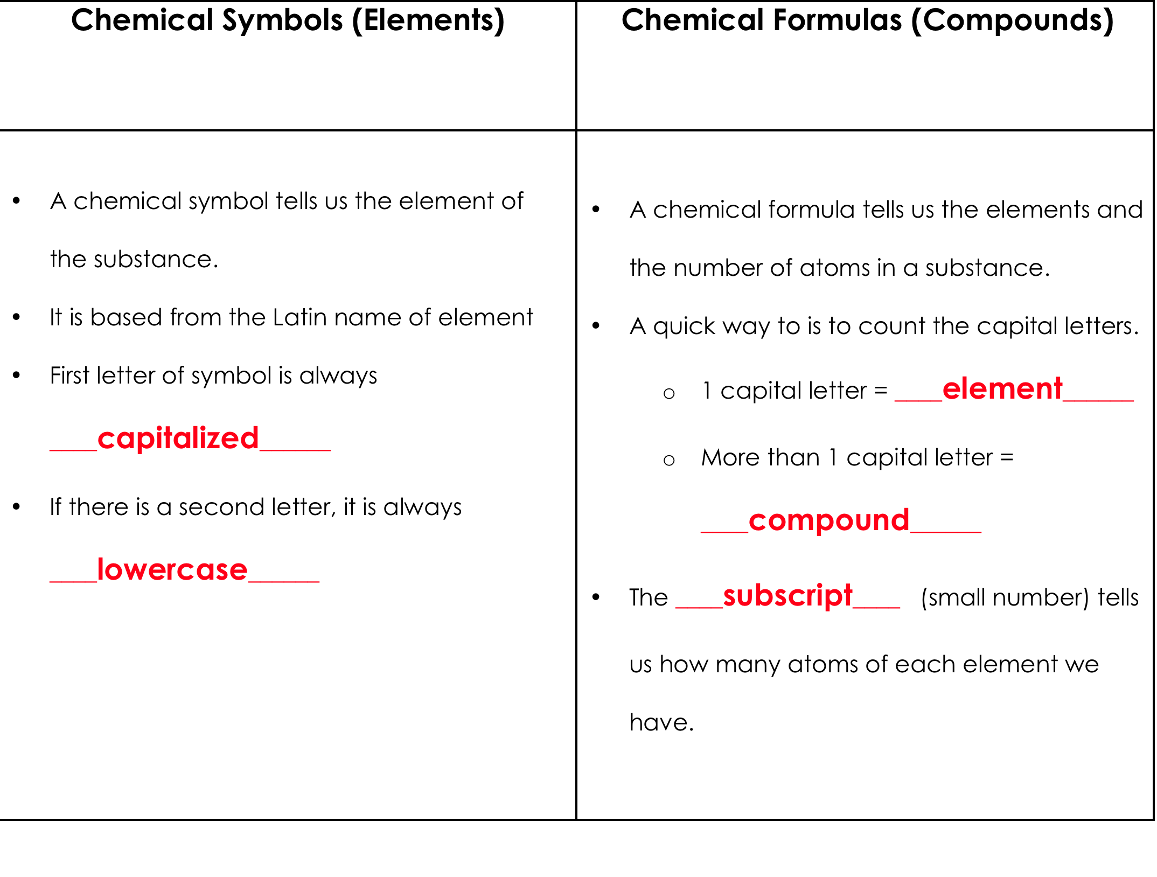
Unit 2: Matter & Energy—It All Matters
2.1
Aim: How is matter classified?
How pure is pure?
Do Now
Introduction
Mini-Lesson
Summary
Work Period
Exit Slip

Slide 21
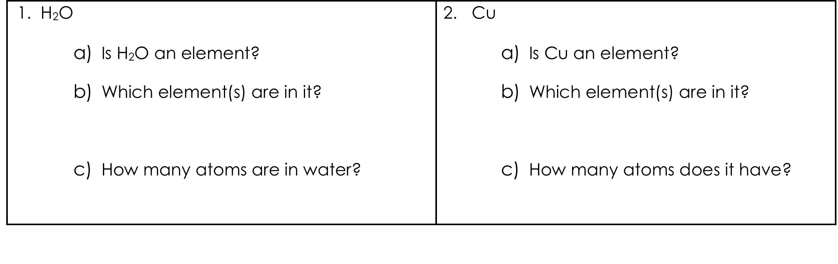
Unit 2: Matter & Energy—It All Matters
2.1
Aim: How is matter classified?
How pure is pure?
example
Do Now
Introduction
Mini-Lesson
Summary
Work Period
Exit Slip

Slide 22
Unit 2: Matter & Energy—It All Matters
2.1
Aim: How is matter classified?
How pure is pure?
Examples
1. Place a check in the circle, if the substance is a compound. If it is, state what elements are contained in the compound. Go to the front of room if you think it is an element. Go to the back of the room if you think it is a compound.
CO₂ : _____________________________________________________________________
Ni : _______________________________________________________________________
BaCl₂ : ____________________________________________________________________
NO₃ : _____________________________________________________________________
AlF₃ : _____________________________________________________________________
Cs : ______________________________________________________________________
Do Now
Introduction
Mini-Lesson
Summary
Work Period
Exit Slip

Slide 23
Unit 2: Matter & Energy—It All Matters
2.1
Aim: How is matter classified?
How pure is pure?
Summary: Lines of Learning (LOL)
In a coherent, well-written paragraph. compare and contrast an element and a compound and give an example of each (pg . 7)
Do Now
Introduction
Mini Lesson
Summary
Work Period
Exit Slip

Slide 24
Unit 2: Matter & Energy—It All Matters
2.1
Aim: How is matter classified?
How pure is pure?
Work period
Complete pages 6-7
Do Now
Introduction
Mini-Lesson
Summary
Work Period
Exit Slip

Slide 25
Unit 2: Matter & Energy—It All Matters
2.1
Aim: How is matter classified?
How pure is pure?
HOMEWORK:
Complete rest of 2.1
in the packet for homework
Do Now
Introduction
Mini-Lesson
Summary
Work Period
Exit Slip

Slide 26
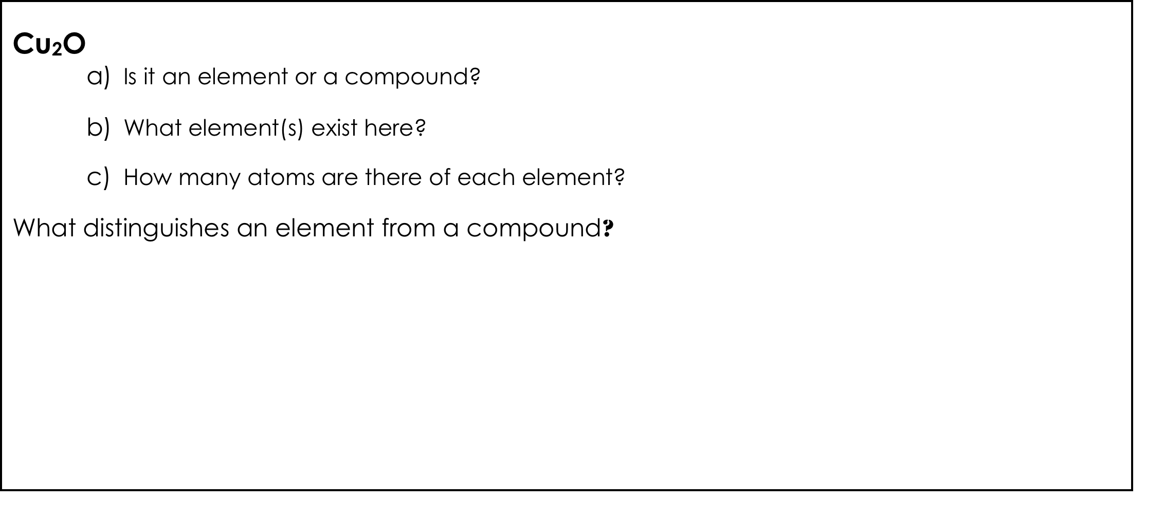
Unit 2: Matter & Energy—It All Matters
2.1
Aim: How is matter classified?
How pure is pure?
Exit Slip
Make sure you get your trackers checked!
Do Now
Introduction
Mini-Lesson
Summary
Work Period
Exit Slip

