Slide 1
Unit 2: Matter & Energy—It All Matters
2.10
Aim: How can we analyze temperature changes, phase changes, and energy changes using a heating curve?
Objective:
I will analyze the temperature changes, phase changes, and energy changes using a heating curve.
AGENDA
Do Now
Introduction
Mini-Lesson
Summary
Work Period
QUIZ:
(You have 10 minutes to complete the quiz)
Exit Slip

Slide 2
Unit 2: Matter & Energy—It All Matters
2.10
Aim: How can we analyze temperature changes, phase changes, and energy changes using a heating curve?
Real-world connection
Cooking—from freezing to boiling
Vocabulary
Heating curve, kinetic energy, potential energy
AGENDA
Do Now
Introduction
Mini-Lesson
Summary
Work Period
Exit Slip

Slide 3
Unit 2: Matter & Energy—It All Matters
2.10
Aim: How can we analyze temperature changes, phase changes, and energy changes using a heating curve?
Announcements
Papers put in binder—passed back
Tuesday 11/18: Guest speakers coming in
Wed 11/19: Interim Assessment
Thurs 11/20: Larry will be teaching the class
AGENDA
Do Now
Introduction
Mini-Lesson
Summary
Work Period
Exit Slip

Slide 4
Unit 2: Matter & Energy—It All Matters
2.10
Aim: How can we analyze temperature changes, phase changes, and energy changes using a heating curve?
Do now
AGENDA
Do Now
Introduction
Mini-Lesson
Summary
Work Period
Exit Slip

Slide 5
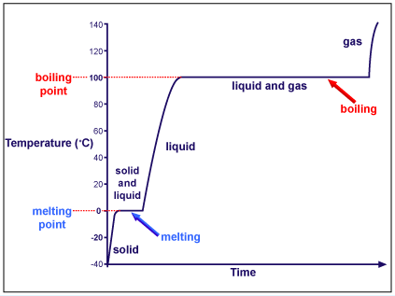
Unit 2: Matter & Energy—It All Matters
2.10
Aim: How can we analyze temperature changes, phase changes, and energy changes using a heating curve?
Thinking about…heating curve
Examine the heating curve to the right. Describe what happens to the temperature as the water on the right goes from -40°C to 140°C. Why do you think this is the case?
Do Now
Introduction
Mini-Lesson
Summary
Work Period
Exit Slip

Slide 6
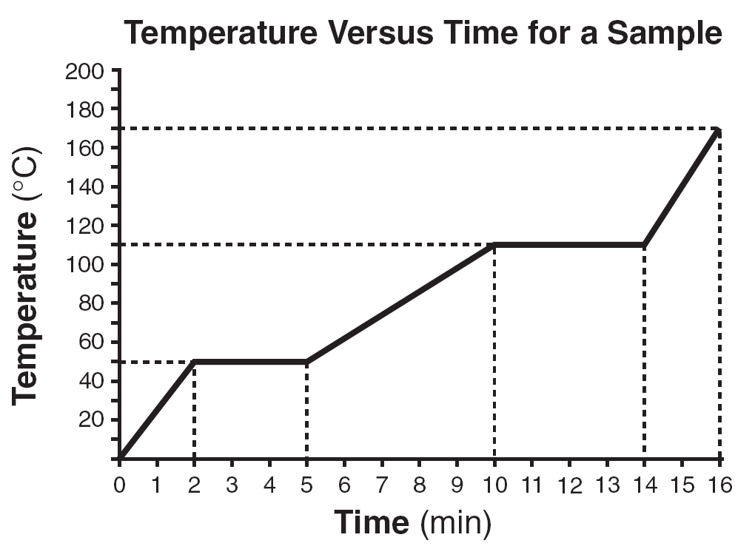
Unit 2: Matter & Energy—It All Matters
2.10
Aim: How can we analyze temperature changes, phase changes, and energy changes using a heating curve?
Heating curve
a diagram that shows the heating of a substance from the solid phase to the gaseous phase
Do Now
Introduction
Mini-Lesson
Summary
Work Period
Exit Slip

Slide 7
Unit 2: Matter & Energy—It All Matters
2.10
Aim: How can we analyze temperature changes, phase changes, and energy changes using a heating curve?
Do Now
Introduction
Mini-Lesson
Summary
Work Period
Exit Slip

Slide 8
Unit 2: Matter & Energy—It All Matters
2.10
Aim: How can we analyze temperature changes, phase changes, and energy changes using a heating curve?
Watch video
http://www.brainpop.com/science/matterandchemistry/matterchangingstates/
Do Now
Introduction
Mini-Lesson
Summary
Work Period
Exit Slip

Slide 9
Unit 2: Matter & Energy—It All Matters
2.10
Aim: How can we analyze temperature changes, phase changes, and energy changes using a heating curve?
As you watch video
Write down definitions of key terms
Write 2 questions you have?
Write one connection to chemistry
Do Now
Introduction
Mini-Lesson
Summary
Work Period
Exit Slip

Slide 10
Unit 2: Matter & Energy—It All Matters
2.10
Aim: How can we analyze temperature changes, phase changes, and energy changes using a heating curve?
DEFINITIONS OF THE FOLLOWING
Heat of fusion
Heat of vaporization
Melting Point
Boiling Point
Sublimation
Do Now
Introduction
Mini-Lesson
Summary
Work Period
Exit Slip

Slide 11
Unit 2: Matter & Energy—It All Matters
2.10
Aim: How can we analyze temperature changes, phase changes, and energy changes using a heating curve?
QUESTION STEMS
How come ____________?
Why did ______________?
What would happen if _____________?
How is _______ related to ________?
Do Now
Introduction
Mini-Lesson
Summary
Work Period
Exit Slip

Slide 12
Unit 2: Matter & Energy—It All Matters
2.10
Aim: How can we analyze temperature changes, phase changes, and energy changes using a heating curve?
SHARE OUT TIME!
Share out your connection to Chemistry/the real world in your groups—quick whip around
Questions will be shared out to the whole class
Do Now
Introduction
Mini-Lesson
Summary
Work Period
Exit Slip

Slide 13
Unit 2: Matter & Energy—It All Matters
2.10
Aim: How can we analyze temperature changes, phase changes, and energy changes using a heating curve?
Types of energy
Do Now
Introduction
Mini-Lesson
Summary
Work Period
Exit Slip

Slide 14
Unit 2: Matter & Energy—It All Matters
2.10
Aim: How can we analyze temperature changes, phase changes, and energy changes using a heating curve?
Relationship bet. Energy & temperature
As temperature increases, the kinetic energy increases because the motion of the particles increases.
As temperature increases, the potential energy stays the same because heat is being added but the particles are not increasing in motion. This means the energy stored in the object is constant.
Do Now
Introduction
Mini-Lesson
Summary
Work Period
Exit Slip

Slide 15
Unit 2: Matter & Energy—It All Matters
2.10
Aim: How can we analyze temperature changes, phase changes, and energy changes using a heating curve?
Parts of a heating curve
Do Now
Introduction
Mini-Lesson
Summary
Work Period
Exit Slip

Slide 16
Unit 2: Matter & Energy—It All Matters
2.10
Aim: How can we analyze temperature changes, phase changes, and energy changes using a heating curve?
Why is there no change in temperature during a phase change?
Do Now
Introduction
Mini-Lesson
Summary
Work Period
Exit Slip

Slide 17
Unit 2: Matter & Energy—It All Matters
2.10
Aim: How can we analyze temperature changes, phase changes, and energy changes using a heating curve?
Why is there no change in temperature during a phase change?
During a phase change, the heat is used to break the molecular bonds rather than change the velocity of the particles
Do Now
Introduction
Mini-Lesson
Summary
Work Period
Exit Slip

Slide 18
Unit 2: Matter & Energy—It All Matters
2.10
Aim: How can we analyze temperature changes, phase changes, and energy changes using a heating curve?
Annotating questions
Box any Chemistry terms—write a quick definition
Circle any numbers with units. Above write down what the number represents
Put a ?? Above something you are confused
Underline what the question is
Do Now
Introduction
Mini-Lesson
Summary
Work Period
Exit Slip

Slide 19
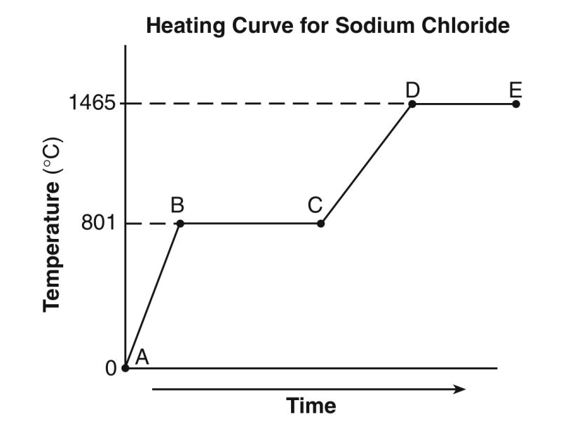
Unit 2: Matter & Energy—It All Matters
2.10
Aim: How can we analyze temperature changes, phase changes, and energy changes using a heating curve?
SAMPLE QUESTION #1:
A 100.0-gram sample of NaCl(s) has an initial temperature of 0°C. A chemist measures the temperature of the sample as it is heated. Heat is not added at a constant rate. The heating curve for the sample is shown below.
Determine the temperature range over which the entire NaCl sample is a liquid.
Identify one line segment on the curve where the average kinetic energy of the particles of the NaCl sample is changing.
Circle the portion of the graph where fusion is occurring.
Do Now
Introduction
Mini-Lesson
Summary
Work Period
Exit Slip

Slide 20
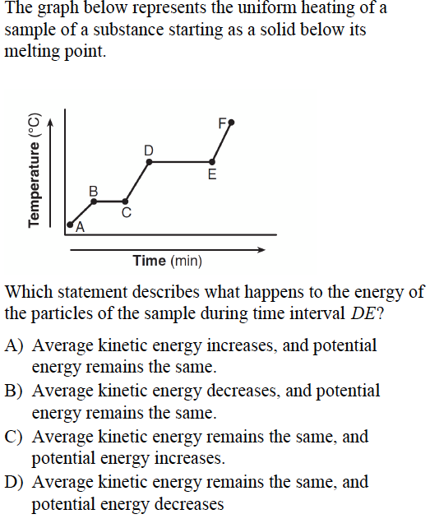
Unit 2: Matter & Energy—It All Matters
2.10
Aim: How can we analyze temperature changes, phase changes, and energy changes using a heating curve?
Sample question #2
Do Now
Introduction
Mini-Lesson
Summary
Work Period
Exit Slip

Slide 21
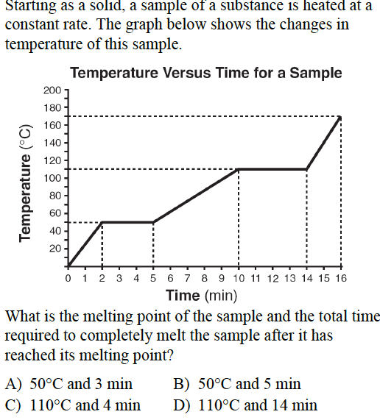
Unit 2: Matter & Energy—It All Matters
2.10
Aim: How can we analyze temperature changes, phase changes, and energy changes using a heating curve?
Sample question #3
Do Now
Introduction
Mini-Lesson
Summary
Work Period
Exit Slip

Slide 22
Unit 2: Matter & Energy—It All Matters
2.10
Aim: How can we analyze temperature changes, phase changes, and energy changes using a heating curve?
Work period
Complete pages 7-10
Do Now
Introduction
Mini-Lesson
Summary
Work Period
Exit Slip

Slide 23
Unit 2: Matter & Energy—It All Matters
2.10
Aim: How can we analyze temperature changes, phase changes, and energy changes using a heating curve?
Do Now
Introduction
Mini-Lesson
Summary
Work Period
Exit Slip

Slide 24
Unit 2: Matter & Energy—It All Matters
2.10
Aim: How can we analyze temperature changes, phase changes, and energy changes using a heating curve?
Do Now
Introduction
Mini-Lesson
Summary
Work Period
Exit Slip

Slide 25
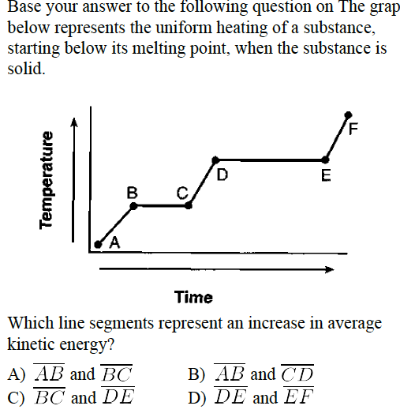
Unit 2: Matter & Energy—It All Matters
2.10
Aim: How can we analyze temperature changes, phase changes, and energy changes using a heating curve?
Do Now
Introduction
Mini-Lesson
Summary
Work Period
Exit Slip

Slide 26
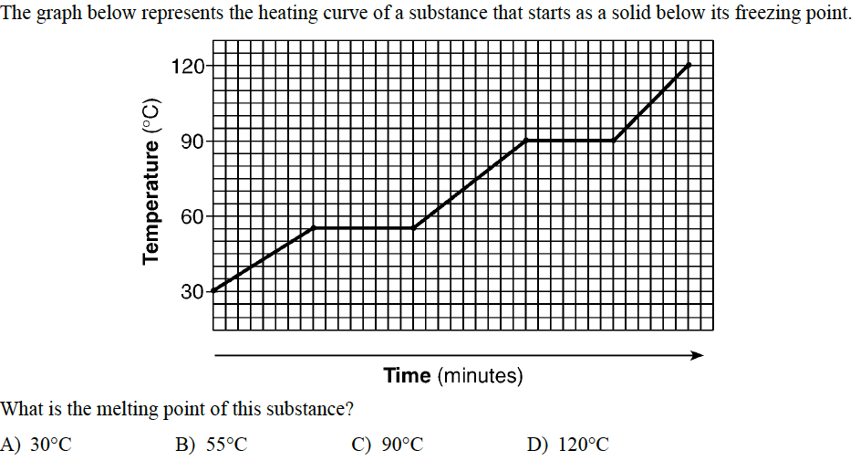
Unit 2: Matter & Energy—It All Matters
2.10
Aim: How can we analyze temperature changes, phase changes, and energy changes using a heating curve?
Do Now
Introduction
Mini-Lesson
Summary
Work Period
Exit Slip

Slide 27
Unit 2: Matter & Energy—It All Matters
2.10
Aim: How can we analyze temperature changes, phase changes, and energy changes using a heating curve?
HOMEWORK:
Complete rest of 2.10
in the packet for homework
Do Now
Introduction
Mini-Lesson
Summary
Work Period
Exit Slip

Slide 28
Unit 2: Matter & Energy—It All Matters
2.10
Aim: How can we analyze temperature changes, phase changes, and energy changes using a heating curve?
Exit Slip
Make sure you get your trackers checked!
Do Now
Introduction
Mini-Lesson
Summary
Work Period
Exit Slip

