Slide 1
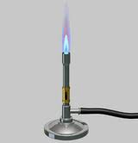
Unit 2: Matter & Energy—It All Matters
2.7
Aim: How do I distinguish among
the different states of matter?
DO NOW (ON LOOSELEAF)
Explain the meaning behind the joke. Connect the joke to what we have learned with states of matter.
Cite a real life example as evidence
Please write for 5 minutes. Write a TIEDC paragraph (5+ sentences):
T = Topic Sentence
I = Introduce Evidence (use real life example)
E = Evidence (cite specifics)
D = Develop evidence (explain example)
C = Conclusion
Joke
A small piece of ice which lived in a test tube fell in love with a Bunsen burner. "Bunsen! my flame! I melt whenever I see you" said the ice. The Bunsen burner replied :"It's just a phase you're going through".
AGENDA
Do Now
Introduction
Mini-Lesson
Summary
Work Period
Exit Slip

Slide 2
Unit 2: Matter & Energy—It All Matters
2.11
Aim: How can we analyze temperature changes, phase changes, and energy changes using a cooling curve?
Objective:
I will analyze the temperature changes, phase changes, and energy changes using a cooling curve.
AGENDA
Do Now
Introduction
Mini-Lesson
Summary
Work Period
DO NOW:
(Please complete the journal entry—Periods 2 and 4)
Exit Slip

Slide 3
Unit 2: Matter & Energy—It All Matters
2.11
Aim: How can we analyze temperature changes, phase changes, and energy changes using a cooling curve?
Real-world connection
Cooking—from evaporation to freezing
Vocabulary
cooling curve, kinetic energy, potential energy
AGENDA
Do Now
Introduction
Mini-Lesson
Summary
Work Period
Exit Slip

Slide 4
Unit 2: Matter & Energy—It All Matters
2.11
Aim: How can we analyze temperature changes, phase changes, and energy changes using a cooling curve?
Announcements
AGENDA
Do Now
Introduction
Mini-Lesson
Summary
Work Period
Exit Slip

Slide 5
Unit 2: Matter & Energy—It All Matters
2.11
Aim: How can we analyze temperature changes, phase changes, and energy changes using a cooling curve?
Do now
AGENDA
Do Now
Introduction
Mini-Lesson
Summary
Work Period
Exit Slip

Slide 6
Unit 2: Matter & Energy—It All Matters
2.11
Aim: How can we analyze temperature changes, phase changes, and energy changes using a cooling curve?
Thinking about…cooling curve
Examine the heating curve to the right. Describe what happens to the temperature as the water on the right goes from 160°C to 10°C. Why do you think this is happening?
Do Now
Introduction
Mini-Lesson
Summary
Work Period
Exit Slip

Slide 7
Unit 2: Matter & Energy—It All Matters
2.11
Aim: How can we analyze temperature changes, phase changes, and energy changes using a cooling?
cooling curve
a diagram that shows the cooling of a substance from the gas phase to the solid phase
Do Now
Introduction
Mini-Lesson
Summary
Work Period
Exit Slip

Slide 8
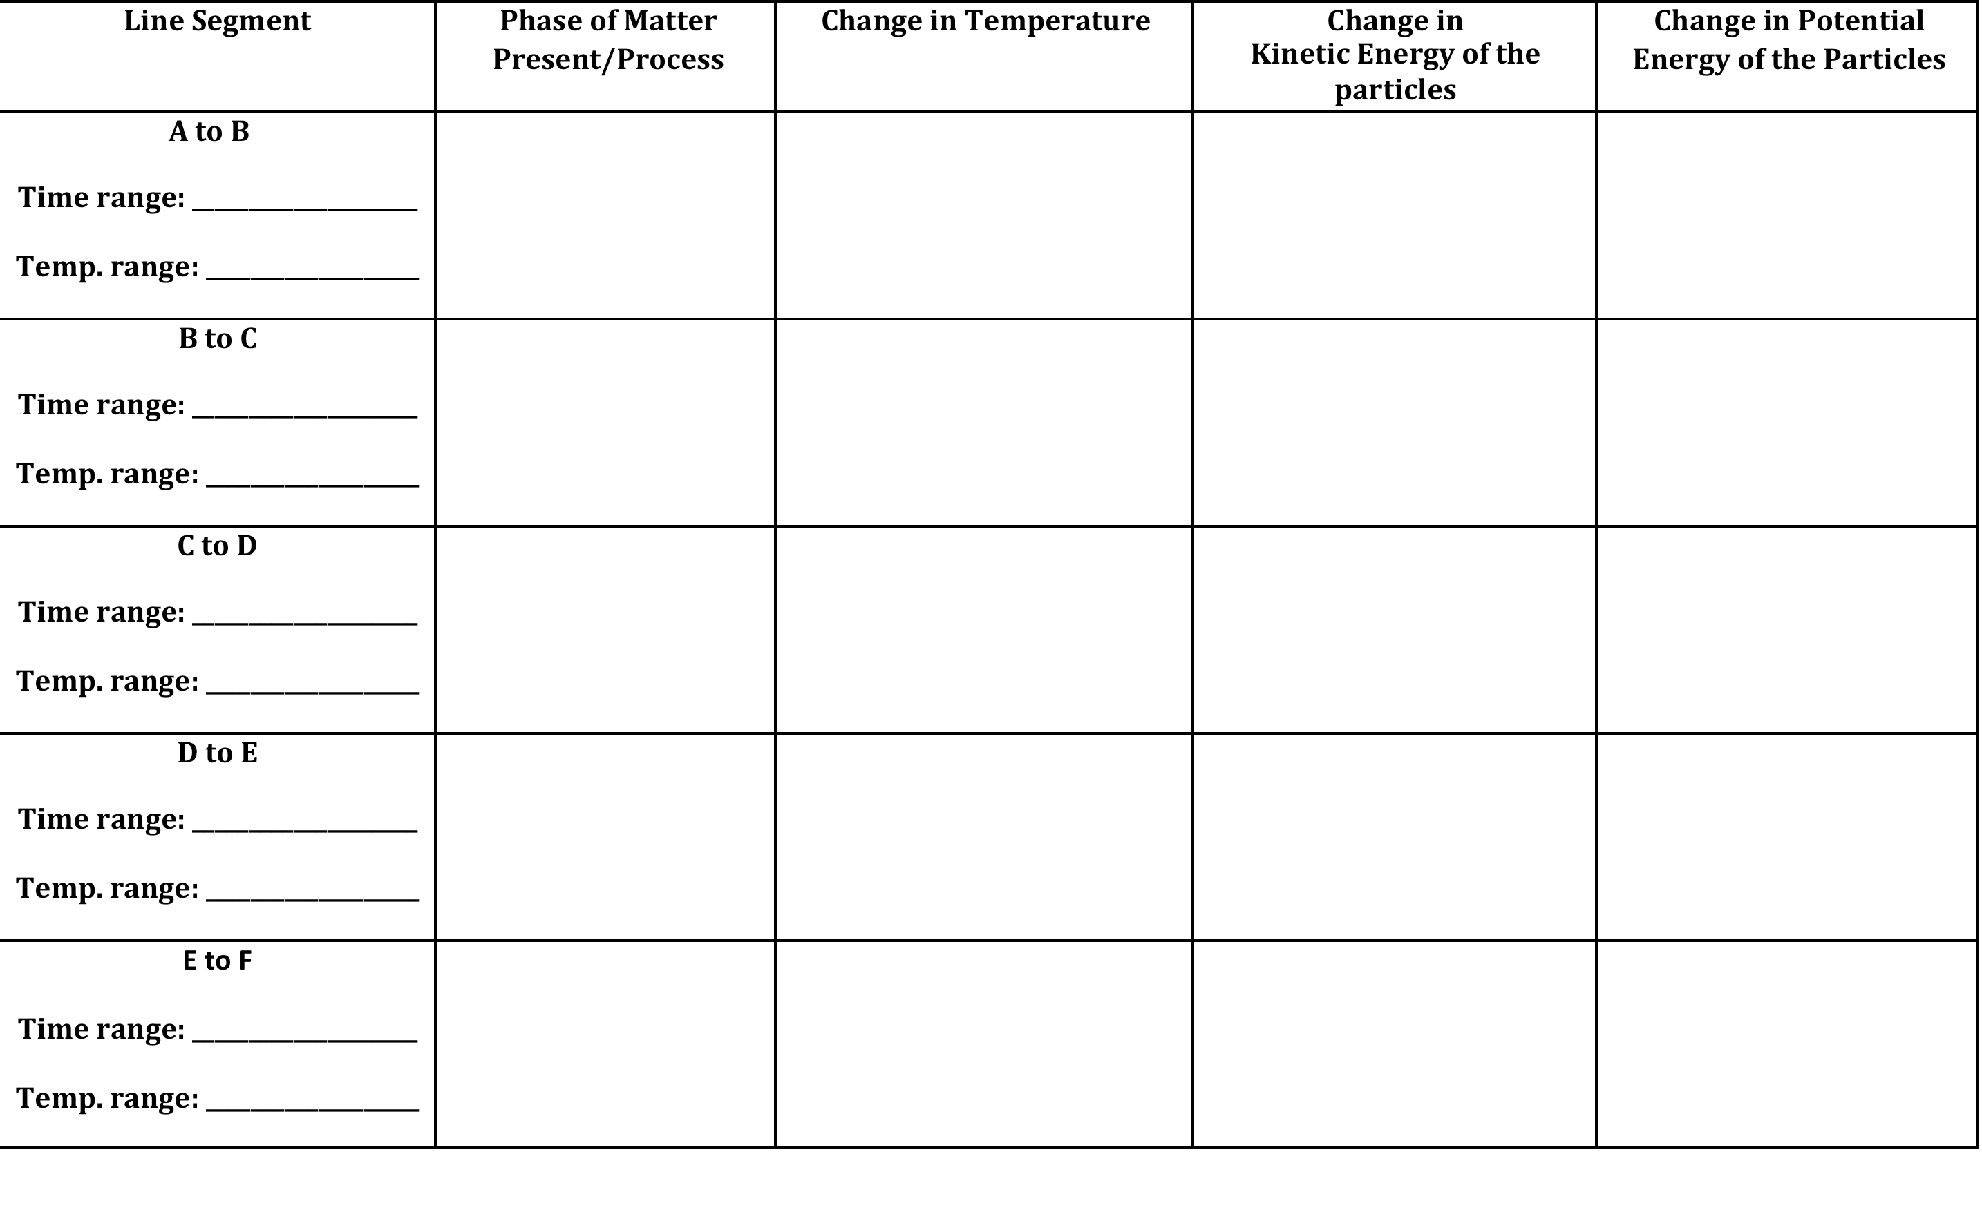
Unit 2: Matter & Energy—It All Matters
2.11
Aim: How can we analyze temperature changes, phase changes, and energy changes using a cooling curve?
Parts of a cooling curve
Do Now
Introduction
Mini-Lesson
Summary
Work Period
Exit Slip

Slide 9
Unit 2: Matter & Energy—It All Matters
2.11
Aim: How can we analyze temperature changes, phase changes, and energy changes using a cooling curve?
Annotating questions
Box any Chemistry terms—write a quick definition
Circle any numbers with units. Above write down what the number represents
Put a ?? Above something you are confused
Underline what the question is
Do Now
Introduction
Mini-Lesson
Summary
Work Period
Exit Slip

Slide 10
Unit 2: Matter & Energy—It All Matters
2.11
Aim: How can we analyze temperature changes, phase changes, and energy changes using a cooling curve?
SAMPLE QUESTION #1:
Do Now
Introduction
Mini-Lesson
Summary
Work Period
Exit Slip

Slide 11
Unit 2: Matter & Energy—It All Matters
2.11
Aim: How can we analyze temperature changes, phase changes, and energy changes using a cooling curve?
SAMPLE QUESTION #2:
Do Now
Introduction
Mini-Lesson
Summary
Work Period
Exit Slip

Slide 12
Unit 2: Matter & Energy—It All Matters
2.11
Aim: How can we analyze temperature changes, phase changes, and energy changes using a cooling curve?
question #3
Do Now
Introduction
Mini-Lesson
Summary
Work Period
Exit Slip

Slide 13
Unit 2: Matter & Energy—It All Matters
2.11
Aim: How can we analyze temperature changes, phase changes, and energy changes using a cooling curve?
question #4
Do Now
Introduction
Mini-Lesson
Summary
Work Period
Exit Slip

Slide 14
Unit 2: Matter & Energy—It All Matters
2.11
Aim: How can we analyze temperature changes, phase changes, and energy changes using a cooling curve?
question #5
Do Now
Introduction
Mini-Lesson
Summary
Work Period
Exit Slip

Slide 15
Unit 2: Matter & Energy—It All Matters
2.11
Aim: How can we analyze temperature changes, phase changes, and energy changes using a cooling curve?
question #6
Do Now
Introduction
Mini-Lesson
Summary
Work Period
Exit Slip

Slide 16
Unit 2: Matter & Energy—It All Matters
2.11
Aim: How can we analyze temperature changes, phase changes, and energy changes using a cooling curve?
question #7
Do Now
Introduction
Mini-Lesson
Summary
Work Period
Exit Slip

Slide 17
Unit 2: Matter & Energy—It All Matters
2.11
Aim: How can we analyze temperature changes, phase changes, and energy changes using a cooling curve?
Work period
Complete pages 14-17
Do Now
Introduction
Mini-Lesson
Summary
Work Period
Exit Slip

Slide 18
Unit 2: Matter & Energy—It All Matters
2.11
Aim: How can we analyze temperature changes, phase changes, and energy changes using a cooling curve?
HOMEWORK:
Complete rest of 2.11
in the packet for homework
Do Now
Introduction
Mini-Lesson
Summary
Work Period
Exit Slip

