Slide 1
Unit 2: Matter & Energy—It All Matters
2.14
Aim: How do we apply heat equations to calculate throughout the heating curve?
Objective:
I will calculate heat absorbed at different segments of the heating curve.
AGENDA
Do Now
Introduction
Mini-Lesson
Summary
Work Period
Do now:
(You have 10 minutes to write your journal entry)
Exit Slip

Slide 2
Unit 2: Matter & Energy—It All Matters
2.14
Aim: How do we apply heat equations to calculate throughout the heating curve?
DO NOW (ON LOOSELEAF)
Why does an iceberg have more energy than a pot of boiling water? (HINT: Think about the formulas we have been using)
Cite the formulas as evidence
Please write for 5 minutes. Write a TIEDC paragraph (5+ sentences):
T = Topic Sentence
I = Introduce Evidence
E = Evidence (cite specifics)
D = Develop evidence (explain example)
C = Conclusion
AGENDA
Do Now
Introduction
Mini-Lesson
Summary
Work Period
Exit Slip

Slide 3
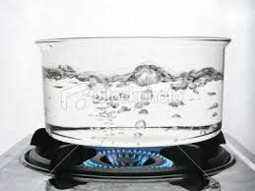
Unit 2: Matter & Energy—It All Matters
2.14
Aim: How do we apply heat equations to calculate throughout the heating curve?
Real-world connection
Cooking
Vocabulary
Heating curve, Specific heat capacity, heat capacity, heat of fusion, heat of vaporization
AGENDA
Do Now
Introduction
Mini-Lesson
Summary
Work Period
Exit Slip

Slide 4
Unit 2: Matter & Energy—It All Matters
2.14
Aim: How do we apply heat equations to calculate throughout the heating curve?
Announcements
AGENDA
Do Now
Introduction
Mini-Lesson
Summary
Work Period
Exit Slip

Slide 5
Unit 2: Matter & Energy—It All Matters
2.14
Aim: How do we apply heat equations to calculate throughout the heating curve?
Refresher: calculating heat
Do Now
Introduction
Mini-Lesson
Summary
Work Period
Exit Slip

Slide 6
Unit 2: Matter & Energy—It All Matters
2.14
Aim: How do we apply heat equations to calculate throughout the heating curve?
*Please write down sublimation (s→g) & deposition (g → s)
Do Now
Introduction
Mini-Lesson
Summary
Work Period
Exit Slip

Slide 7
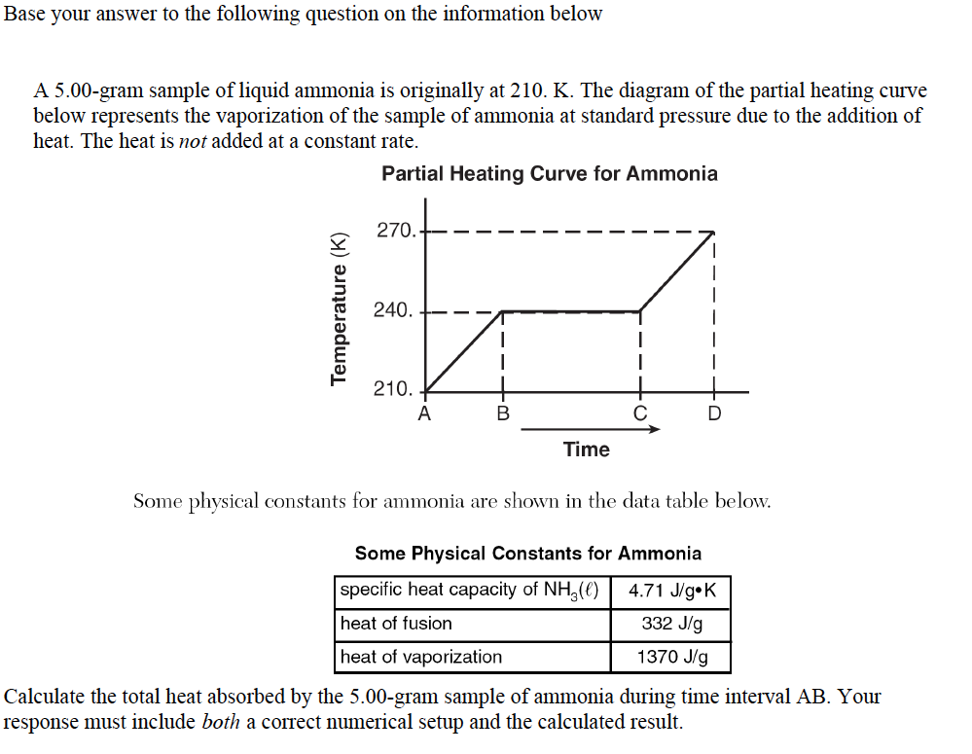
Unit 2: Matter & Energy—It All Matters
2.14
Aim: How do we apply heat equations to calculate throughout the heating curve?
Sample question
Do Now
Introduction
Mini-Lesson
Summary
Work Period
Exit Slip

Slide 8
Unit 2: Matter & Energy—It All Matters
2.14
Aim: How do we apply heat equations to calculate throughout the heating curve?
Heating curve calculations
Questions to consider:
A → B represents what? __________________________________
Is temperature increasing or staying the same? _________________________
Which formula should we use out the three above? Why?
_______________________________________________________________________
Do Now
Introduction
Mini-Lesson
Summary
Work Period
Exit Slip

Slide 9
Unit 2: Matter & Energy—It All Matters
2.14
Aim: How do we apply heat equations to calculate throughout the heating curve?
Heating curve calculations
B. Calculate the total heat absorbed by 5.00-gram sample of ammonia during interval BC.
Questions to consider:
B → C represents what? __________________________________
Is temperature increasing or staying the same? _________________________
Which formula should we use out the three above? Why?
_______________________________________________________________________
Do Now
Introduction
Mini-Lesson
Summary
Work Period
Exit Slip

Slide 10
Unit 2: Matter & Energy—It All Matters
2.14
Aim: How do we apply heat equations to calculate throughout the heating curve?
Heating curve calculations
C. Calculate the total heat absorbed by 5.00-gram sample of ammonia during interval CD.
Questions to consider:
C → D represents what? __________________________________
Is temperature increasing or staying the same? _________________________
Which formula should we use out the three above? Why?
_______________________________________________________________________
Do Now
Introduction
Mini-Lesson
Summary
Work Period
Exit Slip

Slide 11
Unit 2: Matter & Energy—It All Matters
2.14
Aim: How do we apply heat equations to calculate throughout the heating curve?
Page 35
Switch papers and check each other answers. Explain to the person what they did well and what needs to be improved.
Do Now
Introduction
Mini-Lesson
Summary
Work Period
Exit Slip

Slide 12
Unit 2: Matter & Energy—It All Matters
2.14
Aim: How do we apply heat equations to calculate throughout the heating curve?
Work on board
For pages 36-38
Do Now
Introduction
Mini-Lesson
Summary
Work Period
Exit Slip

Slide 13
Unit 2: Matter & Energy—It All Matters
2.14
Aim: How do we apply heat equations to calculate throughout the heating curve?
Work period
Complete pages 35-38
Do Now
Introduction
Mini-Lesson
Summary
Work Period
Exit Slip

Slide 14
Unit 2: Matter & Energy—It All Matters
2.14
Aim: How do we apply heat equations to calculate throughout the heating curve?
HOMEWORK:
Complete rest of 2.14
in the packet for homework
Do Now
Introduction
Mini-Lesson
Summary
Work Period
Exit Slip

Slide 15
Unit 2: Matter & Energy—It All Matters
2.14
Aim: How do we apply heat equations to calculate throughout the heating curve?
Exit Slip
Make sure you get your trackers checked!
Do Now
Introduction
Mini-Lesson
Summary
Work Period
Exit Slip

