Slide 1


Unit 2: Matter & Energy—It All Matters
2.3
Aim: What is the fine line between compounds and mixtures?
Objective:
I will compare and contrast between compounds and mixtures.
AGENDA
Do Now
Introduction
Mini-Lesson
Summary
Work Period
Do now:
(You have 5 minutes)
Exit Slip

Slide 2

Unit 2: Matter & Energy—It All Matters
2.3
Aim: What is the fine line between
compounds and mixtures?
Real-world connection
Water vs. iced tea
Vocabulary
Compounds, mixtures
AGENDA
Do Now
Introduction
Mini-Lesson
Summary
Work Period
Exit Slip

Slide 3
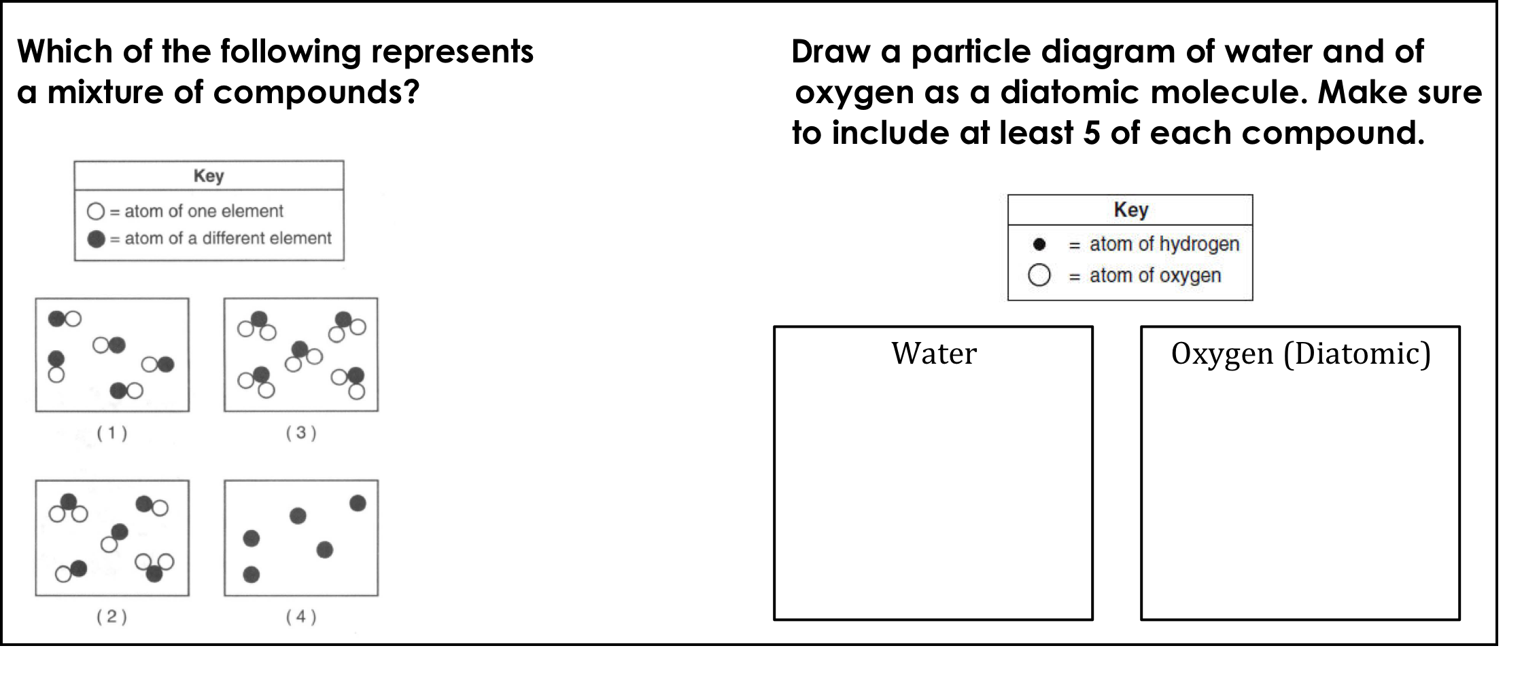
Unit 2: Matter & Energy—It All Matters
2.3
Aim: What is the fine line between
compounds and mixtures?
Review do now
AGENDA
Do Now
Introduction
Mini-Lesson
Summary
Work Period
Exit Slip

Slide 4
Unit 2: Matter & Energy—It All Matters
2.3
Aim: What is the fine line between
compounds and mixtures?
Announcements
SI Unit Project due TODAY Tues 10/14/14
Chemistry in the News due TOMORROW Wed 10/15/14
Lab Report due Fri 10/17/14
AGENDA
Do Now
Introduction
Mini-Lesson
Summary
Work Period
Exit Slip

Slide 5
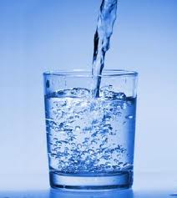

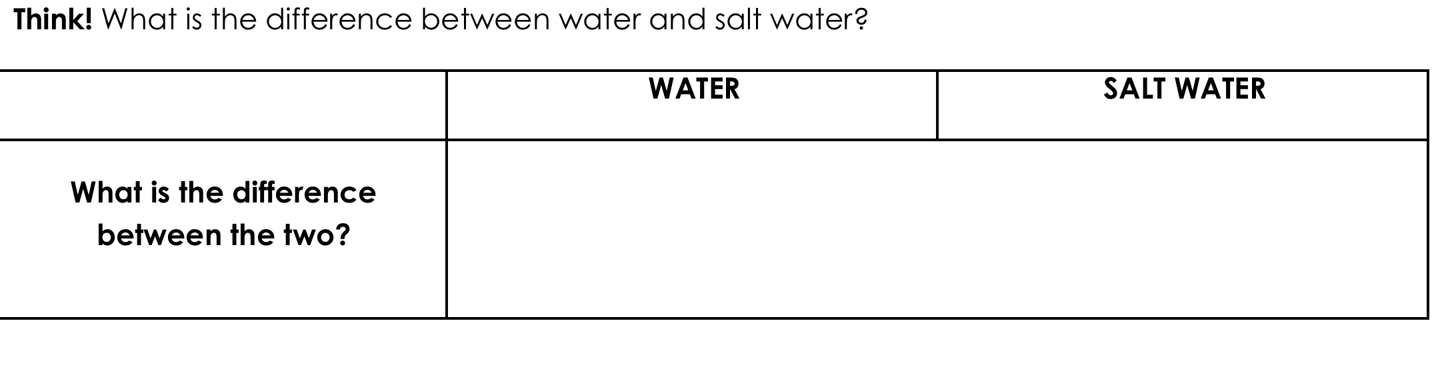
Unit 2: Matter & Energy—It All Matters
2.3
Aim: What is the fine line between
compounds and mixtures?
Compounds vs. mixtures
Do Now
Introduction
Mini-Lesson
Summary
Work Period
Exit Slip

Slide 6
Unit 2: Matter & Energy—It All Matters
2.3
Aim: What is the fine line between
compounds and mixtures?
We represent these differences using:
Chemical formulas
Particle diagrams
*For mixtures in water, we use the symbol aq, meaning aqueous
Do Now
Introduction
Mini-Lesson
Summary
Work Period
Exit Slip

Slide 7
Unit 2: Matter & Energy—It All Matters
2.3
Aim: What is the fine line between
compounds and mixtures?
While watching video
3 Things That You Learned
Two Questions You Have
After video, turn to a partner to ask your question and write your partner’s answer down
Do Now
Introduction
Mini-Lesson
Summary
Work Period
Exit Slip

Slide 8
Unit 2: Matter & Energy—It All Matters
2.3
Aim: What is the fine line between
compounds and mixtures?
Watch this video
http://www.brainpop.com/science/matterandchemistry/compoundsandmixtures/
Do Now
Introduction
Mini-Lesson
Summary
Work Period
Exit Slip

Slide 9
Unit 2: Matter & Energy—It All Matters
2.3
Aim: What is the fine line between
compounds and mixtures?
Characteristics of compounds
Do Now
Introduction
Mini-Lesson
Summary
Work Period
Exit Slip

Slide 10
Unit 2: Matter & Energy—It All Matters
2.3
Aim: What is the fine line between
compounds and mixtures?
Characteristics of mixtures
Do Now
Introduction
Mini-Lesson
Summary
Work Period
Exit Slip

Slide 11
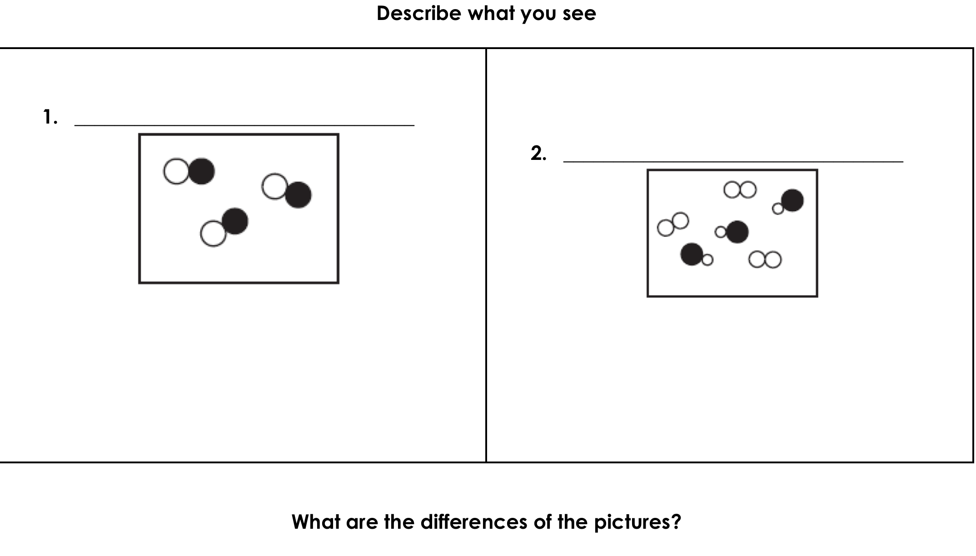
Unit 2: Matter & Energy—It All Matters
2.3
Aim: What is the fine line between
compounds and mixtures?
Examples of particle diagram
Do Now
Introduction
Mini-Lesson
Summary
Work Period
Exit Slip

Slide 12
Unit 2: Matter & Energy—It All Matters
2.3
Aim: What is the fine line between
compounds and mixtures?
Annotating questions
Box any Chemistry terms—write a quick definition
Circle any numbers with units. Above write down what the number represents
Put a ?? Above something you are confused
Underline what the question is
Do Now
Introduction
Mini-Lesson
Summary
Work Period
Exit Slip

Slide 13
Unit 2: Matter & Energy—It All Matters
2.3
Aim: What is the fine line between
compounds and mixtures?
Raise your hand
One finger = answer 1
Two fingers = answer 2
Three fingers = answer 3
Four fingers = answer 4
Do Now
Introduction
Mini-Lesson
Summary
Work Period
Exit Slip

Slide 14
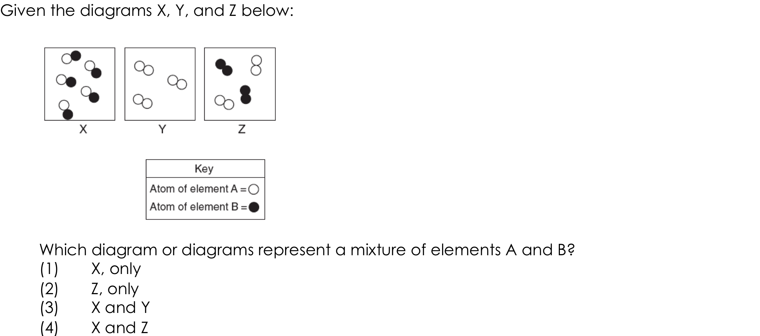
Unit 2: Matter & Energy—It All Matters
2.3
Aim: What is the fine line between
compounds and mixtures?
Sample questions…
Do Now
Introduction
Mini-Lesson
Summary
Work Period
Exit Slip

Slide 15
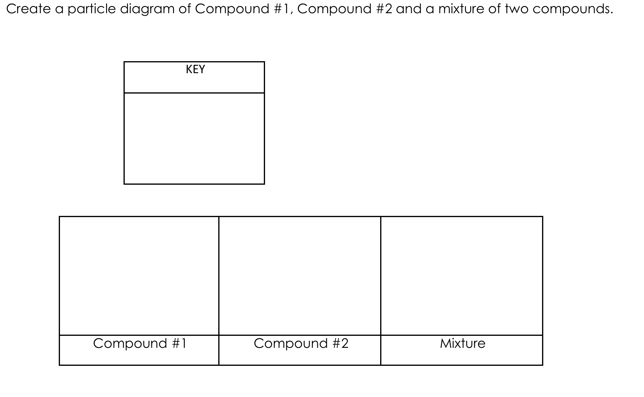
Unit 2: Matter & Energy—It All Matters
2.3
Aim: What is the fine line between
compounds and mixtures?
Sample questions…
Do Now
Introduction
Mini-Lesson
Summary
Work Period
Exit Slip

Slide 16
Unit 2: Matter & Energy—It All Matters
2.3
Aim: What is the fine line between
compounds and mixtures?
Group activity (work in 3)
Using the strips of paper you are given, sort the following substances into elements, compounds, and pure substances. Then make sure to write down your answers in your packet.
Do Now
Introduction
Mini Lesson
Summary
Work Period
Exit Slip

Slide 17
Unit 2: Matter & Energy—It All Matters
2.3
Aim: What is the fine line between
compounds and mixtures?
Summary: Lines of Learning (LOL)
In a coherent, well-written paragraph. compare and contrast a compound and a mixture and give an example of each.
(pg. 15)
Do Now
Introduction
Mini Lesson
Summary
Work Period
Exit Slip

Slide 18
Unit 2: Matter & Energy—It All Matters
2.3
Aim: What is the fine line between
compounds and mixtures?
Work period
Complete pages 17-19
Do Now
Introduction
Mini-Lesson
Summary
Work Period
Exit Slip

Slide 19
Unit 2: Matter & Energy—It All Matters
2.3
Aim: What is the fine line between
compounds and mixtures?
HOMEWORK:
Complete rest of 2.3
in the packet for homework
Do Now
Introduction
Mini-Lesson
Summary
Work Period
Exit Slip

Slide 20
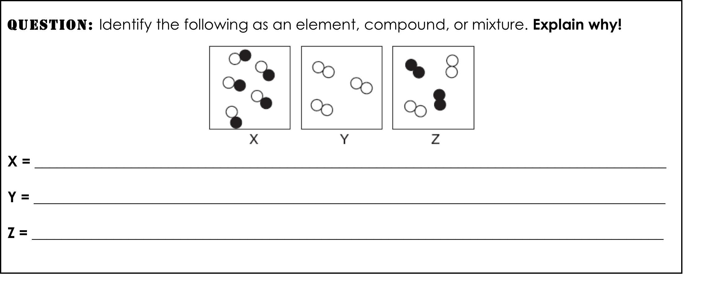
Unit 2: Matter & Energy—It All Matters
2.3
Aim: What is the fine line between
compounds and mixtures?
Exit Slip
Make sure you get your trackers checked!
Do Now
Introduction
Mini-Lesson
Summary
Work Period
Exit Slip

