Slide 1


Unit 2: Matter & Energy—It All Matters
2.4
Aim: What characterizes homogeneous and heterogeneous mixtures?
Objective:
I will distinguish between homogeneous and heterogeneous mixtures.
AGENDA
Do Now
Introduction
Mini-Lesson
Summary
Work Period
DO NOW:
(You have 5 minutes to complete do now slip)
PLEASE GET BINDERS!!!!!
Exit Slip

Slide 2
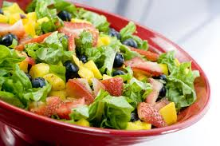
Unit 2: Matter & Energy—It All Matters
2.4
Aim: What characterizes homogeneous and heterogeneous mixtures?
Real-world connection
Food, spices, beverages
Vocabulary
homogeneous mixture; heterogeneous mixtures; alloy; solution
AGENDA
Do Now
Introduction
Mini-Lesson
Summary
Work Period
Exit Slip

Slide 3
Unit 2: Matter & Energy—It All Matters
2.4
Aim: What characterizes homogeneous and heterogeneous mixtures?
SI Unit Project PAST DUE Tues 10/14/14
Chemistry in the News due TODAY Wed 10/15/14
Lab Report due Fri 10/17/14
AGENDA
Do Now
Introduction
Mini-Lesson
Summary
Work Period
Exit Slip

Slide 4
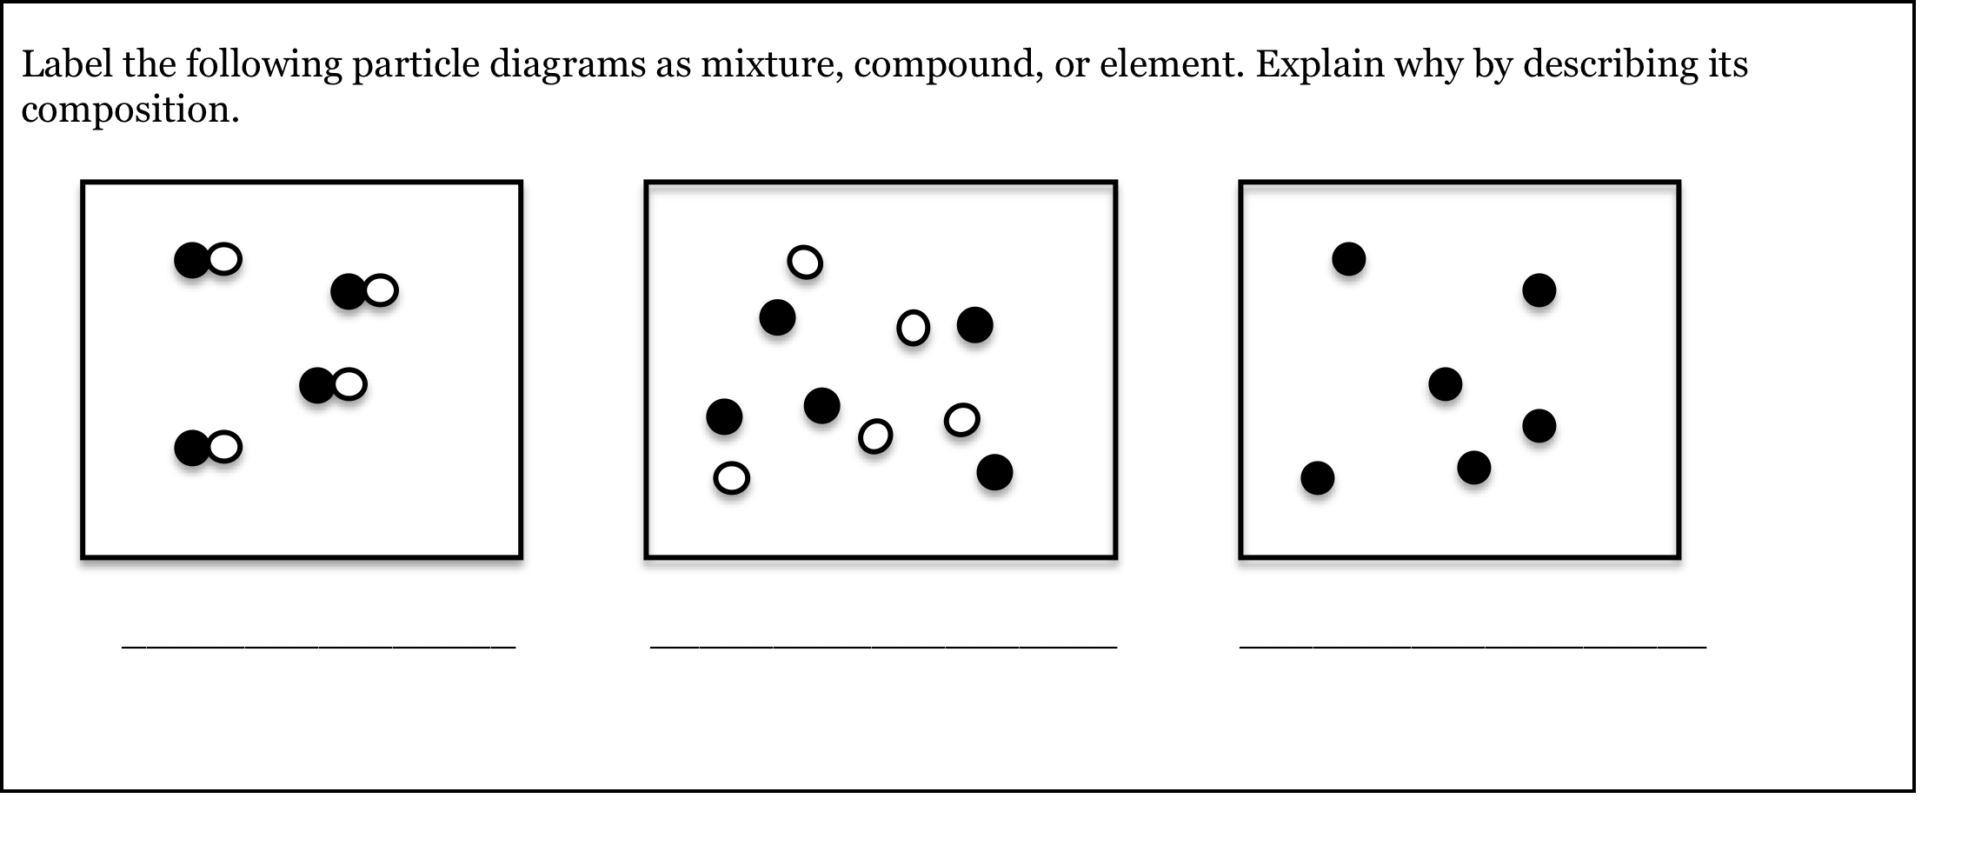
Unit 2: Matter & Energy—It All Matters
2.4
Aim: What characterizes homogeneous and heterogeneous mixtures?
Do now
AGENDA
Do Now
Introduction
Mini-Lesson
Summary
Work Period
Exit Slip

Slide 5
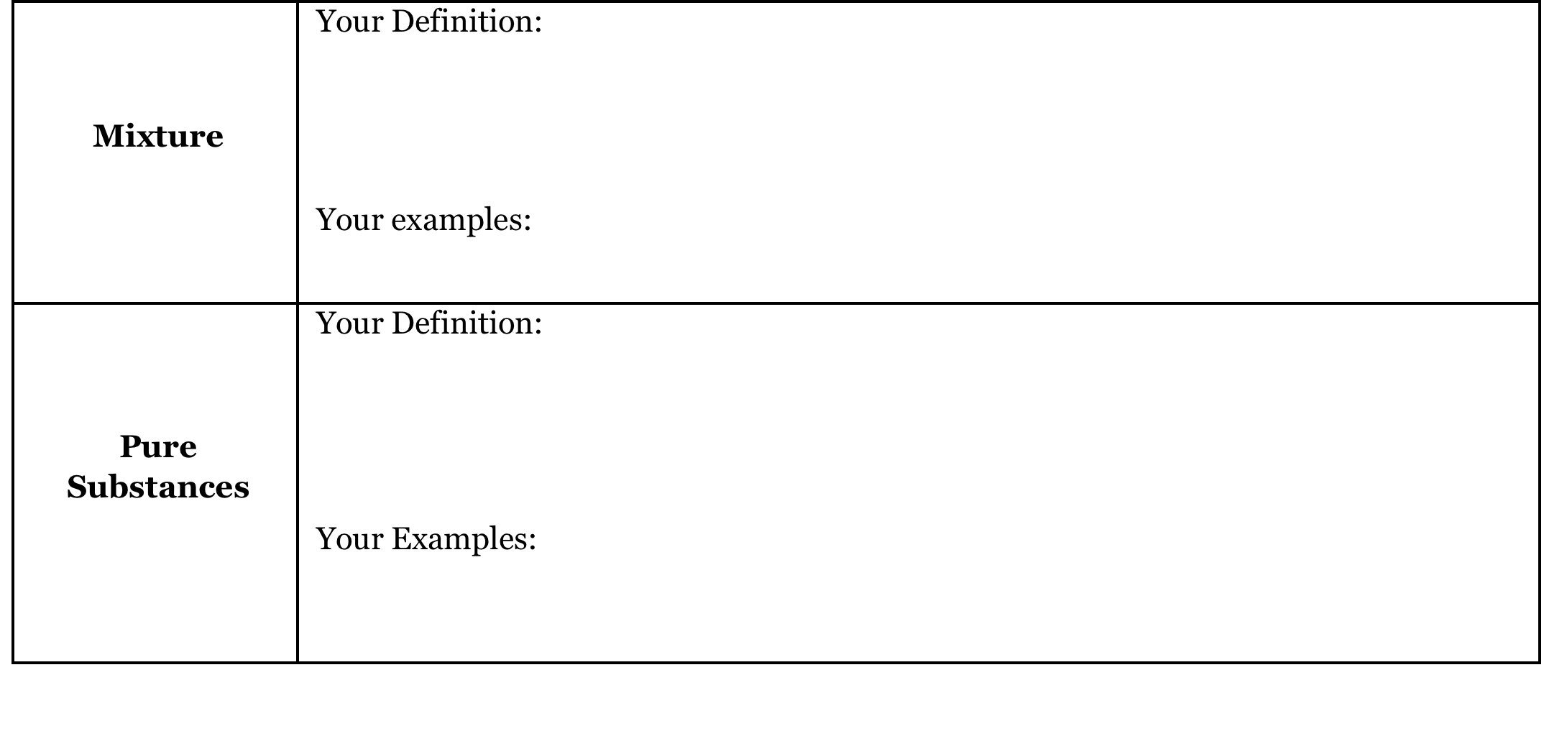
Unit 2: Matter & Energy—It All Matters
2.4
Aim: What characterizes homogeneous and heterogeneous mixtures?
Review
Do Now
Introduction
Mini-Lesson
Summary
Work Period
Exit Slip

Slide 6
Unit 2: Matter & Energy—It All Matters
2.4
Aim: What characterizes homogeneous and heterogeneous mixtures?
Example
Example: Salt water (NaCl_{(aq)})
The two pure substances that make up salt water are:
_______________________ (This is a _________________)
_______________________ (This is a _________________)
Do Now
Introduction
Mini-Lesson
Summary
Work Period
Exit Slip

Slide 7
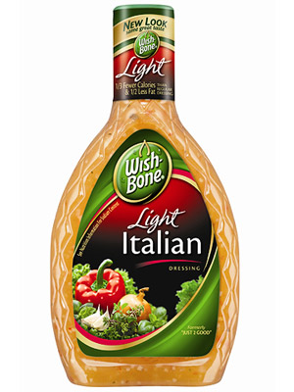

Unit 2: Matter & Energy—It All Matters
2.4
Aim: What characterizes homogeneous and heterogeneous mixtures?
Think…
How are the following similar to each other? How are they different from each other?
Do Now
Introduction
Mini-Lesson
Summary
Work Period
Exit Slip

Slide 8
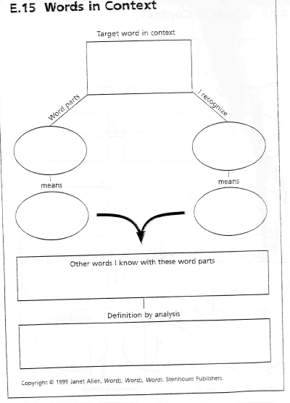
Unit 2: Matter & Energy—It All Matters
2.4
Aim: What characterizes homogeneous and heterogeneous mixtures?
homogeneous
Fill out what you can.
Do Now
Introduction
Mini-Lesson
Summary
Work Period
Exit Slip

Slide 9
Unit 2: Matter & Energy—It All Matters
2.4
Aim: What characterizes homogeneous and heterogeneous mixtures?
heterogeneous
Fill out what you can.
Do Now
Introduction
Mini-Lesson
Summary
Work Period
Exit Slip

Slide 10
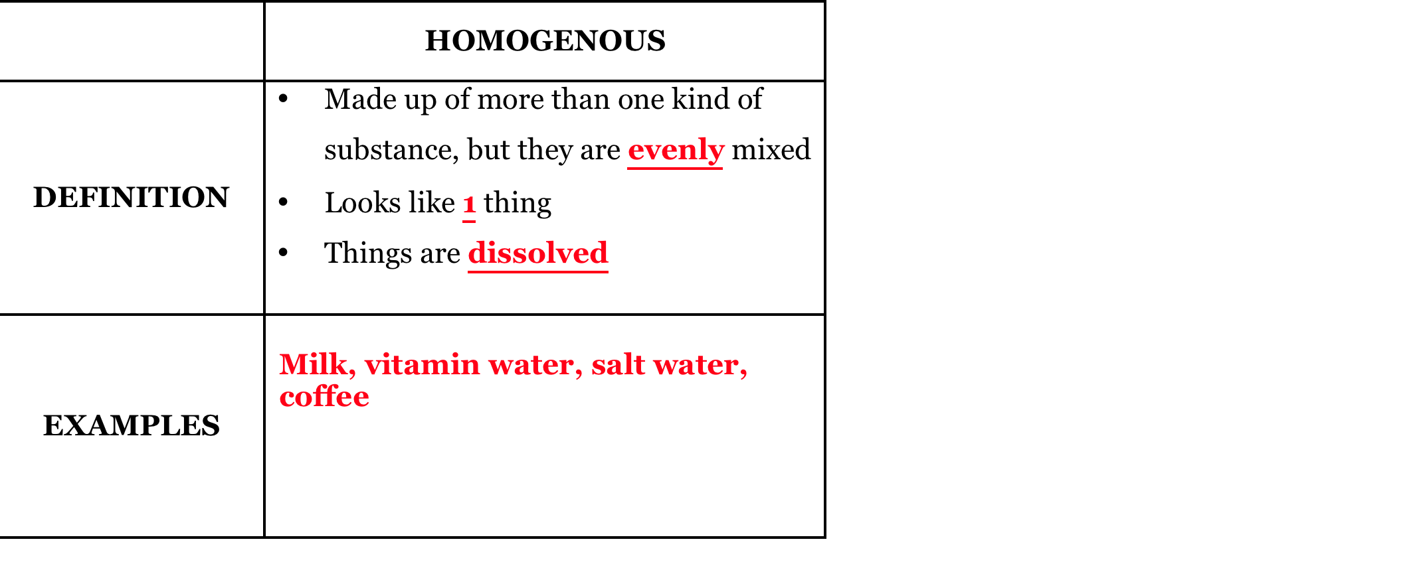
Unit 2: Matter & Energy—It All Matters
2.4
Aim: What characterizes homogeneous and heterogeneous mixtures?
homogeneous mixture
Do Now
Introduction
Mini-Lesson
Summary
Work Period
Exit Slip

Slide 11
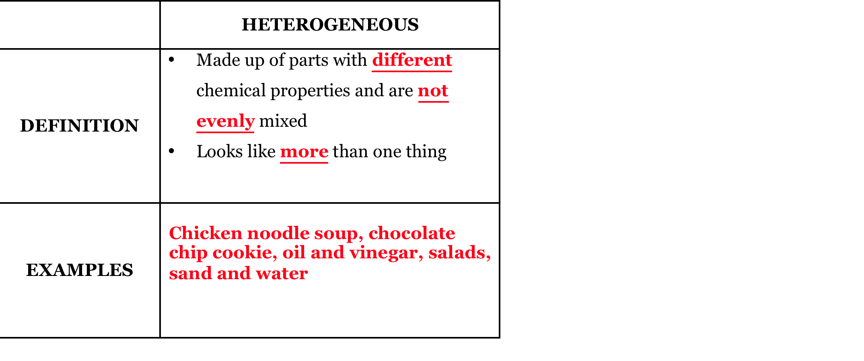
Unit 2: Matter & Energy—It All Matters
2.4
Aim: What characterizes homogeneous and heterogeneous mixtures?
heterogeneous mixture
Do Now
Introduction
Mini-Lesson
Summary
Work Period
Exit Slip

Slide 12
Unit 2: Matter & Energy—It All Matters
2.4
Aim: What characterizes homogeneous and heterogeneous mixtures?
TEST TAKING TIP:
REMEMBEr!!!!!!
HOMOGENEOUS AND HETEROGENOUS ONLY REFER TO MIXTURES!
REGENTS TIP! If you see “homogeneous compound” or “heterogeneous compound”, eliminate those answer choices immediately!
Do Now
Introduction
Mini-Lesson
Summary
Work Period
Exit Slip

Slide 13
Unit 2: Matter & Energy—It All Matters
2.4
Aim: What characterizes homogeneous and heterogeneous mixtures?
Choose a side
When I flash an image on the screen, choose which side you think has the correct answer (30 seconds)
You will then have 45 seconds to discuss with your group why
I will call on people from each group to justify the answer.
Do Now
Introduction
Mini-Lesson
Summary
Work Period
Exit Slip

Slide 14
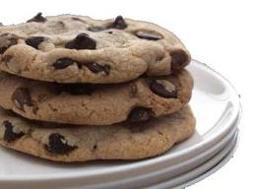
Unit 2: Matter & Energy—It All Matters
2.4
Aim: What characterizes homogeneous and heterogeneous mixtures?
Homo or hetero…justify (why?)
Do Now
Introduction
Mini-Lesson
Summary
Work Period
Exit Slip

Slide 15
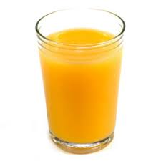
Unit 2: Matter & Energy—It All Matters
2.4
Aim: What characterizes homogeneous and heterogeneous mixtures?
Homo or hetero…justify (why?)
Do Now
Introduction
Mini-Lesson
Summary
Work Period
Exit Slip

Slide 16
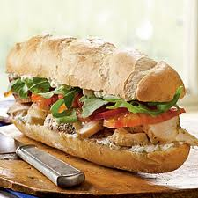
Unit 2: Matter & Energy—It All Matters
2.4
Aim: What characterizes homogeneous and heterogeneous mixtures?
Homo or hetero…justify (why?)
Do Now
Introduction
Mini-Lesson
Summary
Work Period
Exit Slip

Slide 17
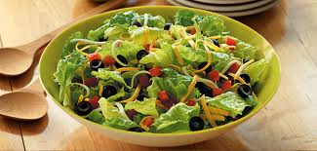
Unit 2: Matter & Energy—It All Matters
2.4
Aim: What characterizes homogeneous and heterogeneous mixtures?
Homo or hetero…justify (why?)
Do Now
Introduction
Mini-Lesson
Summary
Work Period
Exit Slip

Slide 18
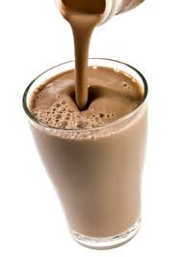
Unit 2: Matter & Energy—It All Matters
2.4
Aim: What characterizes homogeneous and heterogeneous mixtures?
Homo or hetero…justify (why?)
Do Now
Introduction
Mini-Lesson
Summary
Work Period
Exit Slip

Slide 19
Unit 2: Matter & Energy—It All Matters
2.4
Aim: What characterizes homogeneous and heterogeneous mixtures?
Think ink…pair share
QUESTION: A mixture is the chemical bonding of two or more substances in any proportion.” Is this statement true or false?
Do Now
Introduction
Mini-Lesson
Summary
Work Period
Exit Slip

Slide 20
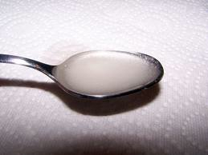
Unit 2: Matter & Energy—It All Matters
2.4
Aim: What characterizes homogeneous and heterogeneous mixtures?
Types of mixtures
Solutions:
When something is completely dissolved in water, it is called a solution
Aqueous solutions describe something dissolved in water
    AQUEOUS = aq
    Example: KNO₃(aq)
  All aqueous solutions are homogeneous mixtures
Do Now
Introduction
Mini-Lesson
Summary
Work Period
Exit Slip

Slide 21
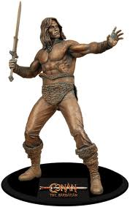
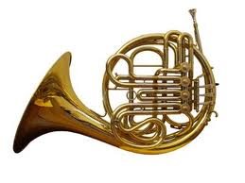
Unit 2: Matter & Energy—It All Matters
2.4
Aim: What characterizes homogeneous and heterogeneous mixtures?
Types of mixtures
B. Alloy:
When two or more metals are mixed together as a solid, it is called a alloy
  Example:
Brass: mixed with copper and zinc
Bronze: mixed with copper and tin
Do Now
Introduction
Mini-Lesson
Summary
Work Period
Exit Slip

Slide 22
Unit 2: Matter & Energy—It All Matters
2.4
Aim: What characterizes homogeneous and heterogeneous mixtures?
Annotating questions
Box any Chemistry terms—write a quick definition
Circle any numbers with units. Above write down what the number represents
Put a ?? Above something you are confused
Underline what the question is
Do Now
Introduction
Mini-Lesson
Summary
Work Period
Exit Slip

Slide 23
Unit 2: Matter & Energy—It All Matters
2.4
Aim: What characterizes homogeneous and heterogeneous mixtures?
Raise your hand
One finger = answer 1
Two fingers = answer 2
Three fingers = answer 3
Four fingers = answer 4
Do Now
Introduction
Mini-Lesson
Summary
Work Period
Exit Slip

Slide 24
Unit 2: Matter & Energy—It All Matters
2.4
Aim: What characterizes homogeneous and heterogeneous mixtures?
Sample question #1
A dilute, aqueous potassium nitrate solution is best classified as a
homogeneous compound
homogeneous mixture
heterogeneous compound
heterogeneous mixture
Key words?
What can we eliminate? Why?
What is the correct answer? Why?
Do Now
Introduction
Mini-Lesson
Summary
Work Period
Exit Slip

Slide 25
Unit 2: Matter & Energy—It All Matters
2.4
Aim: What characterizes homogeneous and heterogeneous mixtures?
Sample question #2
A sample is prepared by completely dissolving 10.0 grams of NaCl in 1.0 liter of H₂O. Which classification best describes this sample?
homogeneous compound
homogeneous mixture
heterogeneous compound
heterogeneous mixture
Key words?
What can we eliminate? Why?
What is the correct answer? Why?
Do Now
Introduction
Mini-Lesson
Summary
Work Period
Exit Slip

Slide 26
Unit 2: Matter & Energy—It All Matters
2.4
Aim: What characterizes homogeneous and heterogeneous mixtures?
Summary: Lines of Learning (LOL)
In a coherent, well-written paragraph, compare and contrast a homogeneous mixture from a heterogeneous mixture. Provide an example for each.
(pg. 26)
Do Now
Introduction
Mini Lesson
Summary
Work Period
Exit Slip

Slide 27
Unit 2: Matter & Energy—It All Matters
2.4
Aim: What characterizes homogeneous and heterogeneous mixtures?
Work period
Complete pages 25-27
Do Now
Introduction
Mini-Lesson
Summary
Work Period
Exit Slip

Slide 28
Unit 2: Matter & Energy—It All Matters
2.4
Aim: What characterizes homogeneous and heterogeneous mixtures?
HOMEWORK:
Complete rest of 2.4
in the packet for homework
Do Now
Introduction
Mini-Lesson
Summary
Work Period
Exit Slip

Slide 29
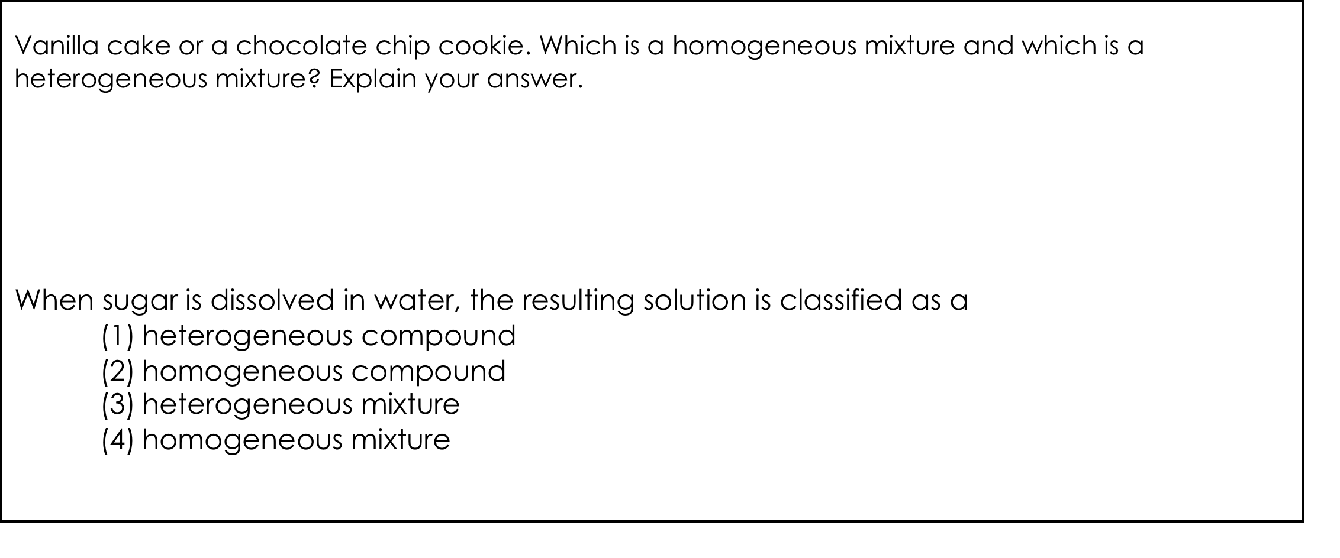
Unit 2: Matter & Energy—It All Matters
2.4
Aim: What characterizes homogeneous and heterogeneous mixtures?
Exit Slip
Make sure you get your trackers checked!
Do Now
Introduction
Mini-Lesson
Summary
Work Period
Exit Slip

