Slide 1
Unit 2: Matter & Energy—It All Matters
2.5
Aim: How can we separate
the parts of a mixture?
Objective:
I will identify the appropriate methods of separating mixtures.
AGENDA
Do Now
Introduction
Mini-Lesson
Summary
Work Period
Do now:
(You have 5 minutes to complete the do now)
Exit Slip

Slide 2
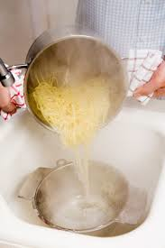
Unit 3: Matter & Energy—It All Matters
2.5
Aim: How can we separate
the parts of a mixture?
Real-world connection
Rock candy, separating noodles from water, separting rubbing alcohol, identifying a thief
Vocabulary
evaporation, crystallization, filtration, chromatography, distillation
AGENDA
Do Now
Introduction
Mini-Lesson
Summary
Work Period
Exit Slip

Slide 3
Unit 2: Matter & Energy—It All Matters
2.5
Aim: How can we separate
the parts of a mixture?
Review do now
AGENDA
Do Now
Introduction
Mini-Lesson
Summary
Work Period
Exit Slip

Slide 4
Unit 2: Matter & Energy—It All Matters
2.5
Aim: How can we separate
the parts of a mixture?
Announcements
SI Unit Project PAST DUE Tues 10/14/14
Chemistry in the News PAST DUE Wed 10/15/14
Lab Report due Fri 10/17/14
AGENDA
Do Now
Introduction
Mini-Lesson
Summary
Work Period
Exit Slip

Slide 5
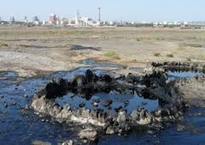
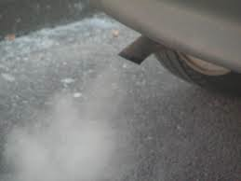
Unit 2: Matter & Energy—It All Matters
2.5
Aim: How can we separate
the parts of a mixture?
THINK INK…PAIR SHARE
Why is oil in the ground black,
but the gas we put in our cars clear?
Do Now
Introduction
Mini-Lesson
Summary
Work Period
Exit Slip

Slide 6
Unit 2: Matter & Energy—It All Matters
2.5
Aim: How can we separate
the parts of a mixture?
Separation of mixtures
ALL mixtures can be separated.
Mixtures can be separated because of differences in physical properties.
Do Now
Introduction
Mini-Lesson
Summary
Work Period
Exit Slip

Slide 7
Unit 2: Matter & Energy—It All Matters
2.5
Aim: How can we separate
the parts of a mixture?
Activity
You will be divided into three groups.
Each group will focus on a technique and answer those questions (5 minutes)
Each group will then share their answers and explain the technique to the class (2 minutes)
Do Now
Introduction
Mini-Lesson
Summary
Work Period
Exit Slip

Slide 8
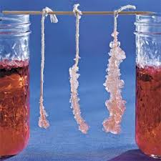
Unit 2: Matter & Energy—It All Matters
2.5
Aim: How can we separate
the parts of a mixture?
Activity
Do Now
Introduction
Mini-Lesson
Summary
Work Period
Exit Slip

Slide 9
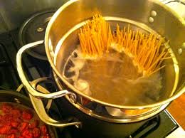
Unit 2: Matter & Energy—It All Matters
2.5
Aim: How can we separate
the parts of a mixture?
Activity
Do Now
Introduction
Mini-Lesson
Summary
Work Period
Exit Slip

Slide 10
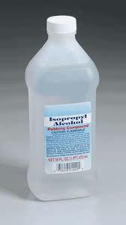
Unit 2: Matter & Energy—It All Matters
2.5
Aim: How can we separate
the parts of a mixture?
Activity
Do Now
Introduction
Mini-Lesson
Summary
Work Period
Exit Slip

Slide 11
Unit 2: Matter & Energy—It All Matters
2.5
Aim: How can we separate
the parts of a mixture?
Think ink…pair share
QUESTION: Gasoline is a specific type of hydrocarbon that is in crude oil. Which separation technique do you think is used to separate gasoline in cars from crude oil? Defend your choice.
Do Now
Introduction
Mini-Lesson
Summary
Work Period
Exit Slip

Slide 12
Unit 2: Matter & Energy—It All Matters
2.5
Aim: How can we separate
the parts of a mixture?
Objective:
I will identify the appropriate methods of separating mixtures.
AGENDA
Do Now
Introduction
Mini-Lesson
Summary
Work Period
quiz:
(You have 10 minutes to complete the quiz)
Exit Slip

Slide 13
Unit 2: Matter & Energy—It All Matters
2.5
Aim: How can we separate
the parts of a mixture?
Announcements
SI Unit Project PAST DUE Tues 10/14/14
Chemistry in the News PAST DUE Wed 10/15/14
Lab Report DUE TODAY Fri 10/17/14
AGENDA
Do Now
Introduction
Mini-Lesson
Summary
Work Period
Exit Slip

Slide 14
Unit 2: Matter & Energy—It All Matters
2.5
Aim: How can we separate
the parts of a mixture?
Annotating questions
Box any Chemistry terms—write a quick definition
Circle any numbers with units. Above write down what the number represents
Put a ?? Above something you are confused
Underline what the question is
Do Now
Introduction
Mini-Lesson
Summary
Work Period
Exit Slip

Slide 15
Unit 2: Matter & Energy—It All Matters
2.5
Aim: How can we separate
the parts of a mixture?
Raise your hand
One finger = answer 1
Two fingers = answer 2
Three fingers = answer 3
Four fingers = answer 4
Do Now
Introduction
Mini-Lesson
Summary
Work Period
Exit Slip

Slide 16
Unit 2: Matter & Energy—It All Matters
2.5
Aim: How can we separate
the parts of a mixture?
Crystallization/evaporation
*video
Do Now
Introduction
Mini-Lesson
Summary
Work Period
Exit Slip

Slide 17
Unit 2: Matter & Energy—It All Matters
2.5
Aim: How can we separate
the parts of a mixture?
Crystallization/evaporation
*video
Do Now
Introduction
Mini-Lesson
Summary
Work Period
Exit Slip

Slide 18
Unit 2: Matter & Energy—It All Matters
2.5
Aim: How can we separate
the parts of a mixture?
filtration
*video
Do Now
Introduction
Mini-Lesson
Summary
Work Period
Exit Slip

Slide 19
Unit 2: Matter & Energy—It All Matters
2.5
Aim: How can we separate
the parts of a mixture?
filtration
*video
Do Now
Introduction
Mini-Lesson
Summary
Work Period
Exit Slip

Slide 20
Unit 2: Matter & Energy—It All Matters
2.5
Aim: How can we separate
the parts of a mixture?
Fractional distillation
*video
Do Now
Introduction
Mini-Lesson
Summary
Work Period
Exit Slip

Slide 21
Unit 2: Matter & Energy—It All Matters
2.5
Aim: How can we separate
the parts of a mixture?
Fractional distillation
*video
Do Now
Introduction
Mini-Lesson
Summary
Work Period
Exit Slip

Slide 22
Unit 2: Matter & Energy—It All Matters
2.5
Aim: How can we separate
the parts of a mixture?
chromatography
*video
Do Now
Introduction
Mini-Lesson
Summary
Work Period
Exit Slip

Slide 23
Unit 2: Matter & Energy—It All Matters
2.5
Aim: How can we separate
the parts of a mixture?
chromatography
*video
Do Now
Introduction
Mini-Lesson
Summary
Work Period
Exit Slip

Slide 24
Unit 2: Matter & Energy—It All Matters
2.5
Aim: How can we separate
the parts of a mixture?
Summary: Lines of Learning (LOL)
In a coherent, well-written paragraph. answer the following question: How does a tea bag work? What method of separation of mixtures is it most similar to? Use TIEDC.
(pg. 7)
Do Now
Introduction
Mini Lesson
Summary
Work Period
Exit Slip

Slide 25
Unit 2: Matter & Energy—It All Matters
2.5
Aim: How can we separate
the parts of a mixture?
Classwork questions (4 corners)
You have 45 seconds to walk to the answer you believe is correct.
You will have 45 seconds to discuss with your group on why you guys chose that answer.
Someone in the group will be asked to share out.
Do Now
Introduction
Mini Lesson
Summary
Work Period
Exit Slip

Slide 26
Unit 2: Matter & Energy—It All Matters
2.5
Aim: How can we separate
the parts of a mixture?
Work period
Complete pages 33-34
Do Now
Introduction
Mini-Lesson
Summary
Work Period
Exit Slip

Slide 27
Unit 2: Matter & Energy—It All Matters
2.5
Aim: How can we separate
the parts of a mixture?
HOMEWORK:
Complete rest of 2.5
in the packet for homework
Do Now
Introduction
Mini-Lesson
Summary
Work Period
Exit Slip

Slide 28
Unit 2: Matter & Energy—It All Matters
2.5
Aim: How can we separate
the parts of a mixture?
Exit Slip
Make sure you get your trackers checked!
Do Now
Introduction
Mini-Lesson
Summary
Work Period
Exit Slip

