Slide 1
Unit 2: Matter & Energy—It All Matters
2.6
Aim: How do I distinguish among the different states of matter?
Objective:
I will distinguish among
the different states of matter.
AGENDA
Do Now
Introduction
Mini-Lesson
Summary
Work Period
Do now:
(You have 5 minutes to complete your do now)
Exit Slip

Slide 2
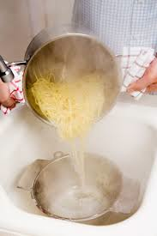
Unit 2: Matter & Energy—It All Matters
2.6
Aim: How do I distinguish among
the different states of matter?
Real-world connection
Making ice, melting snow, boiling water
Vocabulary
Solid, liquid, gas
AGENDA
Do Now
Introduction
Mini-Lesson
Summary
Work Period
Exit Slip

Slide 3
Unit 2: Matter & Energy—It All Matters
2.6
Aim: How do I distinguish among
the different states of matter?
Announcements
Papers back in binders
Turn in Packet #3 fully completed by Thursday
AGENDA
Do Now
Introduction
Mini-Lesson
Summary
Work Period
Exit Slip

Slide 4
Unit 2: Matter & Energy—It All Matters
2.6
Aim: How do I distinguish among
the different states of matter?
Do now
AGENDA
Do Now
Introduction
Mini-Lesson
Summary
Work Period
Exit Slip

Slide 5
Unit 2: Matter & Energy—It All Matters
2.6
Aim: How do I distinguish among
the different states of matter?
While watching video
3 Things That You Learned
Two Questions You Have
1 connection to Chemistry
Do Now
Introduction
Mini-Lesson
Summary
Work Period
Exit Slip

Slide 6
Unit 2: Matter & Energy—It All Matters
2.6
Aim: How do I distinguish among
the different states of matter?
Watch this video
http://www.brainpop.com/science/matterandchemistry/statesofmatter/
Do Now
Introduction
Mini-Lesson
Summary
Work Period
Exit Slip

Slide 7
Unit 2: Matter & Energy—It All Matters
2.6
Aim: How do I distinguish among
the different states of matter?
3-2-1- Protocol
Write the three things you learned on three post-its
Find 3 other people with a different color post-it and read it to them
Do Now
Introduction
Mini-Lesson
Summary
Work Period
Exit Slip

Slide 8
Unit 2: Matter & Energy—It All Matters
2.6
Aim: How do I distinguish among
the different states of matter?
QUESTION STEMS
How come ____________?
Why did ______________?
What would happen if _____________?
How is _______ related to ________?
Do Now
Introduction
Mini-Lesson
Summary
Work Period
Exit Slip

Slide 9
Unit2: Matter & Energy—It All Matters
2.6
Aim: How do I distinguish among
the different states of matter?
3-2-1- Protocol
Each person in your group, share how this connects with Chemistry
Outloud as a class, we will share some questions and try to answer it
Do Now
Introduction
Mini-Lesson
Summary
Work Period
Exit Slip

Slide 10
Unit 2: Matter & Energy—It All Matters
2.6
Aim: How do I distinguish among
the different states of matter?
States of matter
Do Now
Introduction
Mini-Lesson
Summary
Work Period
Exit Slip

Slide 11
Unit 2: Matter & Energy—It All Matters
2.6
Aim: How do I distinguish among
the different states of matter?
States of matter
Do Now
Introduction
Mini-Lesson
Summary
Work Period
Exit Slip

Slide 12
Unit 2: Matter & Energy—It All Matters
2.6
Aim: How do I distinguish among
the different states of matter?
Intermolecular forces
Do Now
Introduction
Mini-Lesson
Summary
Work Period
Exit Slip

Slide 13
Unit 2: Matter & Energy—It All Matters
2.6
Aim: How do I distinguish among
the different states of matter?
Frayer model
As a group, complete the Frayer model for what you were assigned.
Then have a different person share out each part to class
Do Now
Introduction
Mini-Lesson
Summary
Work Period
Exit Slip

Slide 14
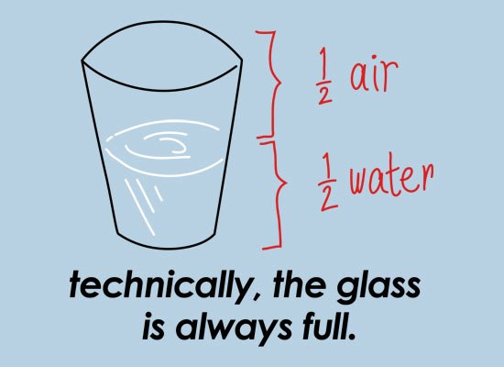
Unit 2: Matter & Energy—It All Matters
2.6
Aim: How do I distinguish among
the different states of matter?
Joke
Do Now
Introduction
Mini-Lesson
Summary
Work Period
Exit Slip

Slide 15
Unit 2: Matter & Energy—It All Matters
2.6
Aim: How do I distinguish among
the different states of matter?
Annotating questions
Box any Chemistry terms—write a quick definition
Circle any numbers with units. Above write down what the number represents
Put a ?? Above something you are confused
Underline what the question is
Do Now
Introduction
Mini-Lesson
Summary
Work Period
Exit Slip

Slide 16
Unit 2: Matter & Energy—It All Matters
2.6
Aim: How do I distinguish among
the different states of matter?
Raise your hand
One finger = answer 1
Two fingers = answer 2
Three fingers = answer 3
Four fingers = answer 4
Do Now
Introduction
Mini-Lesson
Summary
Work Period
Exit Slip

Slide 17
Unit 2: Matter & Energy—It All Matters
2.6
Aim: How do I distinguish among
the different states of matter?
Sample question #1
Do Now
Introduction
Mini-Lesson
Summary
Work Period
Exit Slip

Slide 18
Unit 2: Matter & Energy—It All Matters
2.6
Aim: How do I distinguish among
the different states of matter?
Sample question #2
Do Now
Introduction
Mini-Lesson
Summary
Work Period
Exit Slip

Slide 19
Unit 2: Matter & Energy—It All Matters
2.6
Aim: How do I distinguish among
the different states of matter?
Sample quest. #4
Do Now
Introduction
Mini-Lesson
Summary
Work Period
Exit Slip

Slide 20
Unit 2: Matter & Energy—It All Matters
2.6
Aim: How do I distinguish among
the different states of matter?
4 corners
You have 45 seconds to walk to the answer you believe is correct.
You will have 45 seconds to discuss with your group on why you guys chose that answer.
Someone in the group will be asked to share out.
Do Now
Introduction
Mini-Lesson
Summary
Work Period
Exit Slip

Slide 21
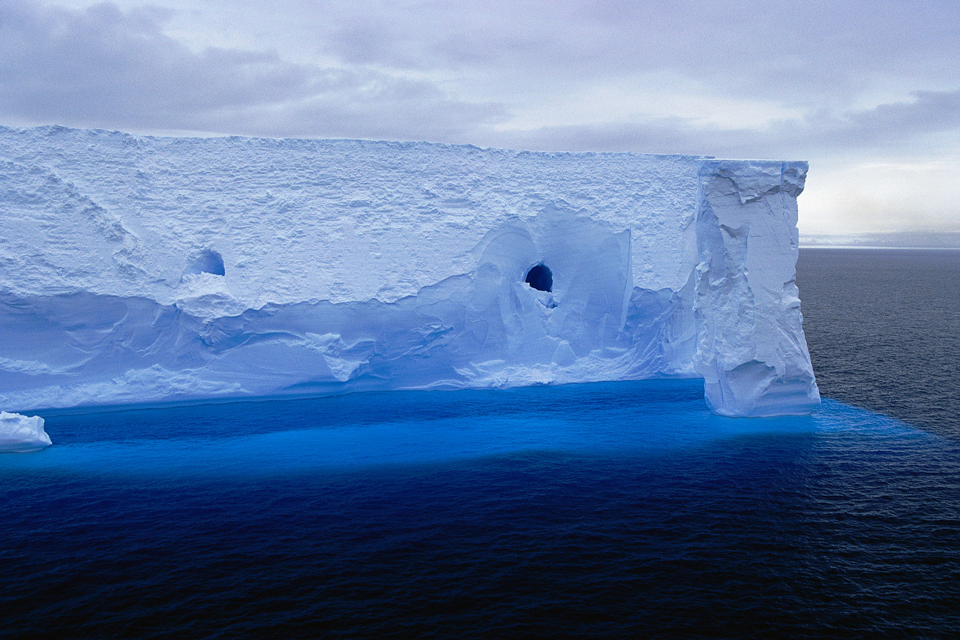
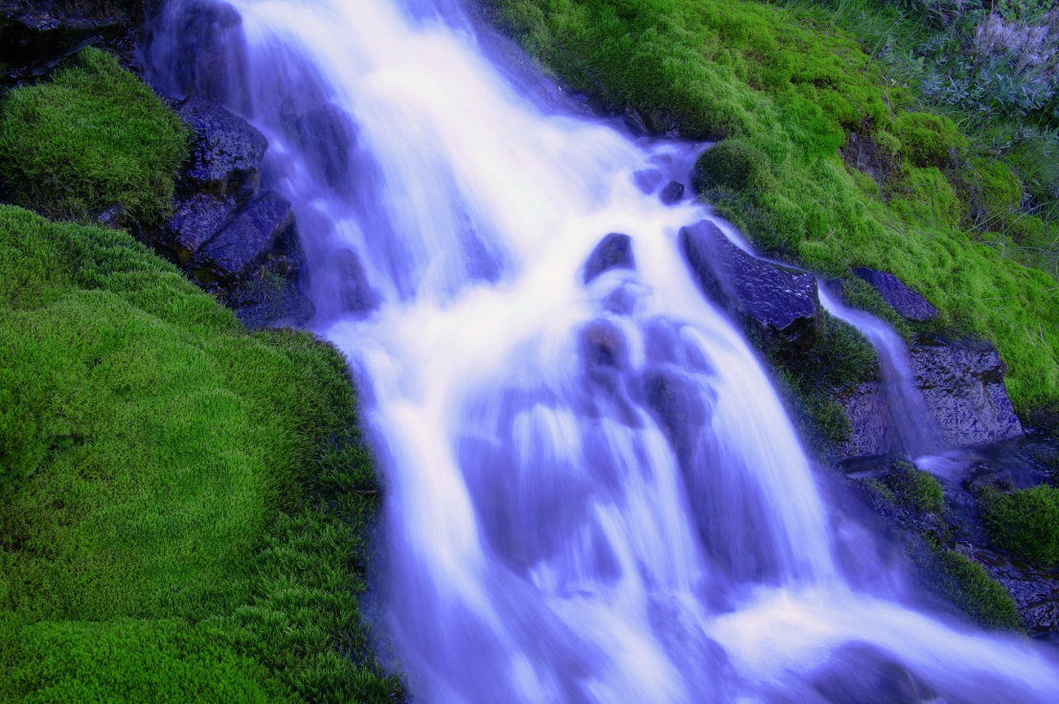
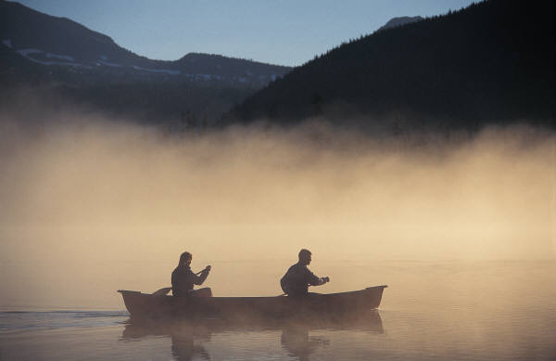
Unit 2: Matter & Energy—It All Matters
2.6
Aim: How do I distinguish among
the different states of matter?
Summary…Turn and talk
What is the ONLY real difference among these phases of matter?
“Vapor”
“Ice”
“Water”
Do Now
Introduction
Mini-Lesson
Summary
Work Period
Exit Slip

Slide 22
Unit 2: Matter & Energy—It All Matters
2.6
Aim: How do I distinguish among
the different states of matter?
Work period
Complete pages 5-7
Do Now
Introduction
Mini-Lesson
Summary
Work Period
Exit Slip

Slide 23
Unit 2: Matter & Energy—It All Matters
2.6
Aim: How do I distinguish among
the different states of matter?
HOMEWORK:
Complete rest of 2.6
in the packet for homework
Do Now
Introduction
Mini-Lesson
Summary
Work Period
Exit Slip

Slide 24
Unit 2: Matter & Energy—It All Matters
2.6
Aim: How do I distinguish among
the different states of matter?
Exit Slip
Make sure you get your trackers checked!
Do Now
Introduction
Mini-Lesson
Summary
Work Period
Exit Slip

