Slide 1
Unit 2: Matter & Energy—It All Matters
2.7
Aim: How do we describe the states of matter in terms of entropy?
Objective:
I will describe the states of matter
in terms of entropy.
AGENDA
Do Now
Introduction
Mini-Lesson
Summary
Work Period
Do now:
(You have 10 minutes to write your journal entry)
Exit Slip

Slide 2
Unit 2: Matter & Energy—It All Matters
2.7
Aim: How do we describe the states of matter in terms of entropy?
Real-world connection
Clean vs. messy room
Vocabulary
Entropy, law of disorder
AGENDA
Do Now
Introduction
Mini-Lesson
Summary
Work Period
Exit Slip

Slide 3
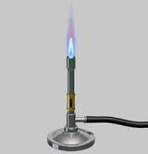
Unit 2: Matter & Energy—It All Matters
2.7
Aim: How do I distinguish among
the different states of matter?
Joke
A small piece of ice which lived in a test tube fell in love with a Bunsen burner. "Bunsen! my flame! I melt whenever I see you" said the ice. The Bunsen burner replied :"It's just a phase you're going through".
Do Now
Introduction
Mini-Lesson
Summary
Work Period
Exit Slip

Slide 4
Unit 2: Matter & Energy—It All Matters
2.7
Aim: How do I distinguish among
the different states of matter?
DO NOW (ON LOOSELEAF)
Explain the meaning behind the joke. Connect the joke to what we have learned with states of matter.
Cite a real life example as evidence
Please write for 5 minutes. Write a TIEDC paragraph (5+ sentences):
T = Topic Sentence
I = Introduce Evidence (use real life example)
E = Evidence (cite specifics)
D = Develop evidence (explain example)
C = Conclusion
AGENDA
Do Now
Introduction
Mini-Lesson
Summary
Work Period
Exit Slip

Slide 5
Unit 2: Matter & Energy—It All Matters
2.7
Aim: How do we describe the states of matter in terms of entropy?
Announcements
Packet #3 due by tomorrow
Chemistry in the News due 15th of each month (first one due Mon 11/17)
AGENDA
Do Now
Introduction
Mini-Lesson
Summary
Work Period
Exit Slip

Slide 6
Unit 2: Matter & Energy—It All Matters
2.7
Aim: How do we describe the states of matter in terms of entropy?
Raise your hand:
What are some other words for order?
Do Now
Introduction
Mini-Lesson
Summary
Work Period
Exit Slip

Slide 7
Unit 2: Matter & Energy—It All Matters
2.7
Aim: How do we describe the states of matter in terms of entropy?
Call out:
What are some words for disorder?
Do Now
Introduction
Mini-Lesson
Summary
Work Period
Exit Slip

Slide 8
Unit 2: Matter & Energy—It All Matters
2.7
Aim: How do we describe the states of matter in terms of entropy?
Thinking back…
Which did you like to do?
Calling out or raising your hand? Why?
Do Now
Introduction
Mini-Lesson
Summary
Work Period
Exit Slip

Slide 9
Unit 2: Matter & Energy—It All Matters
2.7
Aim: How do we describe the states of matter in terms of entropy?
Watch this video
https://www.youtube.com/watch?v=ykUmibZHEZk
Do Now
Introduction
Mini-Lesson
Summary
Work Period
Exit Slip

Slide 10
Unit 2: Matter & Energy—It All Matters
2.7
Aim: How do we describe the states of matter in terms of entropy?
3-2-1- Protocol
Write the three things you learned on three post-its
Turn and talk to a partner and share what you learned
Do Now
Introduction
Mini-Lesson
Summary
Work Period
Exit Slip

Slide 11
Unit 2: Matter & Energy—It All Matters
2.7
Aim: How do we describe the states of matter in terms of entropy?
QUESTION STEMS
How come ____________?
Why did ______________?
What would happen if _____________?
How is _______ related to ________?
Do Now
Introduction
Mini-Lesson
Summary
Work Period
Exit Slip

Slide 12
Unit 2: Matter & Energy—It All Matters
2.7
Aim: How do we describe the states of matter in terms of entropy?
3-2-1- Protocol
Each person in your group, share how this connects with Chemistry
Outloud as a class, we will share some questions and try to answer it
Do Now
Introduction
Mini-Lesson
Summary
Work Period
Exit Slip

Slide 13
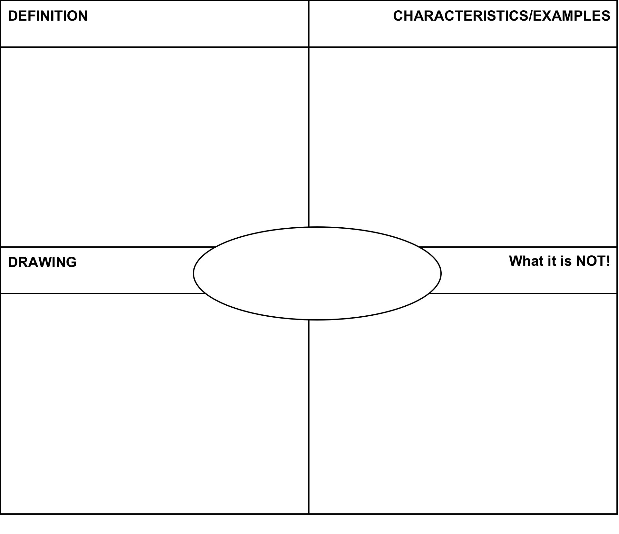
Unit 2: Matter & Energy—It All Matters
2.7
Aim: How do we describe the states of matter in terms of entropy?
ENTROPY—Complete frayer model
Do Now
Introduction
Mini-Lesson
Summary
Work Period
Exit Slip

Slide 14
Unit 2: Matter & Energy—It All Matters
2.7
Aim: How do I distinguish among
the different states of matter?
Entropy
More entropy less entropy
Do Now
Introduction
Mini-Lesson
Summary
Work Period
Exit Slip

Slide 15
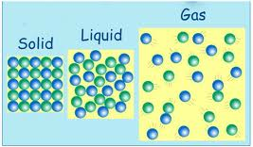
Unit 2: Matter & Energy—It All Matters
2.7
Aim: How do we describe the states of matter in terms of entropy?
Think ink…pare share
Which do you think would have a greater entropy: solids, liquids, or gases?
Do Now
Introduction
Mini-Lesson
Summary
Work Period
Exit Slip

Slide 16
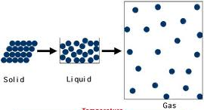
Unit 2: Matter & Energy—It All Matters
2.7
Aim: How do we describe the states of matter in terms of entropy?
As you move from a solid → liquid → gas
What happens to the temperature of the particles?
What happens to the motion of the particles?
What happens to the spacing of the particles?
What happens to the disorder of the particles?
What happens to the entropy of the particles?
Do Now
Introduction
Mini-Lesson
Summary
Work Period
Exit Slip

Slide 17
Unit 2: Matter & Energy—It All Matters
2.7
Aim: How do I distinguish among
the different states of matter?
Annotating questions
Box any Chemistry terms—write a quick definition
Circle any numbers with units. Above write down what the number represents
Put a ?? Above something you are confused
Underline what the question is
Do Now
Introduction
Mini-Lesson
Summary
Work Period
Exit Slip

Slide 18
Unit 2: Matter & Energy—It All Matters
2.7
Aim: How do I distinguish among
the different states of matter?
Raise your hand
One finger = answer 1
Two fingers = answer 2
Three fingers = answer 3
Four fingers = answer 4
Do Now
Introduction
Mini-Lesson
Summary
Work Period
Exit Slip

Slide 19
Unit 2: Matter & Energy—It All Matters
2.7
Aim: How do we describe the states of matter in terms of entropy?
Sample question
Do Now
Introduction
Mini-Lesson
Summary
Work Period
Exit Slip

Slide 20
Unit 2: Matter & Energy—It All Matters
2.7
Aim: How do we describe the states of matter in terms of entropy?
Sample question
Do Now
Introduction
Mini-Lesson
Summary
Work Period
Exit Slip

Slide 21
Unit 2: Matter & Energy—It All Matters
2.7
Aim: How do we describe the states of matter in terms of entropy?
Sample question
Do Now
Introduction
Mini-Lesson
Summary
Work Period
Exit Slip

Slide 22
Unit 2: Matter & Energy—It All Matters
2.7
Aim: How do we describe the states of matter in terms of entropy?
Sample question
Do Now
Introduction
Mini-Lesson
Summary
Work Period
Exit Slip

Slide 23
Unit 2: Matter & Energy—It All Matters
2.7
Aim: How do I distinguish among
the different states of matter?
4 corners
You have 45 seconds to walk to the answer you believe is correct.
You will have 45 seconds to discuss with your group on why you guys chose that answer.
Someone in the group will be asked to share out.
Do Now
Introduction
Mini-Lesson
Summary
Work Period
Exit Slip

Slide 24
Unit 2: Matter & Energy—It All Matters
2.7
Aim: How do we describe the states of matter in terms of entropy?
Work period
Complete pages 13-14
Do Now
Introduction
Mini-Lesson
Summary
Work Period
Exit Slip

Slide 25
Unit 2: Matter & Energy—It All Matters
2.7
Aim: How do we describe the states of matter in terms of entropy?
HOMEWORK:
Complete rest of 2.7
in the packet for homework
Do Now
Introduction
Mini-Lesson
Summary
Work Period
Exit Slip

Slide 26
Unit 2: Matter & Energy—It All Matters
2.7
Aim: How do we describe the states of matter in terms of entropy?
Exit Slip
Make sure you get your trackers checked!
Do Now
Introduction
Mini-Lesson
Summary
Work Period
Exit Slip

