Slide 1


Unit 3: A World of Particles—An Atom & Its Components
3.1
Aim: How has the model of the atom
evolved over time?
Objective:
I will summarize the development of the atom.
AGENDA
Do Now
Introduction
Mini-Lesson
Summary
Work Period
DO NOW:
You have 5 minutes for the Do Now
Exit Slip

Slide 2
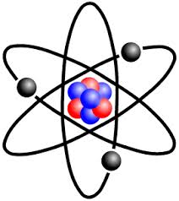
Unit 3: A World of Particles—An Atom & Its Components
3.1
Aim: How has the model of the atom
evolved over time?
Real-world connection
“acceptance of unknown”
Vocabulary
Atom, atomic model, Dalton’s atomic theory, Plum-pudding model, nuclear model, Rutherford gold foil experiment, Bohr Model, wave mechanical model
AGENDA
Do Now
Introduction
Mini-Lesson
Summary
Work Period
Exit Slip

Slide 3
Unit 3: A World of Particles—An Atom & Its Components
3.1
Aim: How has the model of the atom
evolved over time?
ANNOUNCEMENTS
Fill out test reflections for Exam 2 by Thursday
AGENDA
Do Now
Introduction
Mini-Lesson
Summary
Work Period
Exit Slip

Slide 4

Unit 3: A World of Particles—An Atom & Its Components
3.1
Aim: How has the model of the atom
evolved over time?
Activity: One volunteer
Rip a piece of paper to as tiny as it can go
Questions to consider:
    What were you doing here?
    Is it still a piece of paper?
    Can it be broken down even further? Could you cut the piece in half again 10 more times? 100 more times? 1000 more times?
    How small can something be?
Do Now
Introduction
Mini-Lesson
Summary
Work Period
Exit Slip

Slide 5

Unit 3: A World of Particles—An Atom & Its Components
3.1
Aim: How has the model of the atom
evolved over time?
Atoms & ATOMIC MODEL
What is your definition of an atom? Atomic model?
Do Now
Introduction
Mini-Lesson
Summary
Work Period
Exit Slip

Slide 6
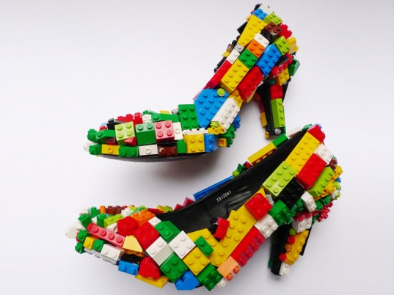
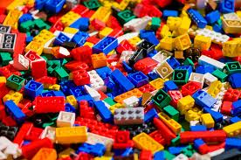
Unit 3: A World of Particles—An Atom & Its Components
3.1
Aim: How has the model of the atom
evolved over time?
Atoms
Smallest particle of a type of matter that has all of the same characteristics as that type of matter
Do Now
Introduction
Mini-Lesson
Summary
Work Period
Exit Slip

Slide 7
Unit 3: A World of Particles—An Atom & Its Components
3.1
Aim: How has the model of the atom
evolved over time?
Think ink-pair share
  How are atoms like legoes?
Do Now
Introduction
Mini-Lesson
Summary
Work Period
Exit Slip

Slide 8
Unit 3: A World of Particles—An Atom & Its Components
3.1
Aim: How has the model of the atom
evolved over time?
Brain pop video
  3 Things You Learned
  2 Questions You Have
  1 Wondering
  LINK: https://www.brainpop.com/science/matterandchemistry/atomicmodel/
Do Now
Introduction
Mini-Lesson
Summary
Work Period
Exit Slip

Slide 9
Unit 3: A World of Particles—An Atom & Its Components
3.1
Aim: How has the model of the atom
evolved over time?
QUESTION STEMS
How come ____________?
Why did ______________?
What would happen if _____________?
How is _______ related to ________?
Do Now
Introduction
Mini-Lesson
Summary
Work Period
Exit Slip

Slide 10
Unit 3: A World of Particles—An Atom & Its Components
3.1
Aim: How has the model of the atom
evolved over time?
Group assignment
Read each passage that are on pages 4-6 and answer the questions as a group.
You will also be responsible to fill out the chart on page 3 based on the readings on pages 4-6
Do Now
Introduction
Mini-Lesson
Summary
Work Period
Exit Slip

Slide 11
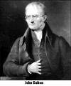
Unit 3: A World of Particles—An Atom & Its Components
3.1
Aim: How has the model of the atom
evolved over time?
John dalton—model #1
1. What is the name of his theory? ________________________________________
2. What are elements made of? ___________________________________________
3. An atom of hydrogen and an atom of carbon are ______________________.
4. What are compounds made of ? ___________________________________
5. The ratio of atoms in HCl is a) 1:3 b) 2:1 c) 1:1
Do Now
Introduction
Mini-Lesson
Summary
Work Period
Exit Slip

Slide 12
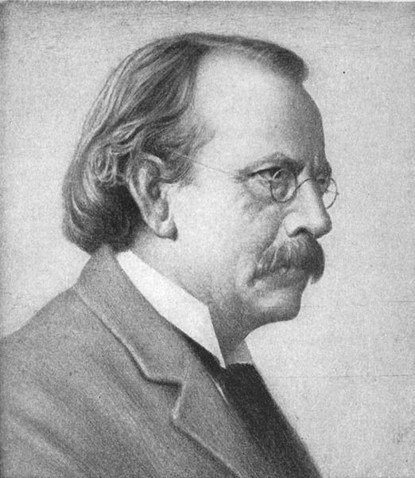
Unit 3: A World of Particles—An Atom & Its Components
3.1
Aim: How has the model of the atom
evolved over time?
j.j. thomson—model #2
What did J.J. Thompson discover?
What is the charge of an electron?
What are cathode rays made of?
Why do electrons move from the negative end of the tube to the positive end?
What was Thompson working with when he discovered the cathode rays?
Do Now
Introduction
Mini-Lesson
Summary
Work Period
Exit Slip

Slide 13
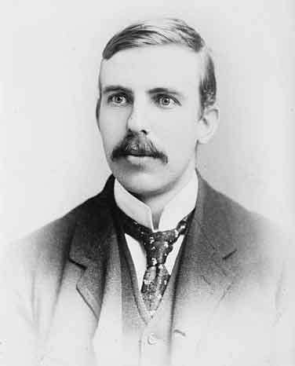
Unit 3: A World of Particles—An Atom & Its Components
3.1
Aim: How has the model of the atom
evolved over time?
Ernest rutherford—model #3
What is the name of his theory? What is the charge of an alpha particle?
Why is Rutherford’s experiment called the gold foil experiment?
How did he know that atom was mostly empty space?
What happened to the alpha particles as they
hit the gold foil?
5. How did he know that the nucleus was positively
charged?
Do Now
Introduction
Mini-Lesson
Summary
Work Period
Exit Slip

Slide 14
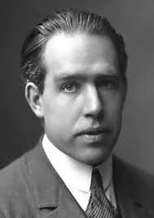
Unit 3: A World of Particles—An Atom & Its Components
3.1
Aim: How has the model of the atom
evolved over time?
Neils bohr—model #4
Why could Bohr’s model be called a planetary model of the atom?
How do electrons in the same atom differ?
How many electrons can the fourth energy level hold?
Would an electron have to absorb or release energy to jump from the second energy level to the third energy level?
For an electron to fall from the third energy level to the second energy level, it must ________________________ energy.
Do Now
Introduction
Mini-Lesson
Summary
Work Period
Exit Slip

Slide 15
Unit 3: A World of Particles—An Atom & Its Components
3.1
Aim: How has the model of the atom
evolved over time?
quantum mechanical—model #5
According to this theory, electrons are both ______________ and __________.
What is an electron cloud? ___________________________________________.
What are orbitals? __________________________________________________.
Where are we most likely to find electrons? _____________________________
Where are we least likely? _______________________________________
Do Now
Introduction
Mini-Lesson
Summary
Work Period
Exit Slip

Slide 16
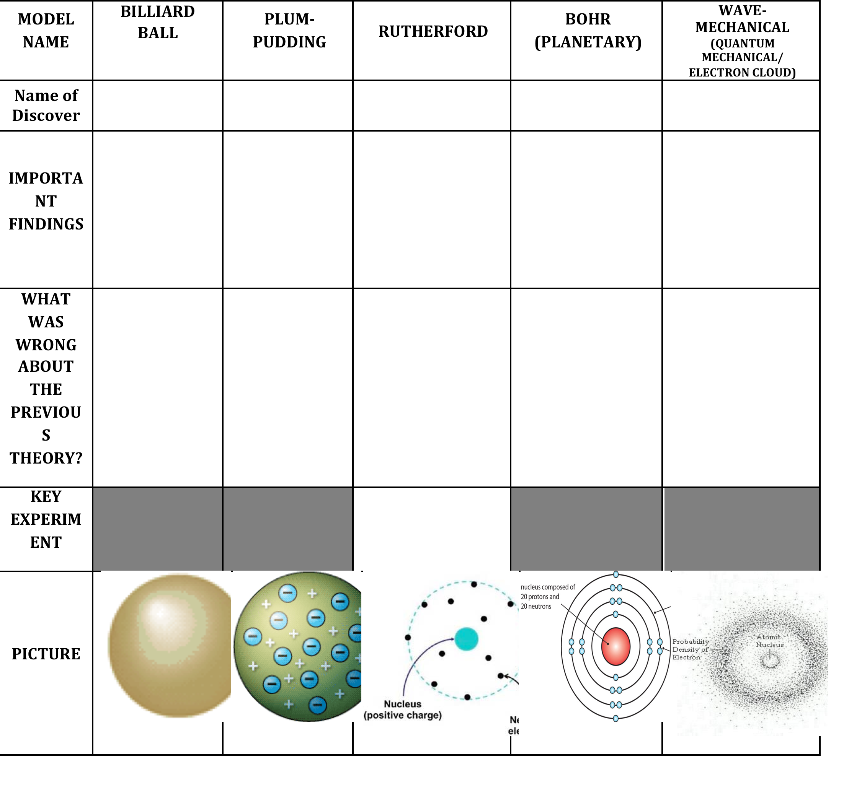
Unit 3: Matter & Energy—It All Matters
3.16
Aim: How is temperature, volume and pressure of a gas related to each other?
Do Now
Introduction
Mini-Lesson
Summary
Work Period
Exit Slip

Slide 17
Unit 3: A World of Particles—An Atom & Its Components
3.1
Aim: How has the model of the atom
evolved over time?
What does this cartoon mean?
Do Now
Introduction
Mini-Lesson
Summary
Work Period
Exit Slip

Slide 18
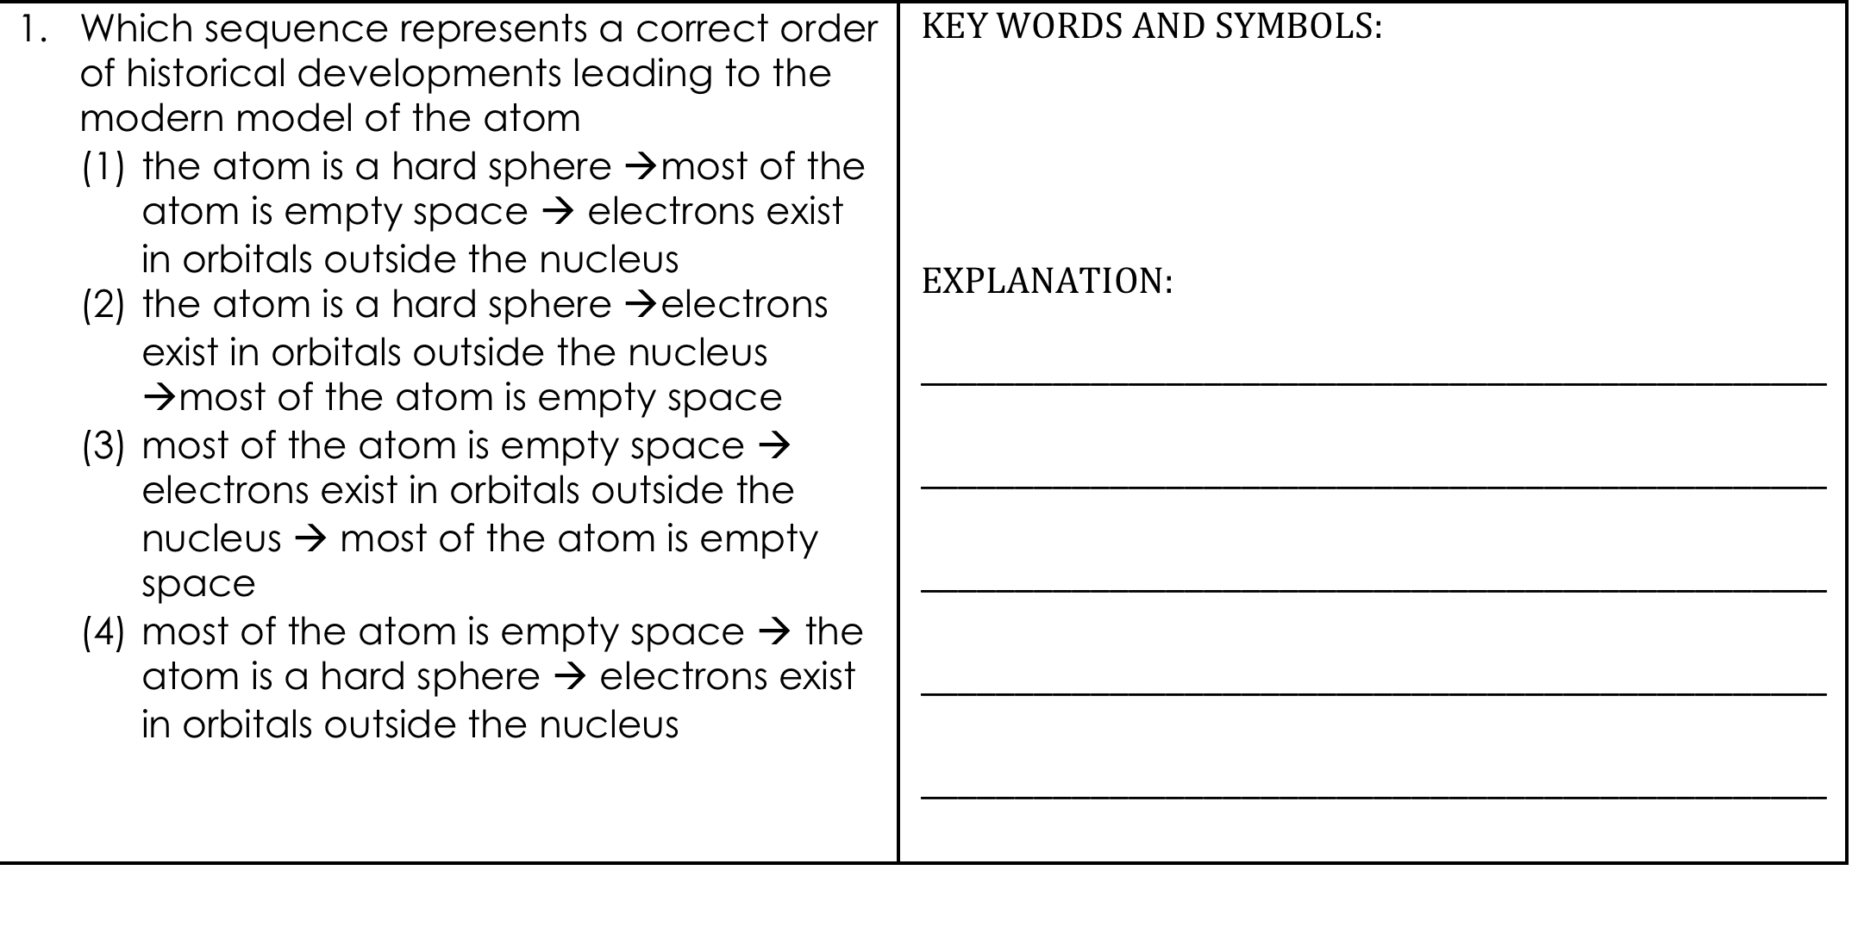
Unit 3: A World of Particles—An Atom & Its Components
3.1
Aim: How has the model of the atom
evolved over time?
Sample question #1
Do Now
Introduction
Mini-Lesson
Summary
Work Period
Exit Slip

Slide 19
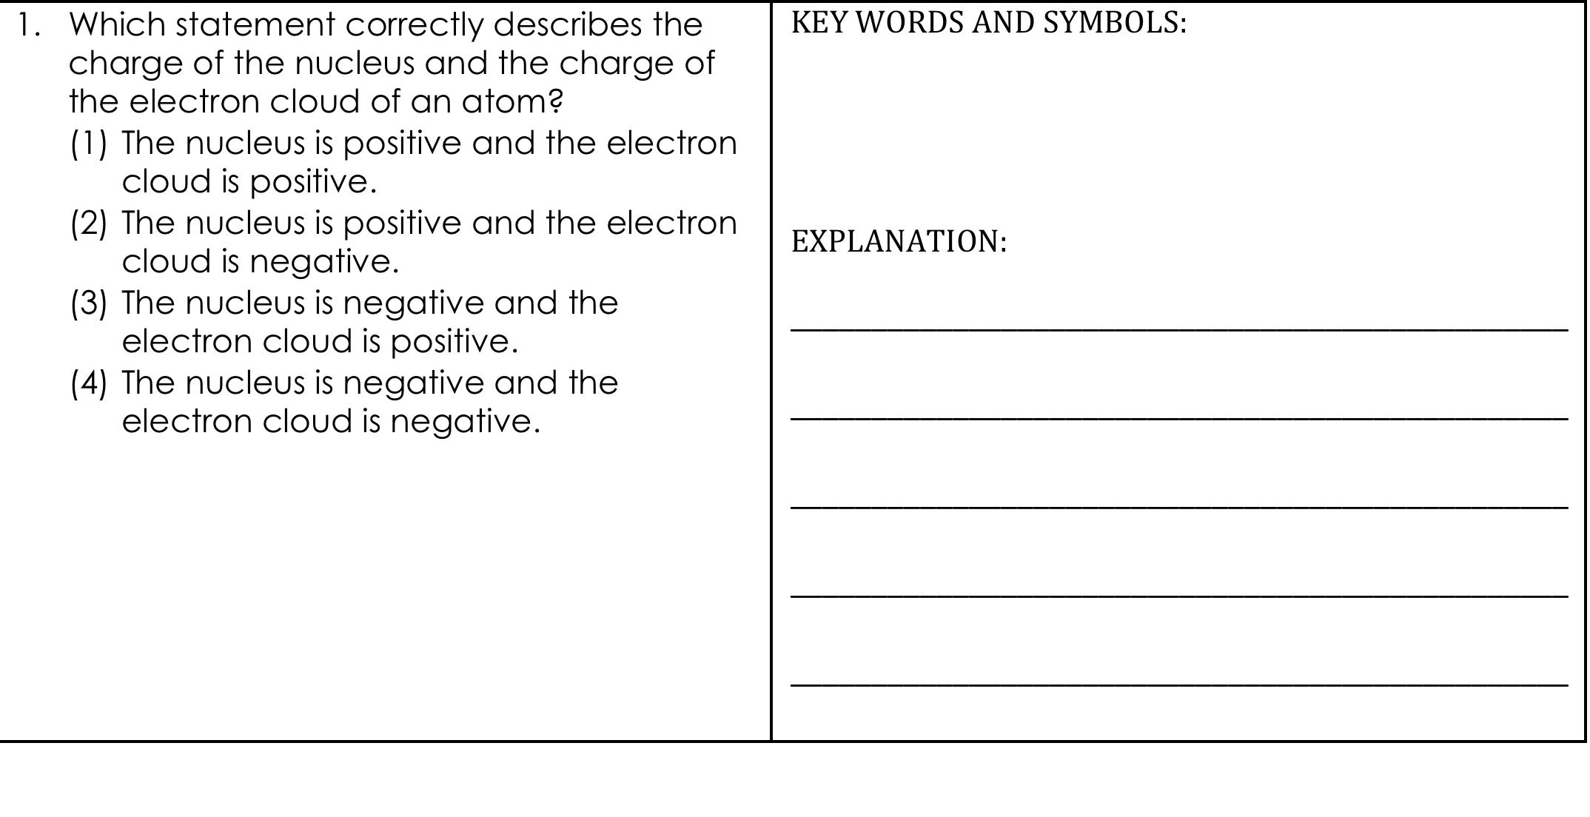
Unit 3: A World of Particles—An Atom & Its Components
3.1
Aim: How has the model of the atom
evolved over time?
Sample question #2
Do Now
Introduction
Mini-Lesson
Summary
Work Period
Exit Slip

Slide 20
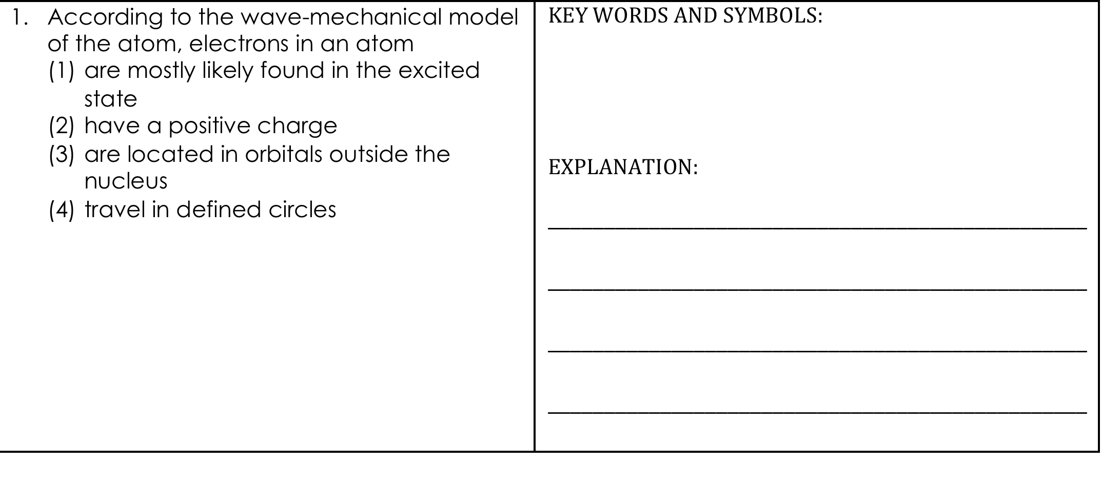
Unit 3: A World of Particles—An Atom & Its Components
3.1
Aim: How has the model of the atom
evolved over time?
Sample question #3
Do Now
Introduction
Mini-Lesson
Summary
Work Period
Exit Slip

Slide 21
Unit 3: A World of Particles—An Atom & Its Components
3.1
Aim: How has the model of the atom
evolved over time?
Work period
Complete pages 7-8
Do Now
Introduction
Mini-Lesson
Summary
Work Period
Exit Slip

Slide 22
Unit 3: A World of Particles—An Atom & Its Components
3.1
Aim: How has the model of the atom
evolved over time?
HOMEWORK:
Complete rest of 3.1
in the packet for homework
Do Now
Introduction
Mini-Lesson
Summary
Work Period
Exit Slip

Slide 23
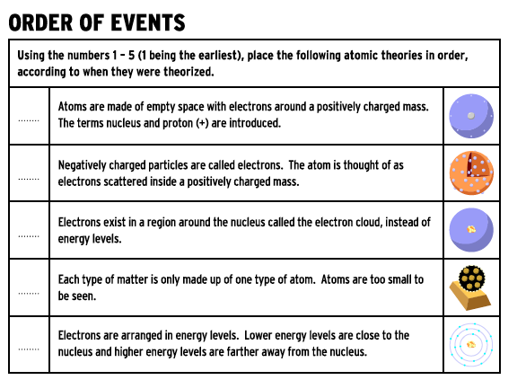
Unit 3: A World of Particles—An Atom & Its Components
3.1
Aim: How has the model of the atom
evolved over time?
Exit Slip
Make sure you get your trackers checked!
Do Now
Introduction
Mini-Lesson
Summary
Work Period
Exit Slip

