Slide 1


Unit 3: A World of Particles—An Atom & Its Components
3.2
Aim: How did the gold-foil experiment lead to the modern model of the atom?
Objective:
I will analyze how the gold-foil experiment led to the modern model of the atom.
AGENDA
Do Now
Introduction
Mini-Lesson
Summary
Work Period
DO NOW:
Complete Do Now slip
You have 5 minutes
Exit Slip

Slide 2
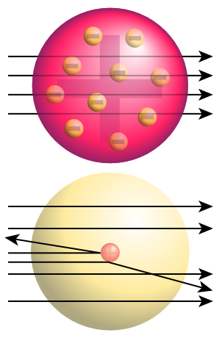
Unit 3: A World of Particles—An Atom & Its Components
3.2
Aim: How did the gold-foil experiment lead to the modern model of the atom?
Real-world connection
“acceptance of unknown”
Vocabulary
Rutherford’s gold foil experiment, alpha particles, deflected
AGENDA
Do Now
Introduction
Mini-Lesson
Summary
Work Period
Exit Slip

Slide 3
Unit 3: A World of Particles—An Atom & Its Components
3.2
Aim: How did the gold-foil experiment lead to the modern model of the atom?
ANNOUNCEMENTS
Test reflections for Exam 2 is due Thursday
AGENDA
Do Now
Introduction
Mini-Lesson
Summary
Work Period
Exit Slip

Slide 4
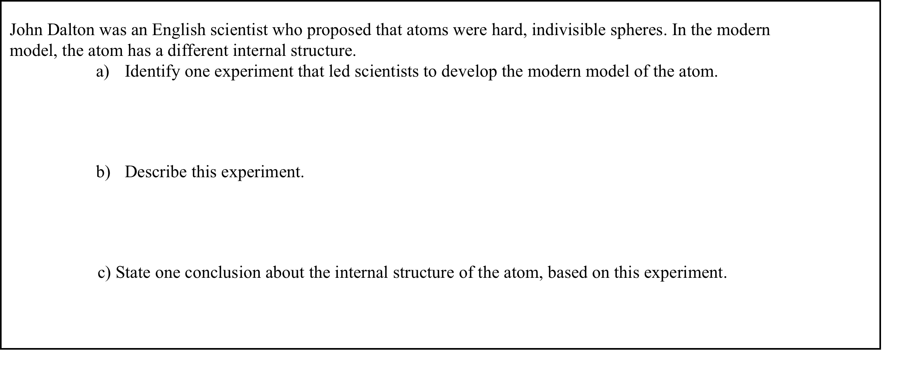
Unit 3: A World of Particles—An Atom & Its Components
3.2
Aim: How did the gold-foil experiment lead to the modern model of the atom?
Do now
AGENDA
Do Now
Introduction
Mini-Lesson
Summary
Work Period
Exit Slip

Slide 5
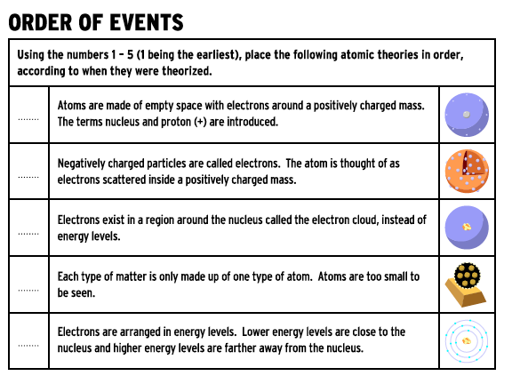
Unit 3: A World of Particles—An Atom & Its Components
3.2
Aim: How did the gold-foil experiment lead to the modern model of the atom?
Do now
AGENDA
Do Now
Introduction
Mini-Lesson
Summary
Work Period
Exit Slip

Slide 6
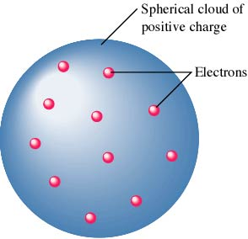
Unit 3: A World of Particles—An Atom & Its Components
3.2
Aim: How did the gold-foil experiment lead to the modern model of the atom?
Plum pudding model
“Plum Pudding” model (I guess you have to be in England to understand)—or chocolate chip cookie!
Do Now
Introduction
Mini-Lesson
Summary
Work Period
Exit Slip

Slide 7
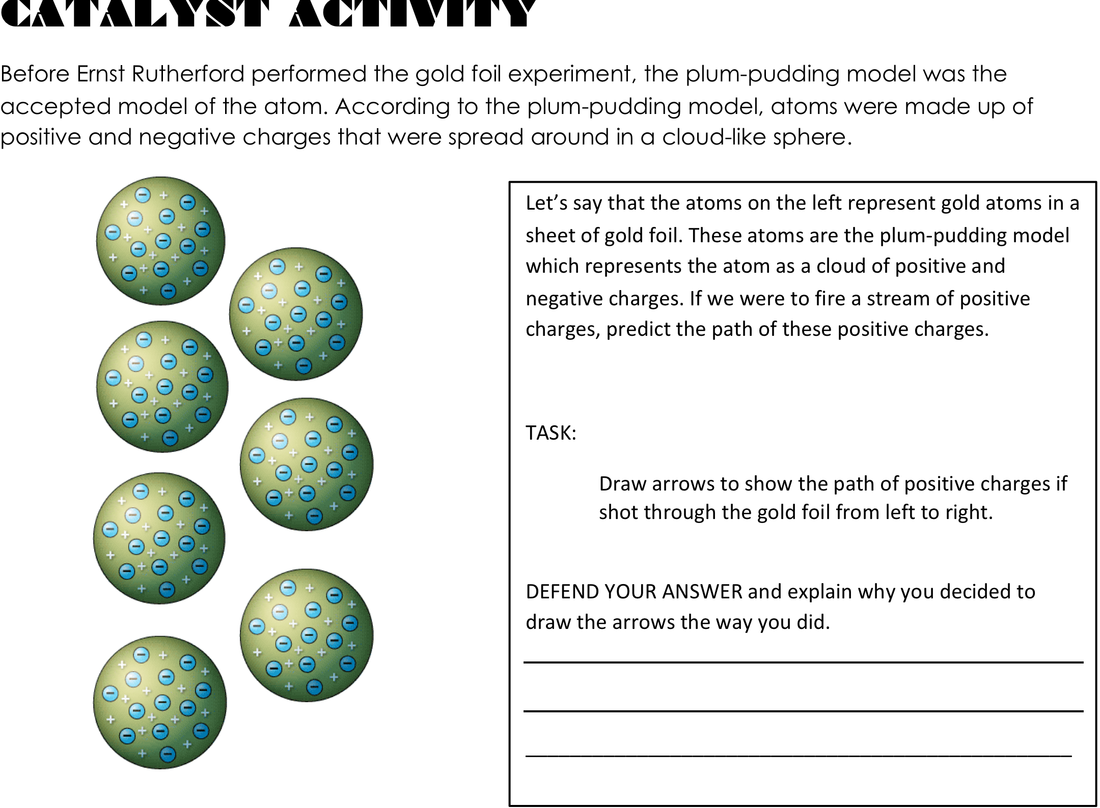
Unit 3: A World of Particles—An Atom & Its Components
3.2
Aim: How did the gold-foil experiment lead to the modern model of the atom?
Think…ink
(on your own for 2 minutes)
Do Now
Introduction
Mini-Lesson
Summary
Work Period
Exit Slip

Slide 8
Unit 3: A World of Particles—An Atom & Its Components
3.2
Aim: How did the gold-foil experiment lead to the modern model of the atom?
Pair share (with a partner for 1 minute)
Do Now
Introduction
Mini-Lesson
Summary
Work Period
Exit Slip

Slide 9
Fluorescent
Screen
Lead block
Uranium
Gold Foil

Slide 10
What he predicted if plum pudding was correct
Explanation:

Slide 11
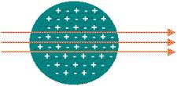
Unit 3: A World of Particles—An Atom & Its Components
3.2
Aim: How did the gold-foil experiment lead to the modern model of the atom?
Think…ink…PAIR…SHARE
Prediction if the Plum-Pudding model of the atom were true. EXPLAIN
Do Now
Introduction
Mini-Lesson
Summary
Work Period
Exit Slip

Slide 12
Answer: Because, he thought the mass was evenly distributed in the atom

Slide 13
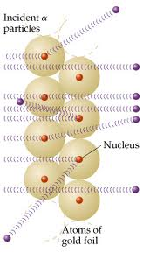
Unit 3: A World of Particles—An Atom & Its Components
3.2
Aim: How did the gold-foil experiment lead to the modern model of the atom?
Think ink…
PAIR SHARE
What actually happened?
Why is this the case?
Do Now
Introduction
Mini-Lesson
Summary
Work Period
Exit Slip

Slide 14
What he got
Explanation:

Slide 15

Unit 3: A World of Particles—An Atom & Its Components
3.2
Aim: How did the gold-foil experiment lead to the modern model of the atom?
Conclusion vs. evidence
Scenario: Courtney looked out the window. He noticed people wearing heavy coats. He said, “Darn, it must be really cold outside.” He decided to wear a heavy coat himself.
What conclusion did he make?
What was the evidence of the conclusion?
How can we distinguish between the terms?
What is the relationship
between these words?
Do Now
Introduction
Mini-Lesson
Summary
Work Period
Exit Slip

Slide 16
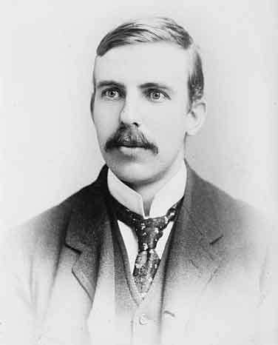
Unit 3: A World of Particles—An Atom & Its Components
3.2
Aim: How did the gold-foil experiment lead to the modern model of the atom?
Rutherford concluded
1. What are two conclusions he made?
(Revisit reading from yesterday)
2. What evidence led to each of these conclusions?
(Revisit reading from yesterday)
Do Now
Introduction
Mini-Lesson
Summary
Work Period
Exit Slip

Slide 17
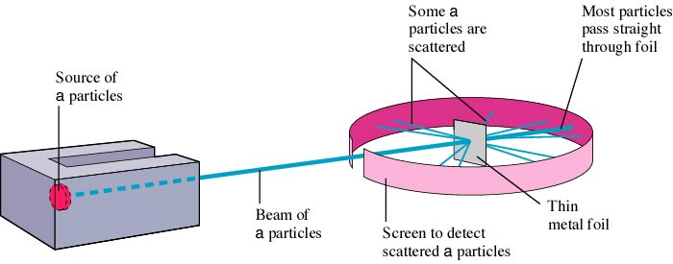
Unit 3: A World of Particles—An Atom & Its Components
3.2
Aim: How did the gold-foil experiment lead to the modern model of the atom?
summary
Summarize Rutherford’s experiment using the following image as a guide. Give me three major points!
Do Now
Introduction
Mini-Lesson
Summary
Work Period
Exit Slip

Slide 18
Unit 3: A World of Particles—An Atom & Its Components
3.2
Aim: How did the gold-foil experiment lead to the modern model of the atom?
The gold-foil experiment led scientists to conclude that an atom’s
Positive charge is evenly spread throughout its volume
Negative charge is mainly concentrated in its nucleus
Mass is evenly spread throughout its volume
Volume is mainly empty space
Sample question #1 (pg. 11)
Do Now
Introduction
Mini-Lesson
Summary
Work Period
Exit Slip

Slide 19
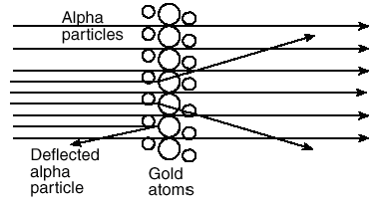
Unit 3: A World of Particles—An Atom & Its Components
3.2
Aim: How did the gold-foil experiment lead to the modern model of the atom?
Sample question #2 (pg. 12)
Most of the alpha particles passed directly through the gold atoms undisturbed. What evidence does this suggest about the structure of gold atoms?
A few of the alpha particles were deflected. What does this evidence suggest about the structure of the gold atoms?
How should the original model be revised based on the results of this experiment?
Do Now
Introduction
Mini-Lesson
Summary
Work Period
Exit Slip

Slide 20
Unit 3: A World of Particles—An Atom & Its Components
3.2
Aim: How did the gold-foil experiment lead to the modern model of the atom?
Work period
Complete pages 11-12
Do Now
Introduction
Mini-Lesson
Summary
Work Period
Exit Slip

Slide 21
Unit 3: A World of Particles—An Atom & Its Components
3.2
Aim: How did the gold-foil experiment lead to the modern model of the atom?
HOMEWORK:
Complete rest of 3.2
in the packet for homework
Do Now
Introduction
Mini-Lesson
Summary
Work Period
Exit Slip

Slide 22
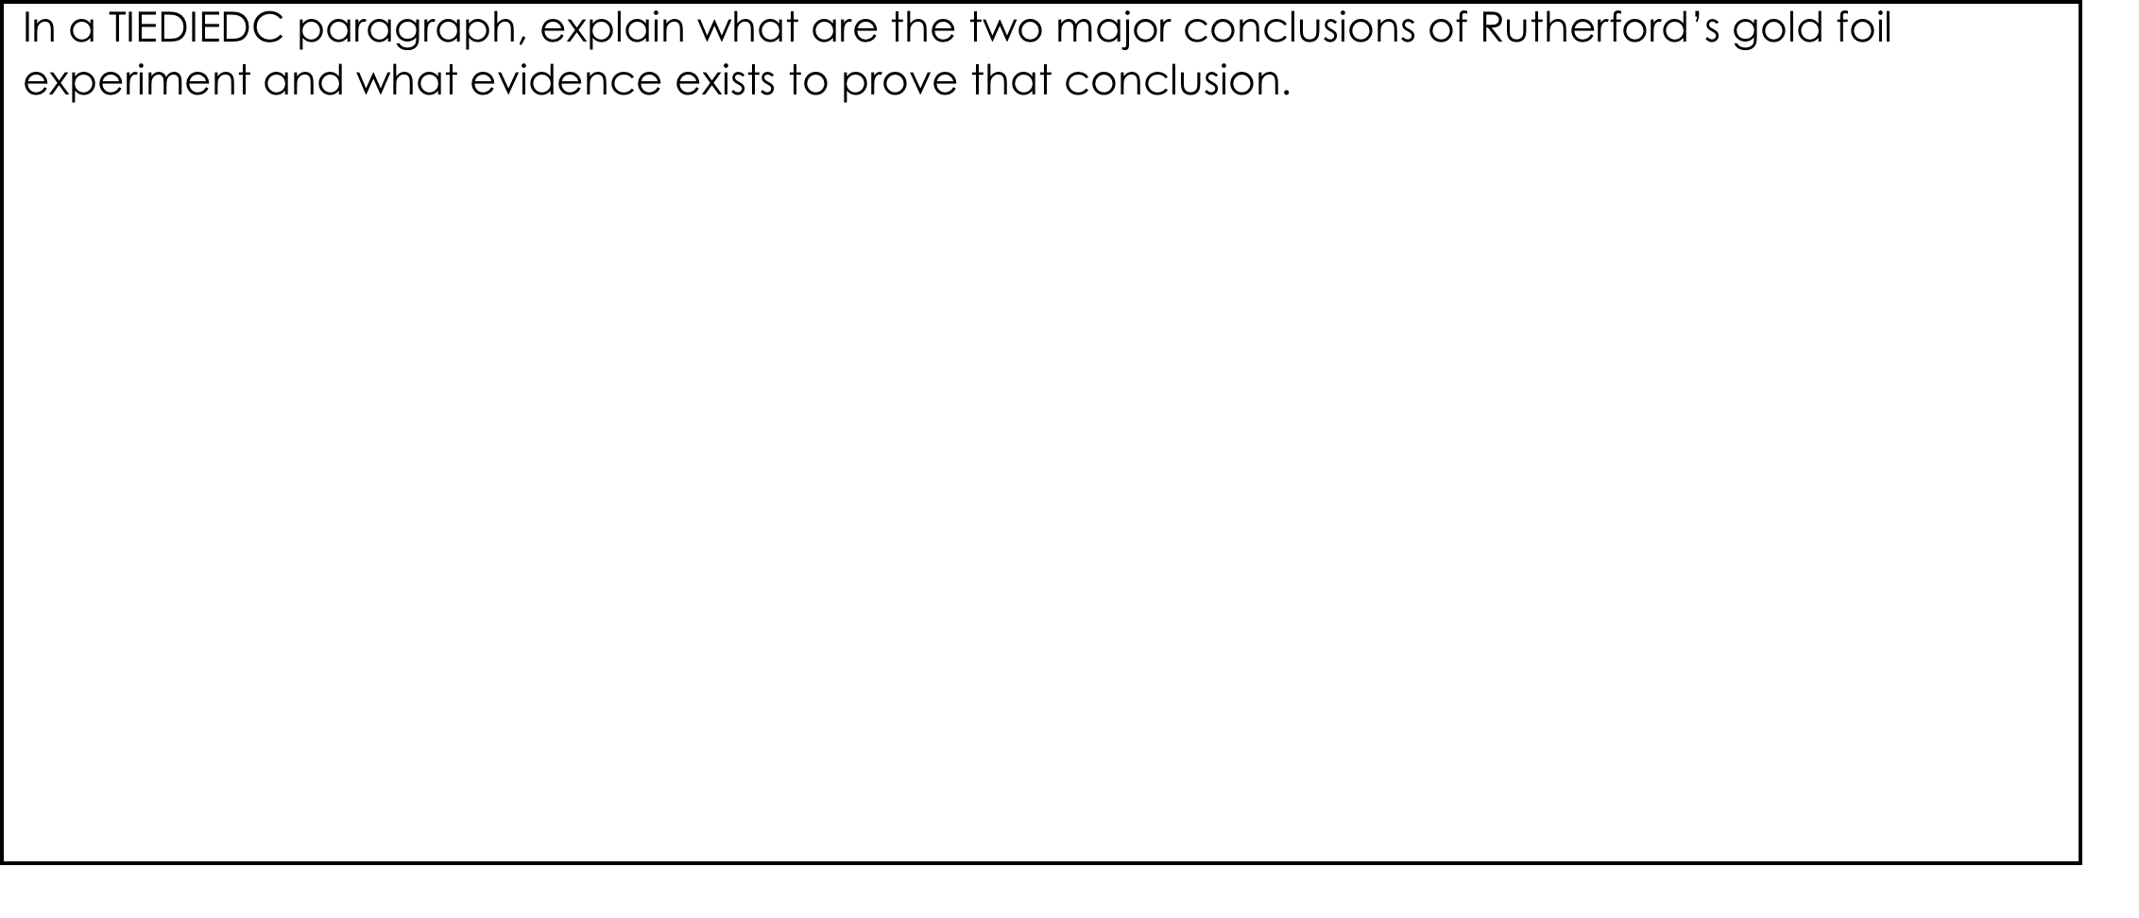
Unit 3: A World of Particles—An Atom & Its Components
3.2
Aim: How did the gold-foil experiment lead to the modern model of the atom?
Exit Slip
Make sure you get your trackers checked!
Do Now
Introduction
Mini-Lesson
Summary
Work Period
Exit Slip

