Slide 1
Unit 3: A World of Particles—An Atom & Its Components
3.3
Aim: What is the basic structure of the atom?
Objective:
I will analyze the basic structure of the atom.
AGENDA
Do Now
Introduction
Mini-Lesson
Summary
Work Period
DO NOW:
Complete Do Now slip
You have 5 minutes
Exit Slip

Slide 2
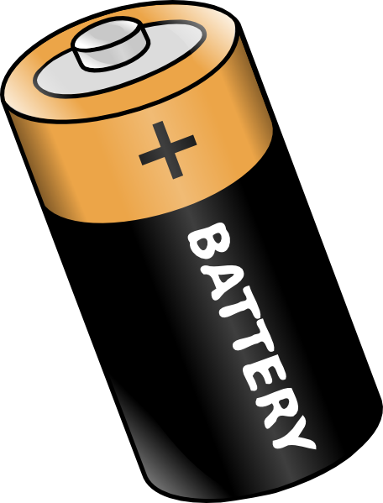
Unit 3: A World of Particles—An Atom & Its Components
3.3
Aim: What is the basic structure of the atom?
Real-world connection
Batteries; magnetism
Vocabulary
Atom, subatomic particles, protons, neutrons, electrons, nucleon, nuclide
AGENDA
Do Now
Introduction
Mini-Lesson
Summary
Work Period
Exit Slip

Slide 3
Unit 3: A World of Particles—An Atom & Its Components
3.3
Aim: What is the basic structure of the atom?
ANNOUNCEMENTS
Test reflections for Exam 2 is due Thursday
AGENDA
Do Now
Introduction
Mini-Lesson
Summary
Work Period
Exit Slip

Slide 4
Unit 3: A World of Particles—An Atom & Its Components
3.3
Aim: What is the basic structure of the atom?
Do now
AGENDA
Do Now
Introduction
Mini-Lesson
Summary
Work Period
Exit Slip

Slide 5
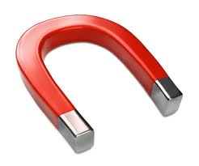
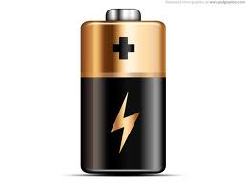
Unit 3: A World of Particles—An Atom & Its Components
3.3
Aim: What is the basic structure of the atom?
Think ink…pair share
Why is a battery labeled with a + and -?
How does magnetism work?
Do Now
Introduction
Mini-Lesson
Summary
Work Period
Exit Slip

Slide 6
Unit 3: A World of Particles—An Atom & Its Components
3.3
Aim: What is the basic structure of the atom?
Brain pop video
3 Things You Learned
2 Questions You Have
1 Wondering
LINK:https://www.brainpop.com/science/matterandchemistry/atoms/
Do Now
Introduction
Mini-Lesson
Summary
Work Period
Exit Slip

Slide 7
Unit 3: A World of Particles—An Atom & Its Components
3.3
Aim: What is the basic structure of the atom?
QUESTION STEMS
How come ____________?
Why did ______________?
What would happen if _____________?
How is _______ related to ________?
Do Now
Introduction
Mini-Lesson
Summary
Work Period
Exit Slip

Slide 8
Unit 3: A World of Particles—An Atom & Its Components
3.3
Aim: What is the basic structure of the atom?
Subatomic particle
How would you define a subatomic particle?
Do Now
Introduction
Mini-Lesson
Summary
Work Period
Exit Slip

Slide 9
Unit 3: A World of Particles—An Atom & Its Components
3.3
Aim: What is the basic structure of the atom?
Subatomic particle
Particles that make up an atom; they are smaller than an atom
Do Now
Introduction
Mini-Lesson
Summary
Work Period
Exit Slip

Slide 10
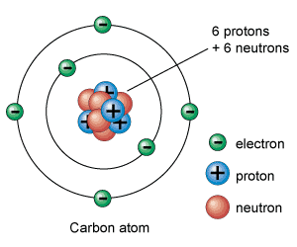
Unit 3: A World of Particles—An Atom & Its Components
3.3
Aim: What is the basic structure of the atom?
The 3 subatomic particles of an atom are:
Protons
Neutrons
electrons
Do Now
Introduction
Mini-Lesson
Summary
Work Period
Exit Slip

Slide 11
Unit 3: A World of Particles—An Atom & Its Components
3.3
Aim: What is the basic structure of the atom?
Subatomic particle
(Annotate article and use it to fill out the chart)
Do Now
Introduction
Mini-Lesson
Summary
Work Period
Exit Slip

Slide 12
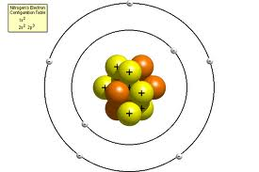
Unit 3: A World of Particles—An Atom & Its Components
3.3
Aim: What is the basic structure of the atom?
Protons
Symbol: p or p+
Size: 1 amu
Location: nucleus
Charge: positive (+1)
Do Now
Introduction
Mini-Lesson
Summary
Work Period
Exit Slip

Slide 13
Unit 3: A World of Particles—An Atom & Its Components
3.3
Aim: What is the basic structure of the atom?
Neutrons
Symbol: n or n⁰
Size: 1 amu
Location: nucleus
Charge: neutral (0)
Do Now
Introduction
Mini-Lesson
Summary
Work Period
Exit Slip

Slide 14
Unit 3: A World of Particles—An Atom & Its Components
3.3
Aim: What is the basic structure of the atom?
Electrons
Symbol: e or e⁻
Size: 1/1836 amu
Location: around the nucleus
Charge: negative (-1)
Do Now
Introduction
Mini-Lesson
Summary
Work Period
Exit Slip

Slide 15
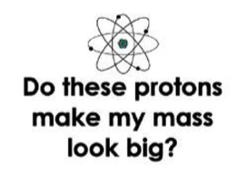
Unit 3: A World of Particles—An Atom & Its Components
3.3
Aim: What is the basic structure of the atom?
JOKE: What does this mean?
Do Now
Introduction
Mini-Lesson
Summary
Work Period
Exit Slip

Slide 16
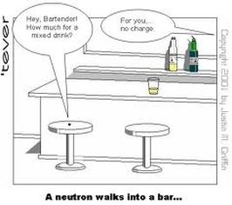
Unit 3: A World of Particles—An Atom & Its Components
3.3
Aim: What is the basic structure of the atom?
What does this mean?:
TURN & TALK
Do Now
Introduction
Mini-Lesson
Summary
Work Period
Exit Slip

Slide 17
Unit 3: A World of Particles—An Atom & Its Components
3.3
Aim: What is the basic structure of the atom?
Do Now
Introduction
Mini-Lesson
Summary
Work Period
Exit Slip

Slide 18
Unit 3: A World of Particles—An Atom & Its Components
3.3
Aim: What is the basic structure of the atom?
What is an atom’s overall charge?
Why is that?
Think INK…PAIR SHARE
Do Now
Introduction
Mini-Lesson
Summary
Work Period
Exit Slip

Slide 19
Unit 3: A World of Particles—An Atom & Its Components
3.3
Aim: What is the basic structure of the atom?
Sample question #1
Which total mass is the smallest?
(1) the mass of 2 electrons
(2) the mass of 2 neutrons
(3) the mass of 1 electron plus the mass of 1 proton
(4) the mass of 1 neutron plus the mass of 1 electron
Let’s solve each multiple choice answer:
____________________________________
____________________________________
____________________________________
____________________________________
Do Now
Introduction
Mini-Lesson
Summary
Work Period
Exit Slip

Slide 20
Unit 3: A World of Particles—An Atom & Its Components
3.3
Aim: What is the basic structure of the atom?
Sample question #2
Base your answers on the information below:
In the modern model of the atom, each atom is composed of three major subatomic (or fundamental) particles.
Name the subatomic particles contained in the nucleus of the atom
State the charge associated with each type of subatomic particle contained in the nucleus of the atom.
What is the net charge of the nucleus?
Do Now
Introduction
Mini-Lesson
Summary
Work Period
Exit Slip

Slide 21
Unit 3: A World of Particles—An Atom & Its Components
3.3
Aim: What is the basic structure of the atom?
Work period
Complete pages 18-19
Do Now
Introduction
Mini-Lesson
Summary
Work Period
Exit Slip

Slide 22
Unit 3: A World of Particles—An Atom & Its Components
3.3
Aim: What is the basic structure of the atom?
HOMEWORK:
Complete rest of 3.3
in the packet for homework
Do Now
Introduction
Mini-Lesson
Summary
Work Period
Exit Slip

Slide 23
Unit 3: A World of Particles—An Atom & Its Components
3.3
Aim: How did the gold-foil experiment lead to the modern model of the atom?
Exit Slip
Make sure you get your trackers checked!
Do Now
Introduction
Mini-Lesson
Summary
Work Period
Exit Slip

