Slide 1
Unit 3: A World of Particles—An Atom & Its Components
3.5
Aim: How can atoms of the
same element be different?
Objective:
I will analyze how isotopes of the same element are similar & different from each other.
AGENDA
Do Now
Introduction
Mini-Lesson
Summary
Work Period
DO NOW:
Complete Do Now slip
You have 5 minutes
Exit Slip

Slide 2
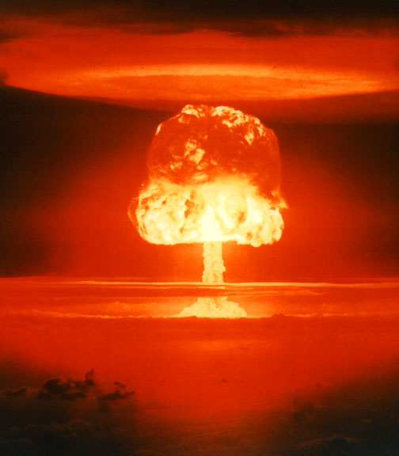
Unit 3: A World of Particles—An Atom & Its Components
3.5
Aim: How can atoms of the
same element be different?
Real-world connection
Hydrogen bomb, radioactive element vs. stable element used to backtrack age
Vocabulary
Isotope, hyphen notation, nuclear notation
AGENDA
Do Now
Introduction
Mini-Lesson
Summary
Work Period
Exit Slip

Slide 3
Unit 3: A World of Particles—An Atom & Its Components
3.5
Aim: How can atoms of the
same element be different?
ANNOUNCEMENTS
Packet #7 is due this Friday
Packet #6 and Lab #6 WAY PAST DUE
Quiz on Packet 7 on Friday
AGENDA
Do Now
Introduction
Mini-Lesson
Summary
Work Period
Exit Slip

Slide 4
Unit 3: A World of Particles—An Atom & Its Components
3.5
Aim: How can atoms of the
same element be different?
Do now
AGENDA
Do Now
Introduction
Mini-Lesson
Summary
Work Period
Exit Slip

Slide 5
Unit 3: A World of Particles—An Atom & Its Components
3.5
Aim: How can atoms of the
same element be different?
Think ink…pair share
How are twins similar to each other?
How are they different from each other?
Do Now
Introduction
Mini-Lesson
Summary
Work Period
Exit Slip

Slide 6
Unit 3: A World of Particles—An Atom & Its Components
3.5
Aim: How can atoms of the
same element be different?
Brain pop video
3 Things You Learned
2 Questions You Have
1 Wondering
LINK: https://www.brainpop.com/science/matterandchemistry/isotopes/
Do Now
Introduction
Mini-Lesson
Summary
Work Period
Exit Slip

Slide 7
Unit 3: A World of Particles—An Atom & Its Components
3.5
Aim: How can atoms of the
same element be different?
QUESTION STEMS
How come ____________?
Why did ______________?
What would happen if _____________?
How is _______ related to ________?
Do Now
Introduction
Mini-Lesson
Summary
Work Period
Exit Slip

Slide 8
Unit 3: A World of Particles—An Atom & Its Components
3.5
Aim: How can atoms of the
same element be different?
Think ink…pair share
How can two atoms of the same element have different number of neutrons?
Do Now
Introduction
Mini-Lesson
Summary
Work Period
Exit Slip

Slide 9
Unit 3: A World of Particles—An Atom & Its Components
3.5
Aim: How can atoms of the
same element be different?
Isotopes are like twins:
ISOTOPE: Different versions of the same atom/element
THINK:
Twins can weigh differently.
One twin more popular than another.
Do Now
Introduction
Mini-Lesson
Summary
Work Period
Exit Slip

Slide 10
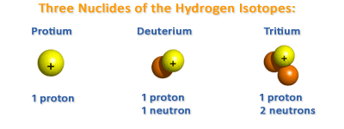
Unit 3: A World of Particles—An Atom & Its Components
3.5
Aim: How can atoms of the
same element be different?
Example: hydrogen
Write down similarities & differences in your chart.
Do Now
Introduction
Mini-Lesson
Summary
Work Period
Exit Slip

Slide 11
Unit 3: A World of Particles—An Atom & Its Components
3.5
Aim: How can atoms of the
same element be different?
Isotope notation
Do Now
Introduction
Mini-Lesson
Summary
Work Period
Exit Slip

Slide 12
Unit 3: A World of Particles—An Atom & Its Components
3.5
Aim: How can atoms of the
same element be different?
Do Now
Introduction
Mini-Lesson
Summary
Work Period
Exit Slip

Slide 13
Unit 3: A World of Particles—An Atom & Its Components
3.5
Aim: How can atoms of the
same element be different?
Steps to figuring out the number of neutrons in an isotope:
Determine the number mass number and the atomic number of the isotope.
Example: Carbon-13
What is the mass number? ______
What is the atomic number? _______
Subtract the number mass number from the atomic number to get the number of neutrons.
Example: Carbon-13
What is the number of neutrons? _______
Do Now
Introduction
Mini-Lesson
Summary
Work Period
Exit Slip

Slide 14
Unit 3: A World of Particles—An Atom & Its Components
3.5
Aim: How can atoms of the
same element be different?
Examples: isotopes of oxygen
Do Now
Introduction
Mini-Lesson
Summary
Work Period
Exit Slip

Slide 15
Unit 3: A World of Particles—An Atom & Its Components
3.5
Aim: How can atoms of the
same element be different?
You try: isotopes of potassium
Do Now
Introduction
Mini-Lesson
Summary
Work Period
Exit Slip

Slide 16
Sample question
Do Now
Introduction
Mini-Lesson
Summary
Work Period
Exit Slip

Slide 17
Unit 3: A World of Particles—An Atom & Its Components
3.5
Aim: How can atoms of the
same element be different?
Work period
Complete pages 32-34
Do Now
Introduction
Mini-Lesson
Summary
Work Period
Exit Slip

Slide 18
Unit 3: A World of Particles—An Atom & Its Components
3.5
Aim: How can atoms of the
same element be different?
HOMEWORK:
Complete rest of 3.5
in the packet for homework
Do Now
Introduction
Mini-Lesson
Summary
Work Period
Exit Slip

Slide 19
Unit 3: A World of Particles—An Atom & Its Components
3.5
Aim: How can atoms of the
same element be different?
Exit Slip
Make sure you get your trackers checked!
Do Now
Introduction
Mini-Lesson
Summary
Work Period
Exit Slip

