Slide 1
Unit 3: A World of Particles—An Atom & Its Components
3.8
Aim: How can I represent the
valence electrons of elements?
Objective:
I will be able to draw the
Lewis Dot structures of elements.
AGENDA
Do Now
Introduction
Mini-Lesson
Summary
Work Period
DO NOW:
Complete Do Now slip
You have 5 minutes
Exit Slip

Slide 2
Unit 3: A World of Particles—An Atom & Its Components
3.8
Aim: How can I represent the
valence electrons of elements?
Real-world connection
Symbols, representation, chemical reactions
Vocabulary
Lewis Dot structure, valence electrons, electron configuration
AGENDA
Do Now
Introduction
Mini-Lesson
Summary
Work Period
Exit Slip

Slide 3
Unit 3: A World of Particles—An Atom & Its Components
3.8
Aim: How can I represent the
valence electrons of elements?
ANNOUNCEMENTS
Unit 3 Exam—Fri 1/23/15
Review Packet due Fri 1/23/15
AGENDA
Do Now
Introduction
Mini-Lesson
Summary
Work Period
Exit Slip

Slide 4
Unit 3: A World of Particles—An Atom & Its Components
3.8
Aim: How can I represent the
valence electrons of elements?
Do now
AGENDA
Do Now
Introduction
Mini-Lesson
Summary
Work Period
Exit Slip

Slide 5
Unit 3: A World of Particles—An Atom & Its Components
3.8
Aim: How can I represent the
valence electrons of elements?
Valence electrons
Do Now
Introduction
Mini-Lesson
Summary
Work Period
Exit Slip

Slide 6
Unit 3: A World of Particles—An Atom & Its Components
3.8
Aim: How can I represent the
valence electrons of elements?
Try it!
Try it on your own!
Directions: Find the electron configuration for the following elements. Circle the valence electrons.
1. Magnesium: ______________
2. Potassium: _______________
3. Xenon: ________________
4. Calcium: ______________
Do Now
Introduction
Mini-Lesson
Summary
Work Period
Exit Slip

Slide 7
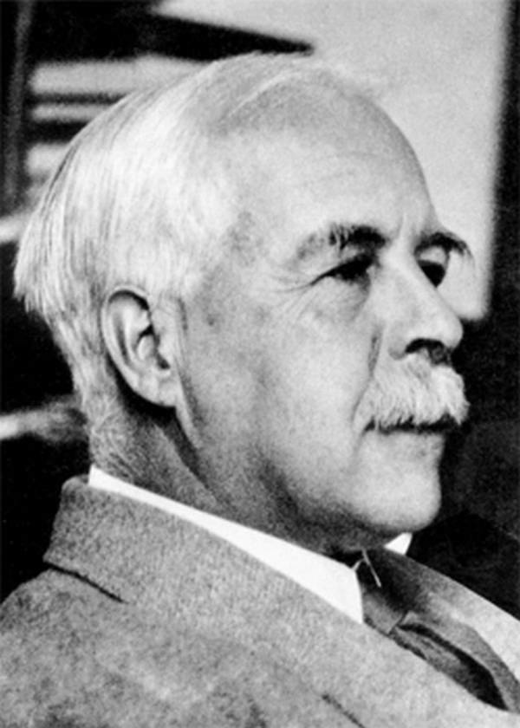
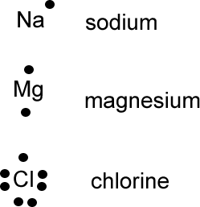
Unit 3: A World of Particles—An Atom & Its Components
3.8
Aim: How can I represent the
valence electrons of elements?
Lewis dot diagram
History:
1920: G.N. Lewis (American chemist) came up w/ system to represent the valence electrons of an atom.
Lewis Dot Structure: diagram to represent the valence electron arrangement in elements and compounds
Do Now
Introduction
Mini-Lesson
Summary
Work Period
Exit Slip

Slide 8
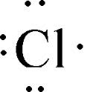
Unit 3: A World of Particles—An Atom & Its Components
3.8
Aim: How can I represent the
valence electrons of elements?
Lewis dot diagram
What is the electron configuration for Cl? _________________
How many valence electrons does it have? _________________
Each dot represents a valence electron.
Do Now
Introduction
Mini-Lesson
Summary
Work Period
Exit Slip

Slide 9
Unit 3: A World of Particles—An Atom & Its Components
3.8
Aim: How can I represent the
valence electrons of elements?
Lewis dot diagram
Steps:
Write symbol of element
Find out number of valence electrons
Draw a dot representing each valence electron. (NOTE: Draw a dot on each side of the valence electron first before you start to pair up.)
NOTES:
A. Cannot have no more than 2 on any side of symbol
B. No more than 8 dots in total
Example: 1) Be 2) F
Do Now
Introduction
Mini-Lesson
Summary
Work Period
Exit Slip

Slide 10
Unit 3: A World of Particles—An Atom & Its Components
3.8
Aim: How can I represent the
valence electrons of elements?
Work period
Complete pages 19-20
Do Now
Introduction
Mini-Lesson
Summary
Work Period
Exit Slip

Slide 11
Unit 3: A World of Particles—An Atom & Its Components
3.8
Aim: How can I represent the
valence electrons of elements?
HOMEWORK:
Complete rest of 3.8
in the packet for homework
Do Now
Introduction
Mini-Lesson
Summary
Work Period
Exit Slip

Slide 12
Unit 3: A World of Particles—An Atom & Its Components
3.8
Aim: How can I represent the
valence electrons of elements?
Exit Slip
Make sure you get your trackers checked!
Do Now
Introduction
Mini-Lesson
Summary
Work Period
Exit Slip

