Slide 1
Unit 3: A World of Particles—An Atom & Its Components
3.9
Why do certain things release
specific colors of light?
Objective:
I will explain how atomic emission spectra works and identify element based on its spectrum.
AGENDA
Do Now
Introduction
Mini-Lesson
Summary
Work Period
DO NOW:
Complete Do Now slip
You have 5 minutes
Exit Slip

Slide 2
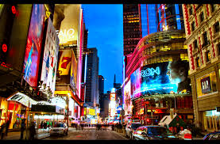
Unit 4: A World of Particles—An Atom & Its Components
3.9
Why do certain things release
specific colors of light?
Real-world connection
Fireworks, laser lights
Vocabulary
Isotope, hyphen notation, nuclear notation
AGENDA
Do Now
Introduction
Mini-Lesson
Summary
Work Period
Exit Slip

Slide 3
Unit 3: A World of Particles—An Atom & Its Components
3.9
Why do certain things release
specific colors of light?
ANNOUNCEMENTS
Unit 3 Exam—Fri 1/23/15
Review Packet due Fri 1/23/15
AGENDA
Do Now
Introduction
Mini-Lesson
Summary
Work Period
Exit Slip

Slide 4
Unit 3: A World of Particles—An Atom & Its Components
3.9
Why do certain things release
specific colors of light?
Do now
AGENDA
Do Now
Introduction
Mini-Lesson
Summary
Work Period
Exit Slip

Slide 5
Unit 3: A World of Particles—An Atom & Its Components
3.9
Why do certain things release
specific colors of light?
How do neon lights works?
Do Now
Introduction
Mini-Lesson
Summary
Work Period
Exit Slip

Slide 6
Unit 3: A World of Particles—An Atom & Its Components
3.9
Why do certain things release
specific colors of light?
Atomic emission spectra
When atoms gain energy, their electrons move to more higher energy levels.
When electrons return back to lower energy levels, electrons lose energy by releasing light
Do Now
Introduction
Mini-Lesson
Summary
Work Period
Exit Slip

Slide 7
Unit 3: A World of Particles—An Atom & Its Components
3.9
Why do certain things release
specific colors of light?
Atomic emission spectra
Energy absorbed by electron moving up = energy lost when moving back down to original level
The amount of energy released when returning from excited state to ground state is different for each element
RESULT: each element has its own atomic emission spectrum
Do Now
Introduction
Mini-Lesson
Summary
Work Period
Exit Slip

Slide 8
Unit 3: A World of Particles—An Atom & Its Components
3.9
Why do certain things release
specific colors of light?
Atomic emission spectra
Lines of light at specific energy levels when electrons go from excited state → ground state (each element has their own spectra and color)
Do Now
Introduction
Mini-Lesson
Summary
Work Period
Exit Slip

Slide 9
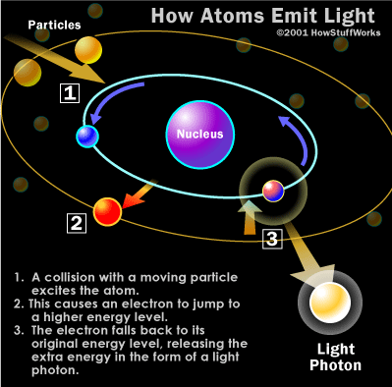
Unit 3: A World of Particles—An Atom & Its Components
3.9
Why do certain things release
specific colors of light?
:
Atomic emission spectra: describe photo
Do Now
Introduction
Mini-Lesson
Summary
Work Period
Exit Slip

Slide 10
Unit 3: A World of Particles—An Atom & Its Components
3.9
Why do certain things release
specific colors of light?
what do different colors of the fireworks represent?
Do Now
Introduction
Mini-Lesson
Summary
Work Period
Exit Slip

Slide 11
Unit 3: A World of Particles—An Atom & Its Components
3.9
Why do certain things release
specific colors of light?
think-ink…pair-share
Why do you think every element produces their unique set of spectral lines?
How are the bright line spectra like a fingerprint?
Do Now
Introduction
Mini-Lesson
Summary
Work Period
Exit Slip

Slide 12
Unit 3: A World of Particles—An Atom & Its Components
3.9
Why do certain things release
specific colors of light?
Sample question
The characteristic bright-line spectrum of an element occurs when electrons
A.) move from lower to higher energy levels
B.) move from higher to lower energy levels
C.) are lost by a neutral atom
D.) are gained by a neutral atom
Do Now
Introduction
Mini-Lesson
Summary
Work Period
Exit Slip

Slide 13
Unit 3: A World of Particles—An Atom & Its Components
3.9
Why do certain things release
specific colors of light?
Sample question
Which of the following quantum leaps would be associated with the greatest energy of emitted light?
A.) n = 5 to n = 1
B.) n = 4 to n = 5
C.) n = 2 to n = 5
D.) n = 5 to n = 4
Which answers make no sense? Why?
Do Now
Introduction
Mini-Lesson
Summary
Work Period
Exit Slip

Slide 14
Unit 3: A World of Particles—An Atom & Its Components
3.9
Why do certain things release
specific colors of light?
Appearance of atomic spectra
Do Now
Introduction
Mini-Lesson
Summary
Work Period
Exit Slip

Slide 15
Unit 3: A World of Particles—An Atom & Its Components
3.9
Why do certain things release
specific colors of light?
Sample question
Explain how a bright-line spectrum is produced, in terms of excited state and ground state.
Do Now
Introduction
Mini-Lesson
Summary
Work Period
Exit Slip

Slide 16
Unit 3: A World of Particles—An Atom & Its Components
3.9
Why do certain things release
specific colors of light?
Appearance of atomic spectra
Do Now
Introduction
Mini-Lesson
Summary
Work Period
Exit Slip

Slide 17
Unit 3: A World of Particles—An Atom & Its Components
3.9
Why do certain things release
specific colors of light?
Work period
Complete pages 25-27
Do Now
Introduction
Mini-Lesson
Summary
Work Period
Exit Slip

Slide 18
Unit 3: A World of Particles—An Atom & Its Components
3.9
Why do certain things release
specific colors of light?
HOMEWORK:
Complete rest of 3.9
in the packet for homework
Do Now
Introduction
Mini-Lesson
Summary
Work Period
Exit Slip

Slide 19
Unit 3: A World of Particles—An Atom & Its Components
3.9
Why do certain things release
specific colors of light?
Exit Slip
Make sure you get your trackers checked!
Do Now
Introduction
Mini-Lesson
Summary
Work Period
Exit Slip

