Slide 1
Unit 4: Cracking the “Chemist’s Code”: The Periodic Table
4.1
How is the periodic table organized?
Objective:
I will analyze the organization of the periodic table by its groups & periods.
AGENDA
Do Now
Introduction
Mini-Lesson
Summary
Work Period
QUIZ:
Complete quiz in the next 10 minutes
Exit Slip

Slide 2
Unit 4: Cracking the “Chemist’s Code”: The Periodic Table
4.1
How is the periodic table organized?
ANNOUNCEMENTS
Unit 3 Exam Results—80 & above
Wenskelly Vallon (Period 2)
Xoe Scott (Period 7)
Mohamed Jalloh (Period 8)
Tracy Peprah (Period 8)
AGENDA
Do Now
Introduction
Mini-Lesson
Summary
Work Period
Exit Slip

Slide 3
Unit 4: Cracking the “Chemist’s Code”: The Periodic Table
4.1
How is the periodic table organized?
CORNELL NOTES
Test Reflections due Wed 2/25
Quiz on 4.1-4.3 on Fri 2/27
AGENDA
Do Now
Introduction
Mini-Lesson
Summary
Work Period
Exit Slip

Slide 4
Unit 4: Cracking the “Chemist’s Code”: The Periodic Table
4.1
How is the periodic table organized?
Essential question = aim
Still on top of every page
TOPIC/objective
Still on first slide
AGENDA
Do Now
Introduction
Mini-Lesson
Summary
Work Period
Exit Slip

Slide 5
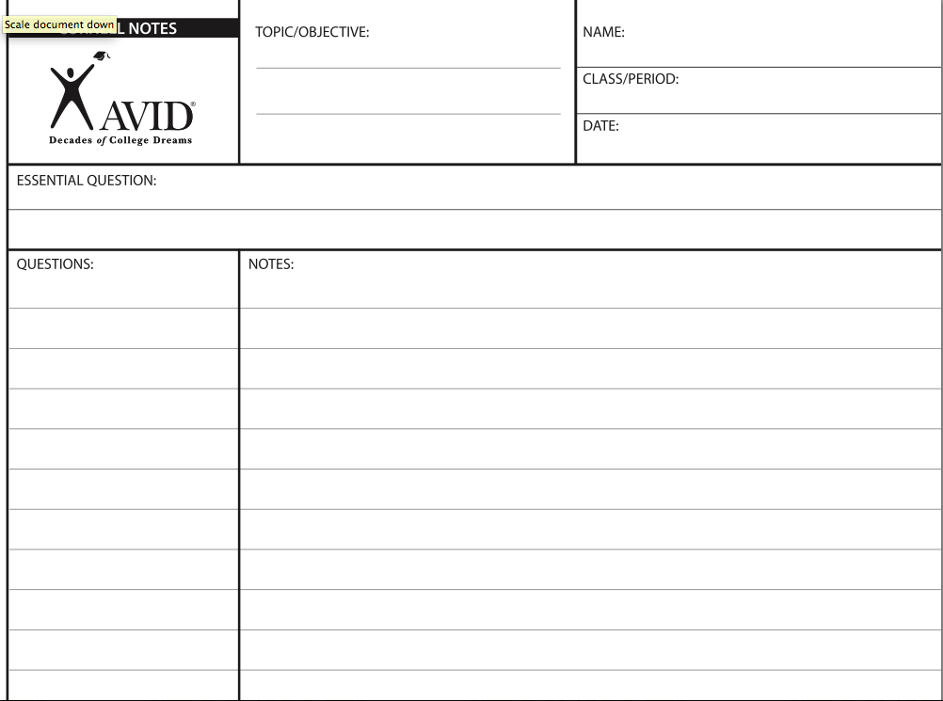
Unit 5: Cracking the “Chemist’s Code”: The Periodic Table
5.1
How is the periodic table organized?
I will analyze the organization of the periodic table by its groups & periods.
How is the periodic table organized?
Do Now
Introduction
Mini-Lesson
Summary
Work Period
Exit Slip

Slide 6
Unit 4: Cracking the “Chemist’s Code”: The Periodic Table
4.1
How is the periodic table organized?
Do now
AGENDA
Do Now
Introduction
Mini-Lesson
Summary
Work Period
Exit Slip

Slide 7
Unit 4: Cracking the “Chemist’s Code”: The Periodic Table
4.1
How is the periodic table organized?
Think aloud…
How do you organize
the clothes in your closet?
Do Now
Introduction
Mini-Lesson
Summary
Work Period
Exit Slip

Slide 8
Unit 4: Cracking the “Chemist’s Code”: The Periodic Table
4.1
How is the periodic table organized?
In your QUESTIONS section
Copy down these guided questions:
What is a group?
What is a period?
What distinguishes a group from a period?
Why are hydrogen and helium on top of the periodic table?
Do Now
Introduction
Mini-Lesson
Summary
Work Period
Exit Slip

Slide 9
Unit 4: Cracking the “Chemist’s Code”: The Periodic Table
4.1
How is the periodic table organized?
In your NOTES section
Answer these guiding questions in your notes section side-by-side using
the article given to you
Include a diagram to help you!
Do Now
Introduction
Mini-Lesson
Summary
Work Period
Exit Slip

Slide 10
Unit 5: Cracking the “Chemist’s Code”: The Periodic Table
5.1
How is the periodic table organized?
What is a group?
A group is…
What is a period?
A period is…
Do Now
Introduction
Mini-Lesson
Summary
Work Period
Exit Slip

Slide 11
Unit 4: Cracking the “Chemist’s Code”: The Periodic Table
4.1
How is the periodic table organized?
Group Share Out
Let’s share out answers to
these guiding questions!
Do Now
Introduction
Mini-Lesson
Summary
Work Period
Exit Slip

Slide 12
Unit 4: Cracking the “Chemist’s Code”: The Periodic Table
4.1
How is the periodic table organized?
HIGHLIGHT
The most important parts!
Do Now
Introduction
Mini-Lesson
Summary
Work Period
Exit Slip

Slide 13
Unit 4: Cracking the “Chemist’s Code”: The Periodic Table
4.1
How is the periodic table organized?
In your QUESTIONS section
Two questions I have
In your NOTES section
Jot down two questions you have
Do Now
Introduction
Mini-Lesson
Summary
Work Period
Exit Slip

Slide 14
Unit 4: Cracking the “Chemist’s Code”: The Periodic Table
4.1
How is the periodic table organized?
Group Share Out
Let’s share out these questions!
Do Now
Introduction
Mini-Lesson
Summary
Work Period
Exit Slip

Slide 15
Unit 4: Cracking the “Chemist’s Code”: The Periodic Table
4.1
How is the periodic table organized?
USE REFERENCE TABLE
Do Now
Introduction
Mini-Lesson
Summary
Work Period
Exit Slip

Slide 16
Unit 4: Cracking the “Chemist’s Code”: The Periodic Table
4.1
How is the periodic table organized?
USE REFERENCE TABLE
Do Now
Introduction
Mini-Lesson
Summary
Work Period
Exit Slip

Slide 17
Unit 4: Cracking the “Chemist’s Code”: The Periodic Table
4.1
How is the periodic table organized?
In your QUESTIONS section
Copy down these guiding questions:
What is the trend of valence electrons for groups?
What is the trend of valence electrons for periods?
Do Now
Introduction
Mini-Lesson
Summary
Work Period
Exit Slip

Slide 18
Unit 4: Cracking the “Chemist’s Code”: The Periodic Table
4.1
How is the periodic table organized?
In your NOTES section
Copy down these guiding questions:
The trend is in a group the valence electrons ….
The trend is in a period the valence electrons ….
Do Now
Introduction
Mini-Lesson
Summary
Work Period
Exit Slip

Slide 19
Unit 4: Cracking the “Chemist’s Code”: The Periodic Table
4.1
How is the periodic table organized?
In your NOTES section
Answer these guided questions in your notes section side-by-side based from the activity you just did
Do Now
Introduction
Mini-Lesson
Summary
Work Period
Exit Slip

Slide 20
Unit 4: Cracking the “Chemist’s Code”: The Periodic Table
4.1
How is the periodic table organized?
Group Share Out
Let’s share out answers to
these guiding questions!
Do Now
Introduction
Mini-Lesson
Summary
Work Period
Exit Slip

Slide 21
Unit 4: Cracking the “Chemist’s Code”: The Periodic Table
4.1
How is the periodic table organized?
In your QUESTIONS section
Two questions I have
In your NOTES section
Jot down two questions you have
Do Now
Introduction
Mini-Lesson
Summary
Work Period
Exit Slip

Slide 22
Unit 4: Cracking the “Chemist’s Code”: The Periodic Table
4.1
How is the periodic table organized?
Group Share Out
Let’s share out these questions!
Do Now
Introduction
Mini-Lesson
Summary
Work Period
Exit Slip

Slide 23
Unit 4: Cracking the “Chemist’s Code”: The Periodic Table
4.1
How is the periodic table organized?
summary
How is the periodic table organized?
Take 2 minutes to read from your notes and write a quick summary.
Do Now
Introduction
Mini-Lesson
Summary
Work Period
Exit Slip

Slide 24
Unit 4: Cracking the “Chemist’s Code”: The Periodic Table
4.1
How is the periodic table organized?
Group Share Out
Let’s share out our summaries!
Do Now
Introduction
Mini-Lesson
Summary
Work Period
Exit Slip

Slide 25
Unit 4: Cracking the “Chemist’s Code”: The Periodic Table
4.1
How is the periodic table organized?
Searching the periodic table
List the atomic numbers of the elements in Period 4:
Write the symbols of these elements:
Name the lightest element in Period 4.
Name the heaviest element in Period 4.
Do Now
Introduction
Mini-Lesson
Summary
Work Period
Exit Slip

Slide 26
Unit 4: Cracking the “Chemist’s Code”: The Periodic Table
4.1
How is the periodic table organized?
Searching the periodic table
5. To which group does each of these elements belong?
Lithium: ____________ e) nitrogen: ________________
Beryllium: __________ f) oxygen: _________________
Boron: _____________ g) fluorine: ________________
Carbon: ____________ h) neon: ___________________
Do Now
Introduction
Mini-Lesson
Summary
Work Period
Exit Slip

Slide 27
Unit 4: Cracking the “Chemist’s Code”: The Periodic Table
4.1
How is the periodic table organized?
Searching the periodic table
6) Find calcium on the Periodic Table.
What is the atomic number of calcium? ___________
To which period does calcium belong? ____________
To which group does calcium belong? ____________
Name the elements that have many properties like Ca.
Which of these elements you listed is the lightest
Which of these elements you listed is the heaviest?
Do Now
Introduction
Mini-Lesson
Summary
Work Period
Exit Slip

Slide 28
Unit 4: Cracking the “Chemist’s Code”: The Periodic Table
4.1
How is the periodic table organized?
Searching the periodic table
Which member of group 13 is found in the second period?
(1) Be (2) Mg (3) B (4) Al
Elements on the modern periodic table are arranged in order of increasing
(1) Atomic mass (2) Atomic number
(3) Number of neutrons (4) Number of valence electrons
Do Now
Introduction
Mini-Lesson
Summary
Work Period
Exit Slip

Slide 29
Unit 4: Cracking the “Chemist’s Code”: The Periodic Table
4.1
How is the periodic table organized?
Searching the periodic table
In which group of the periodic table is oxygen located?
1 (2) 2 (3) 16 (4) 17
Which element is in Group 2 and Period 7 of the Periodic Table?
a. magnesium
b. manganese
c. radium
d. radon
Do Now
Introduction
Mini-Lesson
Summary
Work Period
Exit Slip

Slide 30
Unit 4: Cracking the “Chemist’s Code”: The Periodic Table
4.1
How is the periodic table organized?
HOMEWORK:
Complete rest of 4.1
in the packet for homework
Do Now
Introduction
Mini-Lesson
Summary
Work Period
Exit Slip

Slide 31
Unit 4: Cracking the “Chemist’s Code”: The Periodic Table
4.1
How is the periodic table organized?
Exit Slip
Make sure you get your trackers checked!
Do Now
Introduction
Mini-Lesson
Summary
Work Period
Exit Slip

