Slide 1
Unit 4: Cracking the “Chemist’s Code”: The Periodic Table
4.2
How can we interpret the recurring trends of the atomic radius on the periodic table?
Objective:
I will analyze the periodic trend
of the atomic radius.
AGENDA
Do Now
Introduction
Mini-Lesson
Summary
Work Period
DO NOW:
Complete Do Now slip
You have 5 minutes
Exit Slip

Slide 2
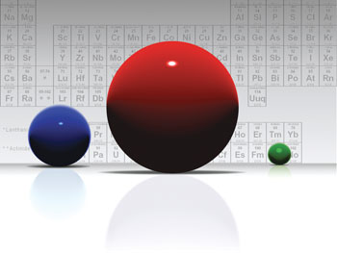
Unit 4: Cracking the “Chemist’s Code”: The Periodic Table
4.2
How can we interpret the recurring trends of the atomic radius on the periodic table?
Essential question = aim
Still on top of every page
TOPIC/objective
Still on first slide
AGENDA
Do Now
Introduction
Mini-Lesson
Summary
Work Period
Exit Slip

Slide 3
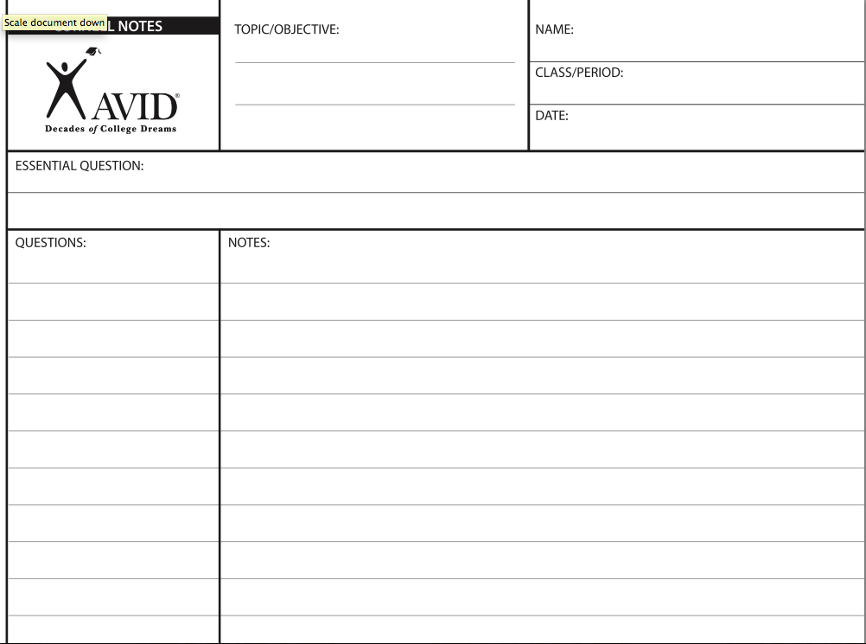
Unit 5: Cracking the “Chemist’s Code”: The Periodic Table
I will analyze the periodic trend of the atomic radius.
5.2
How can we interpret the recurring trends of the atomic radius on the periodic table?
How can we interpret the recurring trends of the atomic radius on the periodic table?
AGENDA
Do Now
Introduction
Mini-Lesson
Summary
Work Period
Exit Slip

Slide 4
Unit 4: Cracking the “Chemist’s Code”: The Periodic Table
4.2
How can we interpret the recurring trends of the atomic radius on the periodic table?
ANNOUNCEMENTS
Exam tracker due tomorrow
Every day for HW: Create a summary, 2 questions, and classwork
AGENDA
Do Now
Introduction
Mini-Lesson
Summary
Work Period
Exit Slip

Slide 5
Unit 4: Cracking the “Chemist’s Code”: The Periodic Table
4.2
How can we interpret the recurring trends of the atomic radius on the periodic table?
Do now
(Using reference table)
AGENDA
Do Now
Introduction
Mini-Lesson
Summary
Work Period
Exit Slip

Slide 6
Unit 4: Cracking the “Chemist’s Code”: The Periodic Table
4.2
How can we interpret the recurring trends of the atomic radius on the periodic table?
Let’s share out our summaries from yesterday! Summaries should answer the essential question:
How is the periodic table organized?
Group Share Out
Do Now
Introduction
Mini-Lesson
Summary
Work Period
Exit Slip

Slide 7
Unit 4: Cracking the “Chemist’s Code”: The Periodic Table
4.2
How can we interpret the recurring trends of the atomic radius on the periodic table?
Group Share Out
Summary
Summaries should answer the essential question:
How is the periodic table organized?
Do Now
Introduction
Mini-Lesson
Summary
Work Period
Exit Slip

Slide 8
Unit 4: Cracking the “Chemist’s Code”: The Periodic Table
4.2
How can we interpret the recurring trends of the atomic radius on the periodic table?
Group Share Out
Questions
What were questions you created about yesterday’s lesson?
Do Now
Introduction
Mini-Lesson
Summary
Work Period
Exit Slip

Slide 9
Unit 4: Cracking the “Chemist’s Code”: The Periodic Table
4.2
How can we interpret the recurring trends of the atomic radius on the periodic table?
STOP AND JOT IN Questions
Answer in notes
What is a trend?
Examples of trends?
Why do we care?
Do Now
Introduction
Mini-Lesson
Summary
Work Period
Exit Slip

Slide 10
Unit 4: Cracking the “Chemist’s Code”: The Periodic Table
4.2
How can we interpret the recurring trends of the atomic radius on the periodic table?
THINK INK-PAIRE SHARE
Question: How do you think trends may relate to the periodic table?
Notes:
Answer the question in 2 minutes ( I think…)
2. Share with your partner. Write down what your partner stated on your paper. (My partner thinks…)
Do Now
Introduction
Mini-Lesson
Summary
Work Period
Exit Slip

Slide 11
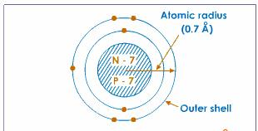
Unit 4: Cracking the “Chemist’s Code”: The Periodic Table
4.2
How can we interpret the recurring trends of the atomic radius on the periodic table?
Atomic radius
Copy question: What is an atomic radius?
In notes:
1. draw diagram
2. answer question: An atomic radius is…
Do Now
Introduction
Mini-Lesson
Summary
Work Period
Exit Slip

Slide 12
Unit 4: Cracking the “Chemist’s Code”: The Periodic Table
4.2
How can we interpret the recurring trends of the atomic radius on the periodic table?
Group Share Out
Let’s share out our answers!
How do you know?
Do Now
Introduction
Mini-Lesson
Summary
Work Period
Exit Slip

Slide 13
Unit 4: Cracking the “Chemist’s Code”: The Periodic Table
4.2
How can we interpret the recurring trends of the atomic radius on the periodic table?
Atomic radius across a period
Work in pairs for
7-10 minutes!
Do Now
Introduction
Mini-Lesson
Summary
Work Period
Exit Slip

Slide 14
Unit 4: Cracking the “Chemist’s Code”: The Periodic Table
4.2
How can we interpret the recurring trends of the atomic radius on the periodic table?
Atomic radius across a period
Work on in pairs for 7-10 minutes!
Do Now
Introduction
Mini-Lesson
Summary
Work Period
Exit Slip

Slide 15
Unit 4: Cracking the “Chemist’s Code”: The Periodic Table
4.2
How can we interpret the recurring trends of the atomic radius on the periodic table?
Copy these guiding questions. Answer in notes:
How does atomic radius change from left to right across a period? How do we know?
How many electron shells does every element in the period have?
Why do we see this trend as we move across a period?
Do Now
Introduction
Mini-Lesson
Summary
Work Period
Exit Slip

Slide 16
Unit 4: Cracking the “Chemist’s Code”: The Periodic Table
4.2
How can we interpret the recurring trends of the atomic radius on the periodic table?
Group Share Out
Let’s share out our answers!
Do Now
Introduction
Mini-Lesson
Summary
Work Period
Exit Slip

Slide 17
Unit 4: Cracking the “Chemist’s Code”: The Periodic Table
4.2
How can we interpret the recurring trends of the atomic radius on the periodic table?
Atomic radius down a group
Work in pairs for
7-10 minutes!
Do Now
Introduction
Mini-Lesson
Summary
Work Period
Exit Slip

Slide 18
Unit 4: Cracking the “Chemist’s Code”: The Periodic Table
4.2
How can we interpret the recurring trends of the atomic radius on the periodic table?
Atomic radius down a group
Work on in pairs for 7-10 minutes!
Do Now
Introduction
Mini-Lesson
Summary
Work Period
Exit Slip

Slide 19
Unit 4: Cracking the “Chemist’s Code”: The Periodic Table
4.2
How can we interpret the recurring trends of the atomic radius on the periodic table?
Copy these guiding questions. Answer in notes:
How does atomic radius change from top to bottom down a group? How do we know?
How does the number of electron shells change for elements as we go down the group? How do we know?
Why do we see this trend as we go down a group? Explain in terms of electron shells.
Do Now
Introduction
Mini-Lesson
Summary
Work Period
Exit Slip

Slide 20
Unit 4: Cracking the “Chemist’s Code”: The Periodic Table
4.2
How can we interpret the recurring trends of the atomic radius on the periodic table?
Group Share Out
Let’s share out our answers!
Do Now
Introduction
Mini-Lesson
Summary
Work Period
Exit Slip

Slide 21
Unit 4: Cracking the “Chemist’s Code”: The Periodic Table
4.2
How can we interpret the recurring trends of the atomic radius on the periodic table?
HOMEWORK:
Create 2 questions
Write a summary answering essential question
Complete classwork
Do Now
Introduction
Mini-Lesson
Summary
Work Period
Exit Slip

Slide 22
Unit 4: Cracking the “Chemist’s Code”: The Periodic Table
4.2
How can we interpret the recurring trends of the atomic radius on the periodic table?
summary
How can we interpret the recurring trends of the atomic radius on the periodic table?
Take 2 minutes to read from your notes and write a quick summary.
Do Now
Introduction
Mini-Lesson
Summary
Work Period
Exit Slip

Slide 23
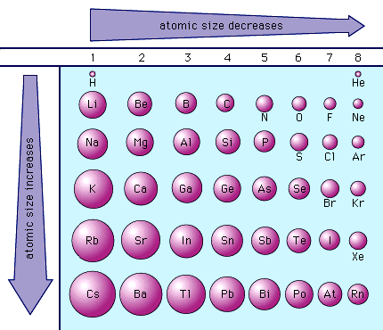
Unit 4: Cracking the “Chemist’s Code”: The Periodic Table
4.2
How can we interpret the recurring trends of the atomic radius on the periodic table?
Sample questions
Raise your finger corresponding to answer choice:
An atom of which element has the largest atomic radius?
Fe
Mg
Si
Zn
Do Now
Introduction
Mini-Lesson
Summary
Work Period
Exit Slip

Slide 24
Unit 4: Cracking the “Chemist’s Code”: The Periodic Table
4.2
How can we interpret the recurring trends of the atomic radius on the periodic table?
Sample questions
Raise your finger corresponding to answer choice:
As atomic number increases within Group 15 on the Periodic Table, atomic radius
decreases, only
increases, only
decreases, then increases
increases, then decreases
Do Now
Introduction
Mini-Lesson
Summary
Work Period
Exit Slip

Slide 25
Unit 4: Cracking the “Chemist’s Code”: The Periodic Table
4.2
How can we interpret the recurring trends of the atomic radius on the periodic table?
Sample questions
Raise your finger corresponding to answer choice:
Which list of elements from Group 2 on the Periodic Table is arranged in order of increasing atomic radius?
Be, Mg, Ca 2) Ca, Mg, Be
3) Ba, Ra, Sr 4) Sr, Ra, Ba
Do Now
Introduction
Mini-Lesson
Summary
Work Period
Exit Slip

Slide 26
Unit 4: Cracking the “Chemist’s Code”: The Periodic Table
4.2
How can we interpret the recurring trends of the atomic radius on the periodic table?
Let’s look at this:
In a TIEDC paragraph, explain, in terms of atomic structure, why the atomic radius of iodine is greater than the atomic radius of fluorine.
Do Now
Introduction
Mini-Lesson
Summary
Work Period
Exit Slip

Slide 27
Unit 4: Cracking the “Chemist’s Code”: The Periodic Table
4.2
How can we interpret the recurring trends of the atomic radius on the periodic table?
HOMEWORK:
Complete rest of 4.2
in the packet for homework
Do Now
Introduction
Mini-Lesson
Summary
Work Period
Exit Slip

Slide 28
Unit 4: Cracking the “Chemist’s Code”: The Periodic Table
4.2
How can we interpret the recurring trends of the atomic radius on the periodic table?
Exit Slip
Make sure you get your trackers checked!
Do Now
Introduction
Mini-Lesson
Summary
Work Period
Exit Slip

