Slide 1
Unit 4: Cracking the “Chemist’s Code”: The Periodic Table
4.3
How can we interpret the recurring trends of ionization energy on the periodic table?
Objective:
I will analyze the periodic trend
of the ionization energy.
AGENDA
Do Now
Introduction
Mini-Lesson
Summary
Work Period
DO NOW:
Complete Do Now slip
You have 5 minutes
Exit Slip

Slide 2
Unit 4: Cracking the “Chemist’s Code”: The Periodic Table
4.3
How can we interpret the recurring trends of ionization energy on the periodic table?
Essential question = aim
Still on top of every page
TOPIC/objective
Still on first slide
AGENDA
Do Now
Introduction
Mini-Lesson
Summary
Work Period
Exit Slip

Slide 3
Unit 4: Cracking the “Chemist’s Code”: The Periodic Table
4.3
How can we interpret the recurring trends of ionization energy on the periodic table?
ANNOUNCEMENTS
Quiz will be tomorrow, Tuesday 3/3/15 on 4.1-4.3
Papers back—please place in binder in back of room
AGENDA
Do Now
Introduction
Mini-Lesson
Summary
Work Period
Exit Slip

Slide 4
Unit 4: Cracking the “Chemist’s Code”: The Periodic Table
4.3
How can we interpret the recurring trends of ionization energy on the periodic table?
Do now
AGENDA
Do Now
Introduction
Mini-Lesson
Summary
Work Period
Exit Slip

Slide 5
Unit 4: Cracking the “Chemist’s Code”: The Periodic Table
4.3
How can we interpret the recurring trends of ionization energy on the periodic table?
Group Share Out of Summaries
How can we interpret the recurring trends of the atomic radius on the periodic table?
Do Now
Introduction
Mini-Lesson
Summary
Work Period
Exit Slip

Slide 6
Unit 4: Cracking the “Chemist’s Code”: The Periodic Table
4.3
How can we interpret the recurring trends of ionization energy on the periodic table?
Group Share Out of Questions
Questions from Last Night
Do Now
Introduction
Mini-Lesson
Summary
Work Period
Exit Slip

Slide 7
Unit 4: Cracking the “Chemist’s Code”: The Periodic Table
4.3
How can we interpret the recurring trends of ionization energy on the periodic table?
Guiding questions
Copy these guiding questions in QUESTIONS section and answer in NOTES section:
What is ionization energy?
If you have a higher ionization energy, is it easier or more difficult to remove an electron? Why?
Which ionization energy is greater—first or second?
Do Now
Introduction
Mini-Lesson
Summary
Work Period
Exit Slip

Slide 8
Unit 4: Cracking the “Chemist’s Code”: The Periodic Table
4.3
How can we interpret the recurring trends of ionization energy on the periodic table?
Group Share Out
Let’s share out answers to
these guiding questions!
Do Now
Introduction
Mini-Lesson
Summary
Work Period
Exit Slip

Slide 9
Unit 4: Cracking the “Chemist’s Code”: The Periodic Table
4.3
How can we interpret the recurring trends of ionization energy on the periodic table?
Think ink…pair share
Copy Question: Why is it harder to remove an electron when it is closer to the nucleus?
Notes:
Answer Question for 2 minutes (I think…)
Turn and Talk and write down what your partner said (My partner thinks…)
Do Now
Introduction
Mini-Lesson
Summary
Work Period
Exit Slip

Slide 10
Unit 4: Cracking the “Chemist’s Code”: The Periodic Table
4.3
How can we interpret the recurring trends of ionization energy on the periodic table?
Ionization energy across a period
Work in pairs for
7-10 minutes!
Do Now
Introduction
Mini-Lesson
Summary
Work Period
Exit Slip

Slide 11
Unit 4: Cracking the “Chemist’s Code”: The Periodic Table
4.3
How can we interpret the recurring trends of ionization energy on the periodic table?
Ionization energy across a period
Work on in pairs for 7-10 minutes!
Do Now
Introduction
Mini-Lesson
Summary
Work Period
Exit Slip

Slide 12
Unit 4: Cracking the “Chemist’s Code”: The Periodic Table
4.3
How can we interpret the recurring trends of ionization energy on the periodic table?
Copy these guiding questions. Answer in notes:
What is the trend of first ionization energy going across a period?
What does this tell you about how easy it is to remove an electron from elements as you move across a period?
Why do we see this trend?
Do Now
Introduction
Mini-Lesson
Summary
Work Period
Exit Slip

Slide 13
Unit 4: Cracking the “Chemist’s Code”: The Periodic Table
4.3
How can we interpret the recurring trends of ionization energy on the periodic table?
Group Share Out
Let’s share out answers to
these guiding questions!
Do Now
Introduction
Mini-Lesson
Summary
Work Period
Exit Slip

Slide 14
Unit 4: Cracking the “Chemist’s Code”: The Periodic Table
4.3
How can we interpret the recurring trends of ionization energy on the periodic table?
Ionization energy down a group
Work in pairs for
7-10 minutes!
Do Now
Introduction
Mini-Lesson
Summary
Work Period
Exit Slip

Slide 15
Unit 4: Cracking the “Chemist’s Code”: The Periodic Table
4.3
How can we interpret the recurring trends of ionization energy on the periodic table?
Ionization energy down a group
Work on in pairs for 7-10 minutes!
Do Now
Introduction
Mini-Lesson
Summary
Work Period
Exit Slip

Slide 16
Unit 4: Cracking the “Chemist’s Code”: The Periodic Table
4.3
How can we interpret the recurring trends of ionization energy on the periodic table?
Copy these guiding questions. Answer in notes:
What is the first ionization energy trend as we go down a group?
What does this tell you about how easy it is to remove an electron from elements as you move down a group?
Why is this happening?
Do Now
Introduction
Mini-Lesson
Summary
Work Period
Exit Slip

Slide 17
Unit 4: Cracking the “Chemist’s Code”: The Periodic Table
4.3
How can we interpret the recurring trends of ionization energy on the periodic table?
Group Share Out
Let’s share out answers to
these guiding questions!
Do Now
Introduction
Mini-Lesson
Summary
Work Period
Exit Slip

Slide 18
Unit 4: Cracking the “Chemist’s Code”: The Periodic Table
4.3
How can we interpret the recurring trends of ionization energy on the periodic table?
HOMEWORK:
Create two questions on notes
Write summary answering essential question
Complete classwork
Do Now
Introduction
Mini-Lesson
Summary
Work Period
Exit Slip

Slide 19
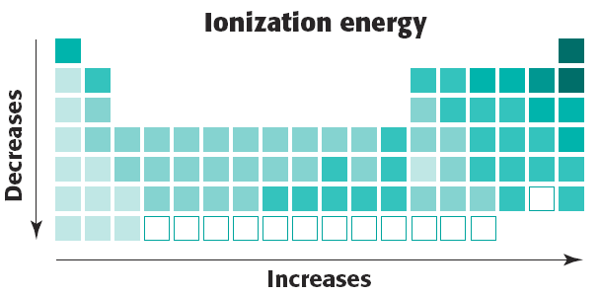
Unit 4: Cracking the “Chemist’s Code”: The Periodic Table
4.3
How can we interpret the recurring trends of ionization energy on the periodic table?
Sample questions
Raise your finger corresponding to answer choice:
Which element requires the least amount of energy to remove the most loosely held electron from a gaseous atom in the ground state?
A) bromine B) calcium
C) sodium D) silver
Do Now
Introduction
Mini-Lesson
Summary
Work Period
Exit Slip

Slide 20
Unit 4: Cracking the “Chemist’s Code”: The Periodic Table
4.3
How can we interpret the recurring trends of ionization energy on the periodic table?
Sample questions
Raise your finger corresponding to answer choice:
As the elements of Group 1 on the Periodic Table are considered in order of increasing atomic radius, the ionization energy of each successive element generally
A) decreases
B) increases
C) remains the same
Do Now
Introduction
Mini-Lesson
Summary
Work Period
Exit Slip

Slide 21
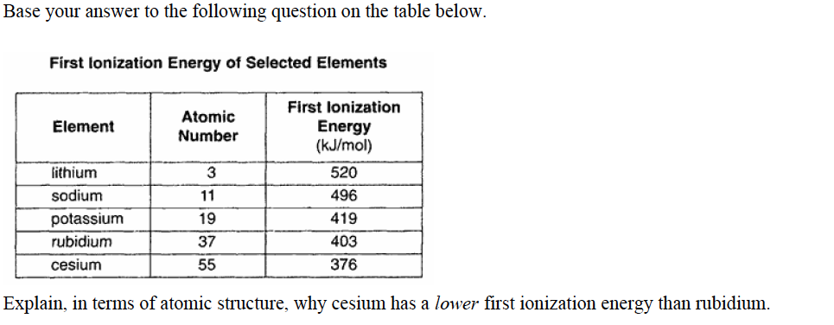
Unit 4: Cracking the “Chemist’s Code”: The Periodic Table
4.3
How can we interpret the recurring trends of ionization energy on the periodic table?
Sample questions
Do Now
Introduction
Mini-Lesson
Summary
Work Period
Exit Slip

Slide 22
Unit 4: Cracking the “Chemist’s Code”: The Periodic Table
4.3
How can we interpret the recurring trends of ionization energy on the periodic table?
Sample questions
Based on the fact that Xenon has more electron shells than Helium, why do you think that it is easier to remove a valence electron from xenon than from helium?
Do Now
Introduction
Mini-Lesson
Summary
Work Period
Exit Slip

Slide 23
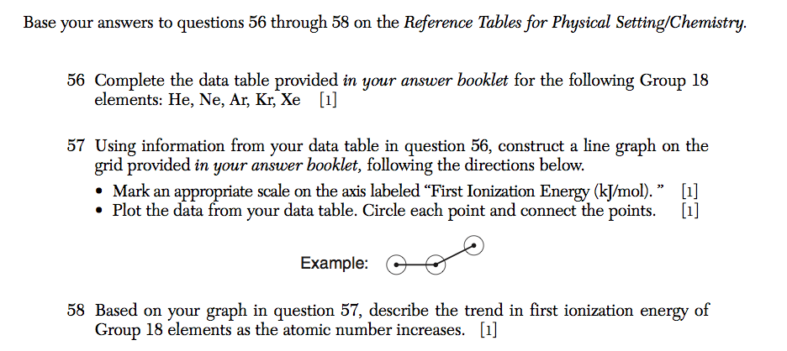
Unit 4: Cracking the “Chemist’s Code”: The Periodic Table
4.3
How can we interpret the recurring trends of ionization energy on the periodic table?
Do Now
Introduction
Mini-Lesson
Summary
Work Period
Exit Slip

Slide 24
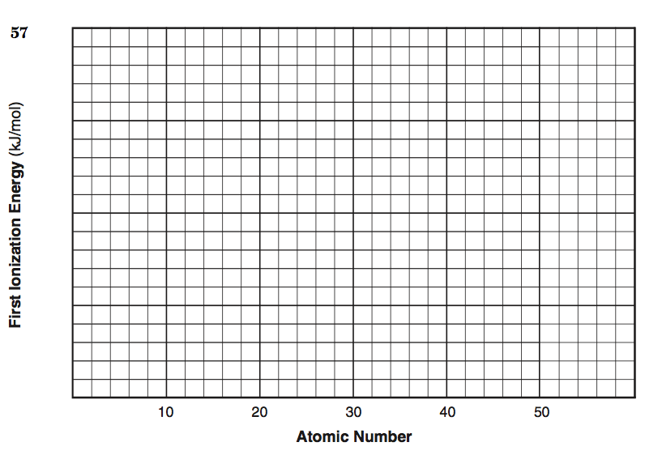
Unit 4: Cracking the “Chemist’s Code”: The Periodic Table
4.3
How can we interpret the recurring trends of ionization energy on the periodic table?
Do Now
Introduction
Mini-Lesson
Summary
Work Period
Exit Slip

Slide 25
Unit 4: Cracking the “Chemist’s Code”: The Periodic Table
4.3
How can we interpret the recurring trends of ionization energy on the periodic table?
HOMEWORK:
Complete rest of 4.3
in the packet for homework
Do Now
Introduction
Mini-Lesson
Summary
Work Period
Exit Slip

Slide 26
Unit 4: Cracking the “Chemist’s Code”: The Periodic Table
4.3
How can we interpret the recurring trends of ionization energy on the periodic table?
Exit Slip
Make sure you get your trackers checked!
Do Now
Introduction
Mini-Lesson
Summary
Work Period
Exit Slip

