Slide 1
Unit 4: Cracking the “Chemist’s Code”: The Periodic Table
4.4
DATE: 3/3/15
TOPIC/ Objective: I will analyze the periodic trend of electronegativity.
Essential question: How can we interpret the recurring trends of electronegativity in the periodic table?
AGENDA
Do Now
Introduction
Mini-Lesson
Summary
Work Period
QUIZ:
Complete Quiz
You have 10 minutes.
Exit Slip

Slide 2
Unit 4: Cracking the “Chemist’s Code”: The Periodic Table
4.4
How can we interpret the recurring trends of electronegativity in the periodic table?
ANNOUNCEMENTS:
Review answers of across a period for electronegativity
Give questions and go over answers about electronegativity down a group
Period 7
Start with 3.4

Slide 3
Unit 4: Cracking the “Chemist’s Code”: The Periodic Table
4.4
How can we interpret the recurring trends of electronegativity in the periodic table?
MISSING PACKET #8. PACKET #7 not taking
Period 2 | Period 4 | Period 7 | Period 8
Keith Alloway | Shania Baboolal | Marie Cajou | Omari Blount
Tasianna Joseph | Dasia Carter | Tyriek Craddock | Genesis Morrison
Saidou Ly | Keino Harris | Jade Davis
Richard Payne | Rasheim Harris | Jade Davis
Javarie Simpson | Julia Lawrence | Madison Durham
 | Jessica Royer | Courtney Hutchinson
 | Jessy Royer | Dachemide Luma
 | Rodney Smokes | Miquasha Menner
 |  | Karen Owusu-Ansah

Slide 4
Unit 4: Cracking the “Chemist’s Code”: The Periodic Table
4.4
How can we interpret the recurring trends of electronegativity in the periodic table?
DO NOW

Slide 5
Unit 4: Cracking the “Chemist’s Code”: The Periodic Table
4.4
How can we interpret the recurring trends of electronegativity in the periodic table?
QUESTION
1. What is electronegativity?
2. What does it mean to have high electronegativity?
3. What does it mean to have low electronegativity?
NOTES
Electronegativity is
High electronegativity means
Low electronegativity means

Slide 6
Unit 4: Cracking the “Chemist’s Code”: The Periodic Table
4.4
How can we interpret the recurring trends of electronegativity in the periodic table?
QUESTION
If you have a higher electronegativity, why is it becoming easier to attract an electron?
NOTES
THINK INK-PAIR SHARE
I think it would be ….because
My partner thinks it would be…because

Slide 7
Unit 4: Cracking the “Chemist’s Code”: The Periodic Table
4.4
How can we interpret the recurring trends of electronegativity in the periodic table?
ELECTRONEGATIVITY ACROSS A PERIOD
Cross out ionization energy

Slide 8
Unit 4: Cracking the “Chemist’s Code”: The Periodic Table
4.4
How can we interpret the recurring trends of electronegativity in the periodic table?
ELECTRONEGATIVITY ACROSS A PERIOD

Slide 9
Unit 4: Cracking the “Chemist’s Code”: The Periodic Table
4.4
How can we interpret the recurring trends of electronegativity in the periodic table?
QUESTION
What is happening to electronegativity across the period?
Is it easier or more difficult to attract an electron as we move across a period? Why?
NOTES
Across a period, the electronegativity is
Across a period it is getting --- to attract an electron. This is happening because

Slide 10
Unit 4: Cracking the “Chemist’s Code”: The Periodic Table
4.4
How can we interpret the recurring trends of electronegativity in the periodic table?
ELECTRONEGATIVITY DOWN A GROUP
(PLEASE CHANGE YOUR CHART)
Cross out ionization energy

Slide 11
Unit 4: Cracking the “Chemist’s Code”: The Periodic Table
4.4
How can we interpret the recurring trends of electronegativity in the periodic table?
ELECTRONEGATIVITY ACROSS A PERIOD

Slide 12
Unit 4: Cracking the “Chemist’s Code”: The Periodic Table
4.4
How can we interpret the recurring trends of electronegativity in the periodic table?
QUESTION
What is happening to electronegativity down a group?
Is it easier or more difficult to attract an electron as we move down a group? Why?
NOTES
Down a group, the electronegativity is
Down a group it is getting --- to attract an electron. This is happening because

Slide 13
Unit 4: Cracking the “Chemist’s Code”: The Periodic Table
4.4
How can we interpret the recurring trends of electronegativity in the periodic table?
QUESTION
Why does Fluorine have the highest electronegativity?
Why does Francium have the lowest electronegativity?
Why does Group 18 have no electronegativity?
NOTES
Fluorine has the highest electronegativity because
Francium has the lowest electronegativity because

Slide 14
Unit 4: Cracking the “Chemist’s Code”: The Periodic Table
4.4
How can we interpret the recurring trends of electronegativity in the periodic table?
QUESTION
Two questions I have are…
NOTES
1.
2.
SUMMARY:

Slide 15
Unit 4: Cracking the “Chemist’s Code”: The Periodic Table
4.4
How can we interpret the recurring trends of electronegativity in the periodic table?
QUESTION #1
Raise your finger corresponding to answer choice:

Slide 16
Unit 4: Cracking the “Chemist’s Code”: The Periodic Table
4.4
How can we interpret the recurring trends of electronegativity in the periodic table?
QUESTION #2
Raise your finger corresponding to answer choice:

Slide 17
Unit 4: Cracking the “Chemist’s Code”: The Periodic Table
4.4
How can we interpret the recurring trends of electronegativity in the periodic table?
QUESTION #3
Raise your finger corresponding to answer choice:

Slide 18
Unit 4: Cracking the “Chemist’s Code”: The Periodic Table
4.4
How can we interpret the recurring trends of electronegativity in the periodic table?
QUESTION #4
Raise your finger corresponding to answer choice:

Slide 19
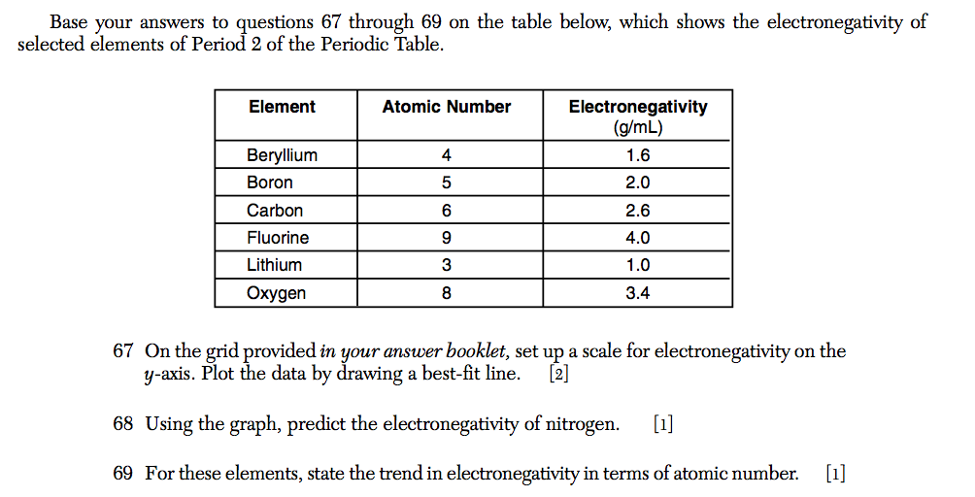
Unit 4: Cracking the “Chemist’s Code”: The Periodic Table
4.4
How can we interpret the recurring trends of electronegativity in the periodic table?

Slide 20
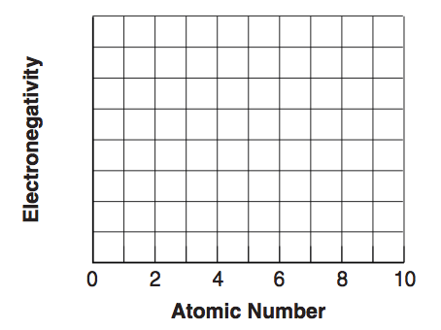
Unit 4: Cracking the “Chemist’s Code”: The Periodic Table
4.4
How can we interpret the recurring trends of electronegativity in the periodic table?

Slide 21
Unit 4: Cracking the “Chemist’s Code”: The Periodic Table
4.4
How can we interpret the recurring trends of electronegativity in the periodic table?
HOMEWORK:
Finish classwork of 4.4
Write a summary of today’s lesson
Create two questions
Highlight important information from the lesson

Slide 22
Unit 4: Cracking the “Chemist’s Code”: The Periodic Table
4.4
How can we interpret the recurring trends of electronegativity in the periodic table?
EXIT SLIP
Make sure you get your trackers checked!

