Slide 1
Unit 4: Cracking the “Chemist’s Code”: The Periodic Table
4.5
DATE: 3/3/15
TOPIC/ Objective: I will classify elements based on physical and chemical properties.
Essential question: How do we classify matter in terms of properties?
AGENDA
Do Now
Introduction
Mini-Lesson
Summary
Work Period
DO NOW:
Complete Do Now Slip.
You have 5 minutes.
Exit Slip

Slide 2
Unit 4: Cracking the “Chemist’s Code”: The Periodic Table
4.5
How do we classify matter
in terms of properties?
ANNOUNCEMENTS:

Slide 3
Unit 4: Cracking the “Chemist’s Code”: The Periodic Table
4.5
How do we classify matter
in terms of properties?
DO NOW

Slide 4
Unit 4: Cracking the “Chemist’s Code”: The Periodic Table
4.5
How do we classify matter
in terms of properties?
QUESTION
What’s a property?
What is a physical property? Examples?
What is a chemical property? Examples?
How can we distinguish between them?
NOTES
A property is
A physical property is
Some examples are
A chemical property is
Some examples are
We can tell them apart by

Slide 5
Unit 4: Cracking the “Chemist’s Code”: The Periodic Table
4.5
How do we classify matter
in terms of properties?
“Let’s Get Physical or Chemical”
Choose whether the following is an example of a physical property or chemical property and explain why
Every student should have 2 sheets of paper:
One says physical; One says chemical
When I show an image, raise your answer in air
.

Slide 6
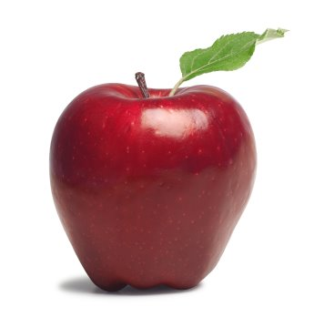
Unit 4: Cracking the “Chemist’s Code”: The Periodic Table
4.5
How do we classify matter
in terms of properties?
“Let’s Get Physical or Chemical”
Apple is red.

Slide 7
Unit 4: Cracking the “Chemist’s Code”: The Periodic Table
4.5
How do we classify matter
in terms of properties?
“Let’s Get Physical or Chemical”
Helium is a gas.

Slide 8
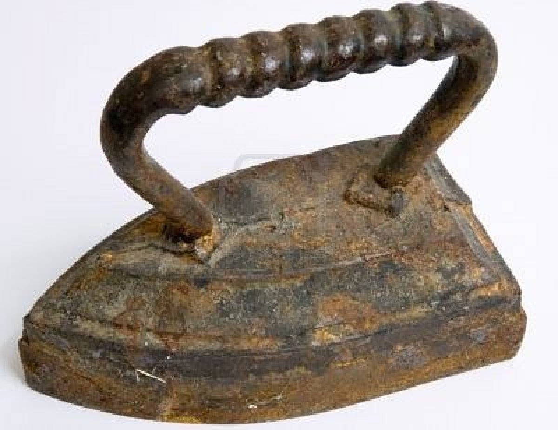
Unit 4: Cracking the “Chemist’s Code”: The Periodic Table
4.5
How do we classify matter
in terms of properties?
“Let’s Get Physical or Chemical”
Iron reacts with water to form rust.

Slide 9
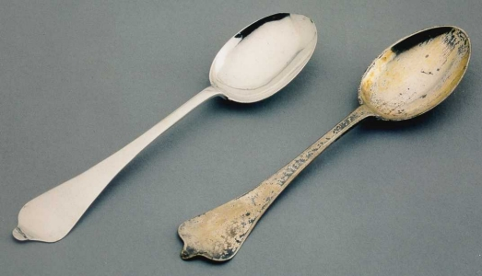
Unit 4: Cracking the “Chemist’s Code”: The Periodic Table
4.5
How do we classify matter
in terms of properties?
“Let’s Get Physical or Chemical”
Silver reacts with moisture in air to form tarnish

Slide 10
Unit 4: Cracking the “Chemist’s Code”: The Periodic Table
4.5
How do we classify matter
in terms of properties?
“Let’s Get Physical or Chemical”
Gold is malleable and has luster

Slide 11
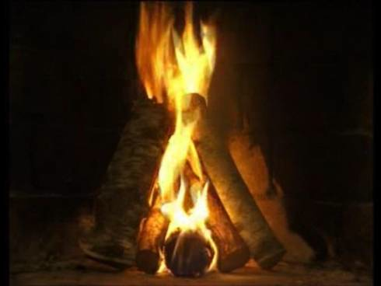
Unit 4: Cracking the “Chemist’s Code”: The Periodic Table
4.5
How do we classify matter
in terms of properties?
“Let’s Get Physical or Chemical”
Wood is flammable

Slide 12
Unit 4: Cracking the “Chemist’s Code”: The Periodic Table
4.5
How do we classify matter
in terms of properties?
QUESTION #1
Raise your finger corresponding to answer choice:

Slide 13
Unit 4: Cracking the “Chemist’s Code”: The Periodic Table
4.5
How do we classify matter
in terms of properties?
QUESTION #2
Raise your finger corresponding to answer choice:

Slide 14
Unit 4: Cracking the “Chemist’s Code”: The Periodic Table
4.5
How do we classify matter
in terms of properties?
QUESTION #3
Raise your finger corresponding to answer choice:

Slide 15
Unit 4: Cracking the “Chemist’s Code”: The Periodic Table
4.5
How do we classify matter
in terms of properties?
QUESTION #4
Raise your finger corresponding to answer choice:

Slide 16
Unit 4: Cracking the “Chemist’s Code”: The Periodic Table
4.5
How do we classify matter
in terms of properties?
QUESTION
What are the three major types of elements?
What are metals? What are some properties? Examples?
What are metalloids/semimetals? What are some properties? Examples?
NOTES
The three major types of elements are: (1) (2) (3)
Metals are …
Some properties they have are…
Some examples are…
Metalloids are …
Some properties they have are…
Some examples are…

Slide 17
Unit 4: Cracking the “Chemist’s Code”: The Periodic Table
4.5
How do we classify matter
in terms of properties?
QUESTION
What are non metals? What are some properties? Examples?
How can we distinguish between metals, nonmetals, and metalloids?
NOTES
Nonmetals are …
Some properties they have are…
Some examples are…
We can distinguish between them by

Slide 18
Unit 4: Cracking the “Chemist’s Code”: The Periodic Table
4.5
How do we classify matter
in terms of properties?
QUESTION
Two questions I have are…
NOTES
1.
2.
SUMMARY:

Slide 19
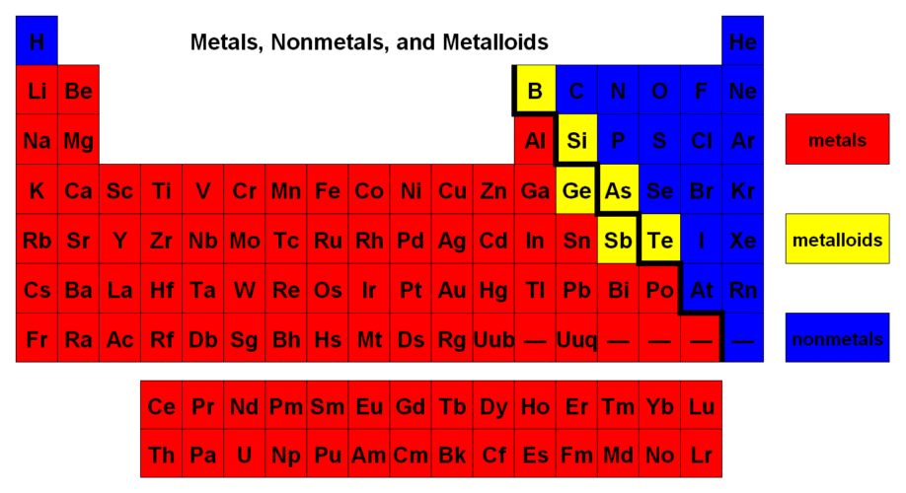
Unit 4: Cracking the “Chemist’s Code”: The Periodic Table
4.5
How do we classify matter
in terms of properties?
Shade periodic table
By metal, nonmetal, and metalloids (3 colors)

Slide 20
Unit 4: Cracking the “Chemist’s Code”: The Periodic Table
4.5
How do we classify matter
in terms of properties?
HOMEWORK:
Finish classwork of 4.5
Write a summary of today’s lesson
Create two questions
Highlight important information from the lesson

Slide 21
Unit 4: Cracking the “Chemist’s Code”: The Periodic Table
4.5
How do we classify matter
in terms of properties?
EXIT SLIP
Make sure you get your trackers checked!

