Slide 1
Unit 4: Cracking the “Chemist’s Code”: The Periodic Table
4.6
DATE: 3/5/15
TOPIC/ Objective: I will characterize the various families on the periodic table.
Essential question: How can we characterize the various families on the periodic table?
AGENDA
Do Now
Introduction
Mini-Lesson
Summary
Work Period
DO NOW:
Complete Do Now Slip.
You have 5 minutes.
Exit Slip

Slide 2
Unit 4: Cracking the “Chemist’s Code”: The Periodic Table
4.6
How can we characterize the various families on the periodic table?
ANNOUNCEMENTS:

Slide 3
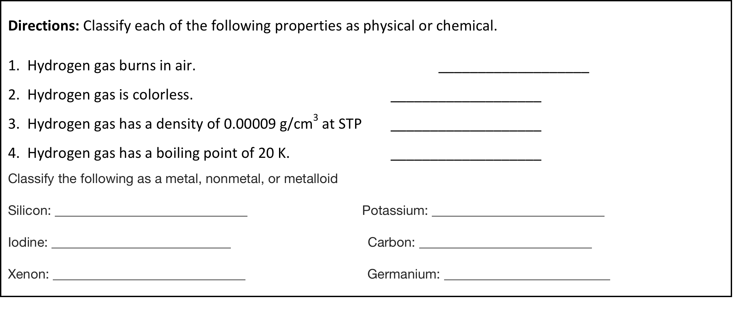
Unit 4: Cracking the “Chemist’s Code”: The Periodic Table
4.6
How can we characterize the various families on the periodic table?
DO NOW

Slide 4
Unit 4: Cracking the “Chemist’s Code”: The Periodic Table
4.6
How can we characterize the various families on the periodic table?
GALLERY WALK POSTER
Each group will be assigned a periodic family to research:
Alkali Metals
Alkaline Metals
Transition Metals
Lanthanides
Actinides
Halogens
Noble Gases

Slide 5
Unit 4: Cracking the “Chemist’s Code”: The Periodic Table
4.6
How can we characterize the various families on the periodic table?
GALLERY WALK POSTER
In your group chart paper, be sure to include the following:
Group Number
# of valence electrons
Type of element (metal, nonmetal or metalloid)
List of elements in group
Common Physical Properties
Common Chemical Properties
Level of Reactivity
Real-life uses
Pictures
One question

Slide 6
Unit 4: Cracking the “Chemist’s Code”: The Periodic Table
4.6
How can we characterize the various families on the periodic table?
GALLERY WALK POSTER
YOU ONLY HAVE 1 PERIOD TO DO YOUR RESEARCH AND COMPLETE THE POSTER SO DIVIDE UP THE WORK AMONG THE MEMBERS IN YOUR GROUP EVENLY!

Slide 7
Unit 4: Cracking the “Chemist’s Code”: The Periodic Table
4.6
How can we characterize the various families on the periodic table?
GALLERY WALK RULES
You are going to spend 5 minutes at each station...
Take down notes in your graphic organizer
Write down an observation or comment on a post-it and put on poster
(One thing I noticed is…)
Write down a question on post-it and put on poster using the Critical Thinking Wheel

Slide 8
Unit 4: Cracking the “Chemist’s Code”: The Periodic Table
4.6
How can we characterize the various families on the periodic table?
DEBRIEF
How did you feel about working in groups?
How did you feel about the gallery walk?
What did you like the most? What did you like the least?
What would you change?

Slide 9
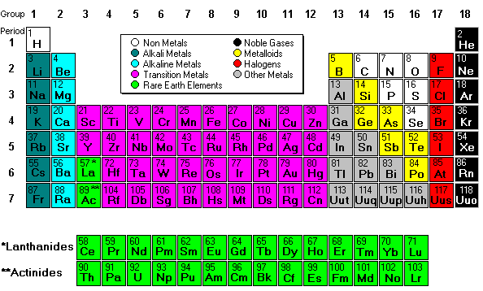
Unit 4: Cracking the “Chemist’s Code”: The Periodic Table
4.6
How can we characterize the various families on the periodic table?
Shade periodic table
By periodic groups/families (9 colors)

Slide 10
Unit 4: Cracking the “Chemist’s Code”: The Periodic Table
4.6
How can we characterize the various families on the periodic table?
HOMEWORK:
Finish classwork of 4.6
Write a summary of today’s lesson
Create two questions
Highlight important information from the lesson

Slide 11
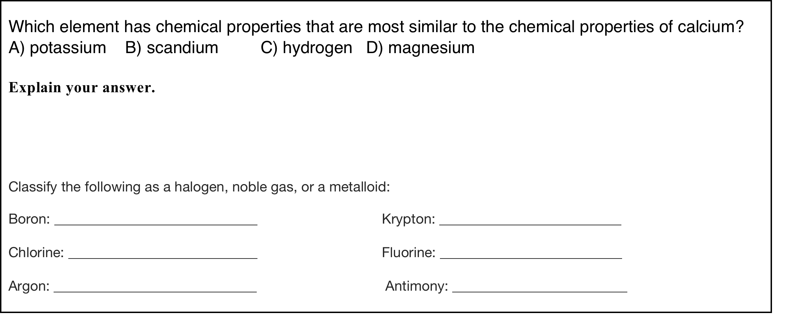
Unit 4: Cracking the “Chemist’s Code”: The Periodic Table
4.6
How can we characterize the various families on the periodic table?
EXIT SLIP
Make sure you get your trackers checked!

