Slide 1


Unit 5: Atomic Hookups—Chemical Bonding
5.1
DATE:
TOPIC/ Objective: I will distinguish between types of ions and atoms
Essential question: How can we distinguish between ions and atoms?
AGENDA
Do Now
Introduction
Mini-Lesson
Summary
Work Period
DO NOW:
Complete Do Now Slip.
You have 5 minutes.
Exit Slip

Slide 2
Unit 5: Atomic Hookups—Chemical Bonding
5.1
How can we distinguish
between ions and atoms?
ANNOUNCEMENTS:
Quality Review is tomorrow!!!!!!

Slide 3
Unit 5: Atomic Hookups—Chemical Bonding
5.1
How can we distinguish
between ions and atoms?
DO NOW (When you explain, also explain partner’s answer)
Raise your finger corresponding to answer choice:
An atom of an element contains 20 protons, 20 neutrons, and 20 electrons. The element is
an alkali metal
a noble gas
an alkaline earth metal
a halogen

Slide 4
Unit 5: Atomic Hookups—Chemical Bonding
5.1
How can we distinguish
between ions and atoms?
QUESTION
How are potassium atoms different from potassium ions?
NOTES
The atom is different from the ion because
STOP AND JOT/TURN AND TALK:
Write down your answer for 1 minute.
Then turn and talk to your group for 45 seconds to share answers

Slide 5
Unit 5: Atomic Hookups—Chemical Bonding
5.1
How can we distinguish
between ions and atoms?
QUESTION
What is an ion?
What is a neutral atom?
NOTES
An ion has extra electrons or less electrons
Example: Na⁺, O⁻²
A neutral atom is an atom where number of electrons = number of protons (atomic #)
Example: Na, Mg

Slide 6
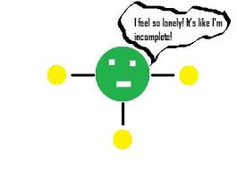
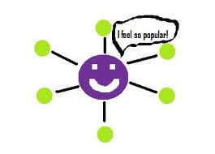
Unit 5: Atomic Hookups—Chemical Bonding
5.1
How can we distinguish
between ions and atoms?
QUESTION
What is the octet rule?
Why are noble gases the most stable atoms?
NOTES
Every elements wants valence electrons (a full valence electron shell). (THINK: “Get noble or die tryin” or “I want to be a noble gas so friggin’ bad”)
Think Ink-Pair Share
I think….
My partner thinks…

Slide 7
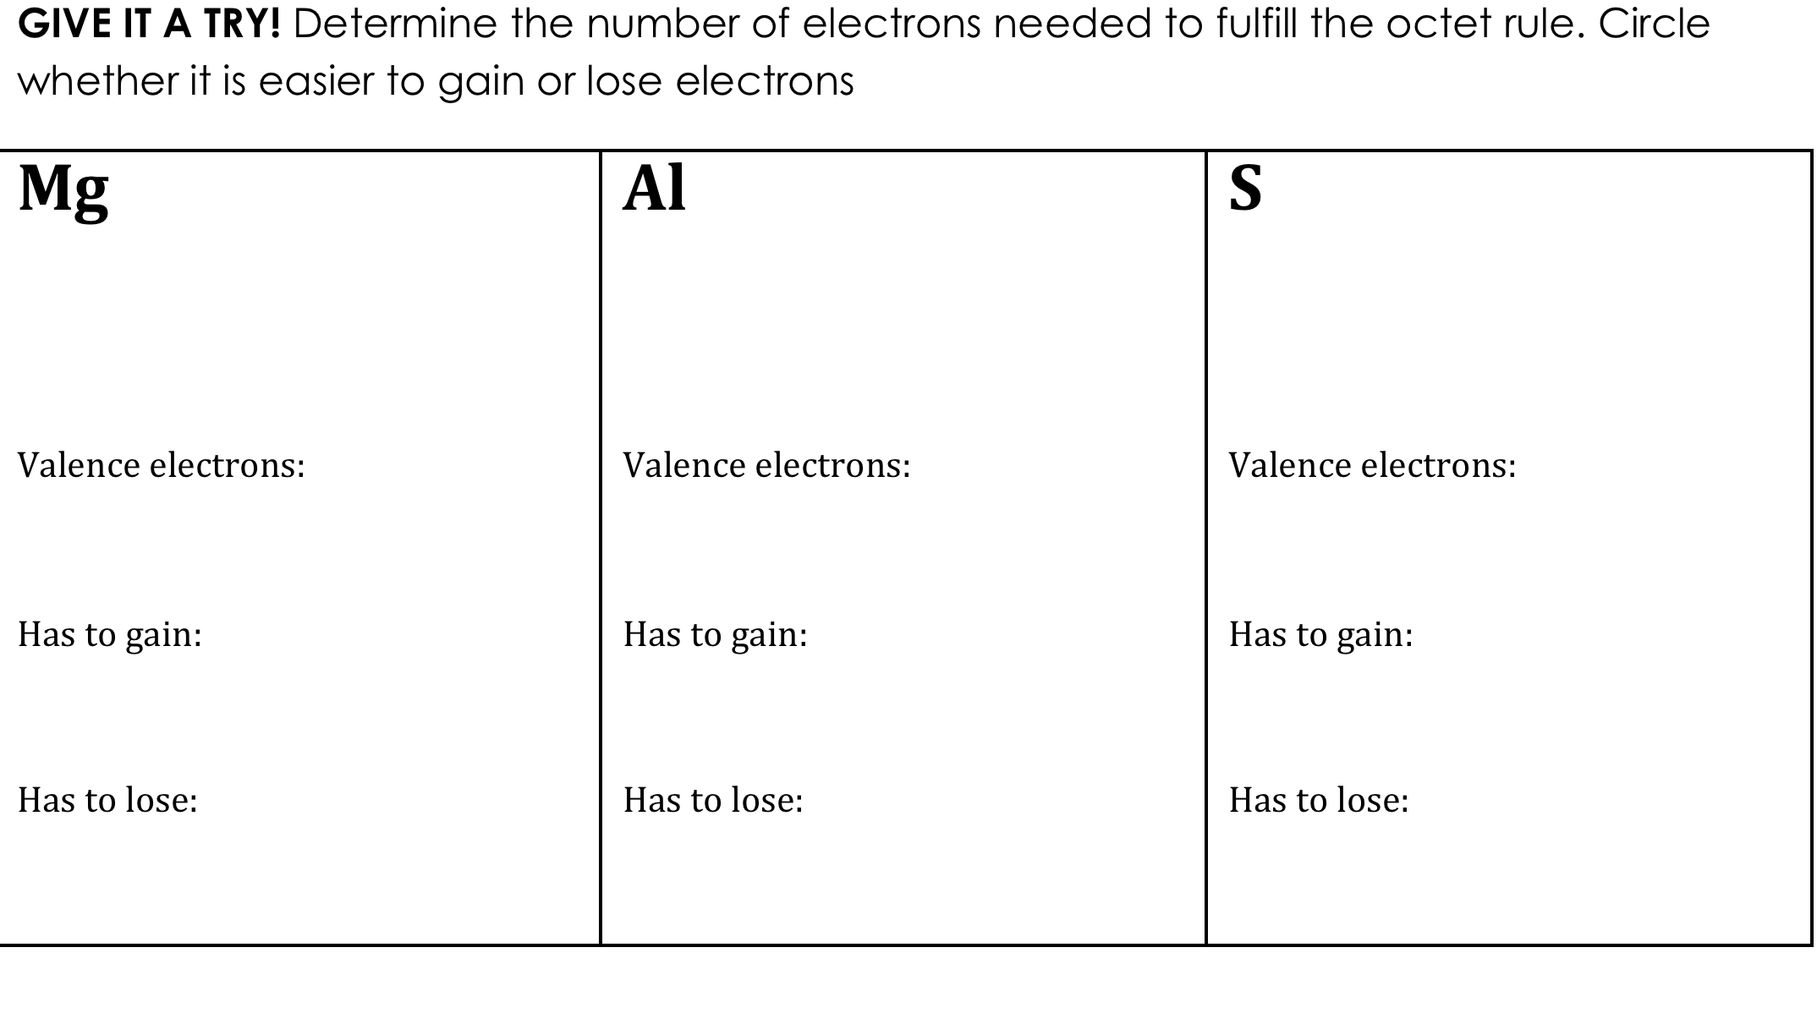
Unit 5: Atomic Hookups—Chemical Bonding
5.1
How can we distinguish
between ions and atoms?

Slide 8
Unit 5: Atomic Hookups—Chemical Bonding
5.1
How can we distinguish
between ions and atoms?
Activity: Cation
Use red squares to represent negative and green to represent positive
1. For the atom Lithium how many Protons and Electrons does this atom contain?
2. For each Proton take a + paper, for each electron take a – paper.
3. What charge does the atom have?
4. To become stable, it will become like Helium Lithium will lose one electron. Take away one – paper.
5. What charge does Lithium have now?

Slide 9
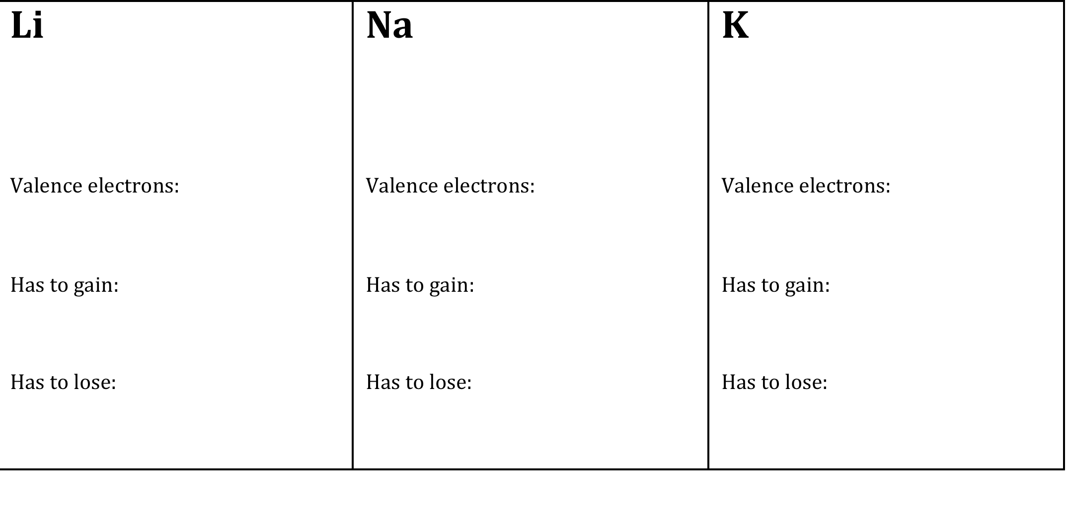
Unit 5: Atomic Hookups—Chemical Bonding
5.1
How can we distinguish
between ions and atoms?
So elements can either gain OR lose electrons to reach stability. Let's look for patterns on the periodic table:
TURN AND TALK: What is the pattern you see? Why?

Slide 10
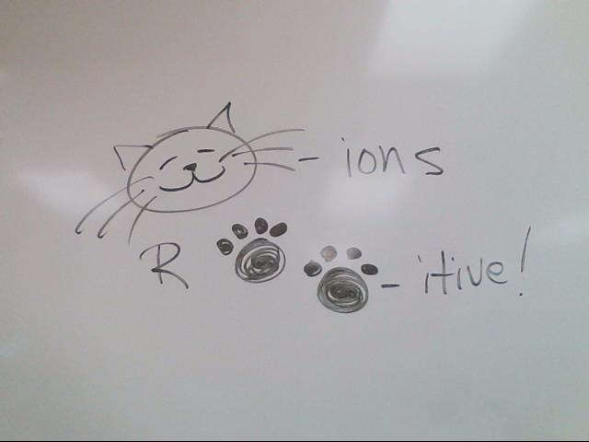
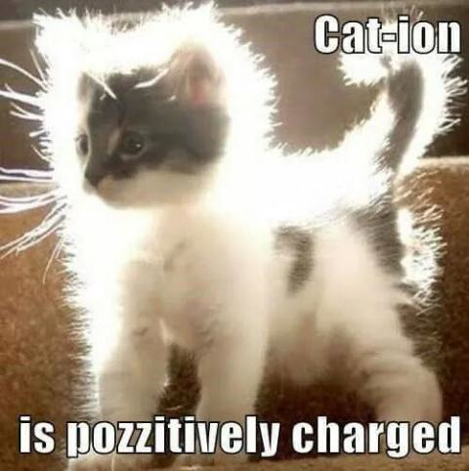
Unit 5: Atomic Hookups—Chemical Bonding
5.1
How can we distinguish
between ions and atoms?
QUESTION
What is a cation?
NOTES
Definition:
Charge of ion:
Gain or lose electrons?
Examples:
Types of elements
Way to remember:

Slide 11
Unit 5: Atomic Hookups—Chemical Bonding
5.1
How can we distinguish
between ions and atoms?
Activity: Anions
Use red squares to represent negative and green to represent positive
1. For the atom Fluorine how many Protons and Electrons does this atom contain?
2. For each Proton take a + paper, for each electron take a – paper.
3. What charge does the atom have?
4. To become stable like, Fluorine will gain one electron. Add one – paper.
5. What charge does Fluorine have now?

Slide 12
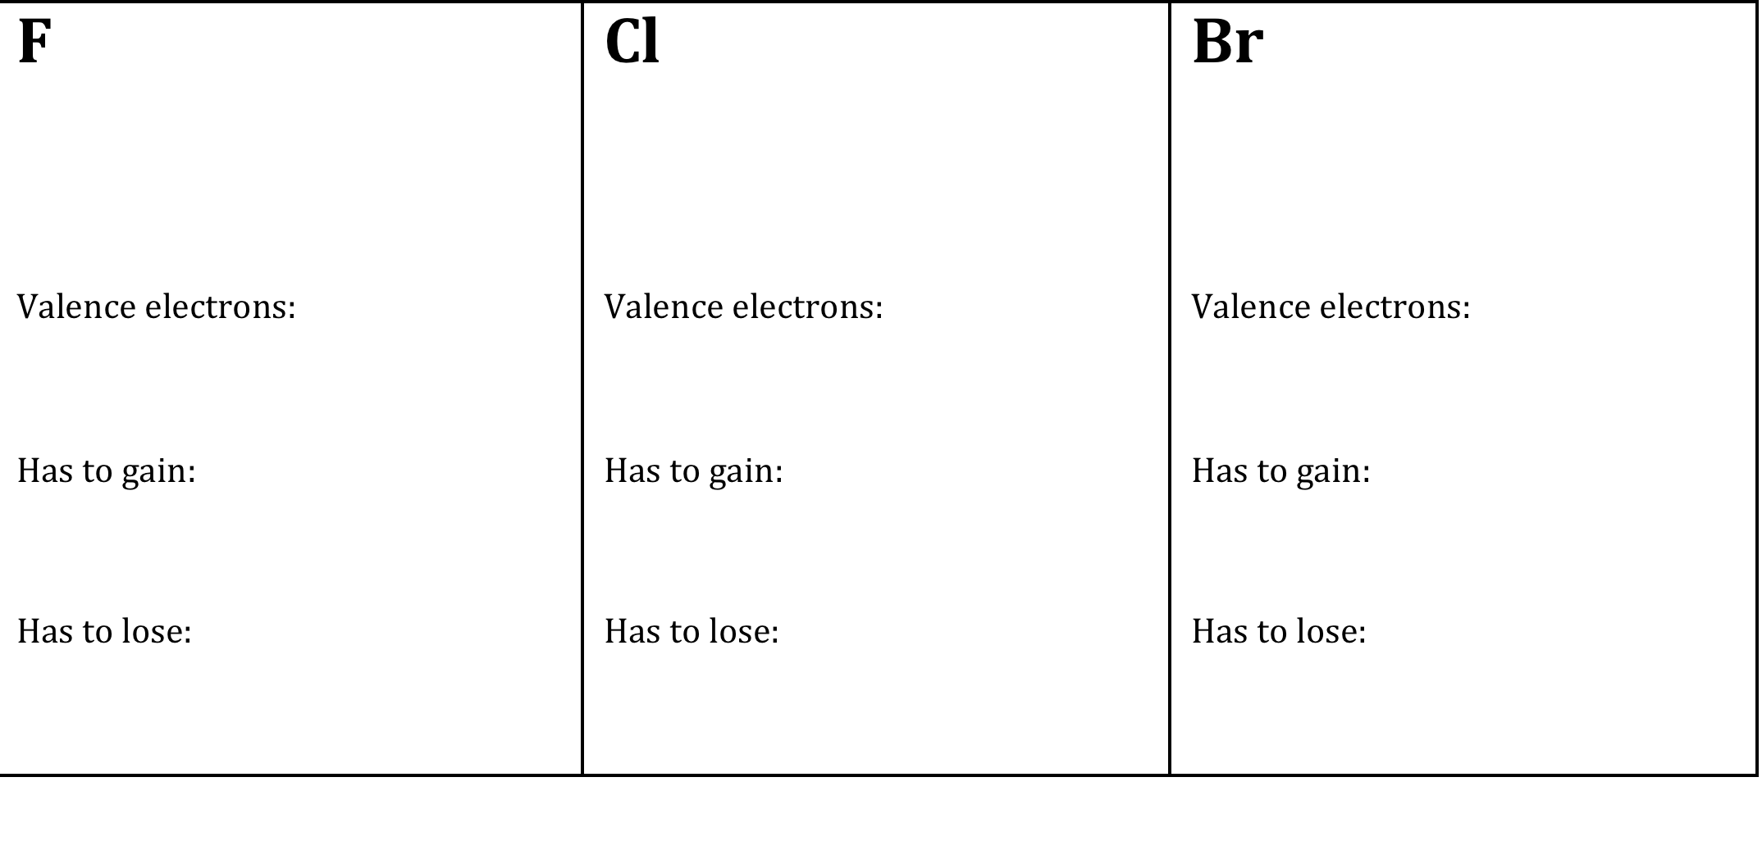
Unit 5: Atomic Hookups—Chemical Bonding
5.1
How can we distinguish
between ions and atoms?
So elements can either gain OR lose electrons to reach stability. Let's look for patterns on the periodic table:
TURN AND TALK: What is the pattern you see? Why?

Slide 13
Unit 5: Atomic Hookups—Chemical Bonding
5.1
How can we distinguish
between ions and atoms?
QUESTION
What is an anion?
NOTES
Definition:
Charge of ion:
Gain or lose electrons?
Examples:
Types of elements
Way to remember:

Slide 14



Unit 5: Atomic Hookups—Chemical Bonding
5.1
How can we distinguish
between ions and atoms?
How to use reference table?

Slide 15
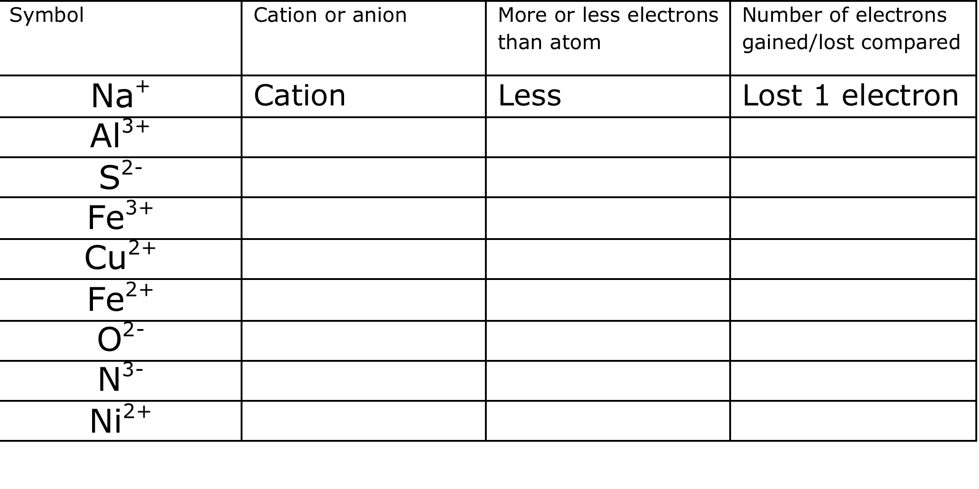
Unit 5: Atomic Hookups—Chemical Bonding
5.1
How can we distinguish
between ions and atoms?
YOU TRY:

Slide 16
Unit 5: Atomic Hookups—Chemical Bonding
5.1
How can we distinguish
between ions and atoms?
SAMPLE QUESTION #1:
Raise your finger corresponding to answer choice:
What is the total number of valence electrons in an ion of boron in the ground state?
8
2
5
3
Which particle has the same electron configuration as a calcium ion?
A) fluoride ion B) sodium ion C) potassium atom D) argon atom
What is the net charge of an ion that has 13 protons, 12 neutrons, and 10 electrons?
A) +1 B) +3 C) -1 D) -3
Which electron configuration is correct for a sodium ion?
2–7 B) 2–8 C) 2–8–1 D) 2–8–2
Compared to a calcium atom, the calcium ion Ca²⁺ has
more protons B) fewer protons C) more electrons D) fewer electrons

Slide 17
Unit 5: Atomic Hookups—Chemical Bonding
5.1
How can we distinguish
between ions and atoms?
SAMPLE QUESTION #2:
Raise your finger corresponding to answer choice:
Which particle has the same electron configuration as a calcium ion?
fluoride ion
sodium ion
potassium atom
argon atom

Slide 18
Unit 5: Atomic Hookups—Chemical Bonding
5.1
How can we distinguish
between ions and atoms?
SAMPLE QUESTION #3:
Raise your finger corresponding to answer choice:
What is the net charge of an ion that has 13 protons, 12 neutrons, and 10 electrons?
+1
+3
-1
-3

Slide 19
Unit 5: Atomic Hookups—Chemical Bonding
5.1
How can we distinguish
between ions and atoms?
SAMPLE QUESTION #4:
Raise your finger corresponding to answer choice:
Which electron configuration is correct for a sodium ion?
2–7
2–8
2–8–1
2–8–2

Slide 20
Unit 5: Atomic Hookups—Chemical Bonding
5.1
How can we distinguish
between ions and atoms?
SAMPLE QUESTION #4:
Raise your finger corresponding to answer choice:
Compared to a calcium atom, the calcium ion Ca²⁺ has
more protons
fewer protons
more electrons
fewer electrons

Slide 21
Unit 5: Atomic Hookups—Chemical Bonding
5.1
How can we distinguish
between ions and atoms?
QUESTION
Two questions I have are…
NOTES
1.
2.
SUMMARY:

Slide 22
Unit 5: Atomic Hookups—Chemical Bonding
5.1
How can we distinguish
between ions and atoms?
HOMEWORK:
Finish classwork of 5.1
Write a summary of today’s lesson
Create two questions
Highlight important information from the lesson

Slide 23
Unit 5: Atomic Hookups—Chemical Bonding
5.1
How can we distinguish
between ions and atoms?
EXIT SLIP
Make sure you get your trackers checked!

