Slide 1
Unit 5: Atomic Hookups—Chemical Bonding
5.2
DATE:
TOPIC/ Objective: I will distinguish between an ionic radius and an atomic radius.
Essential question: How is the ionic radius different from the atomic radius?
AGENDA
Do Now
Introduction
Mini-Lesson
Summary
Work Period
DO NOW:
Complete Do Now Slip.
You have 5 minutes.
Exit Slip

Slide 2
Unit 5: Atomic Hookups—Chemical Bonding
5.2
How is the ionic radius
different from the atomic radius?
MISSING LAB ACTIVITY PAPER:
Period 2 | Period 4 | Period 7 | Period 8
Saleh Ahmed | Shania Baboolal | Jewel Applewhite | Genesis Morrison
Keith Alloway | Dasia Carter | Marie Cajou
Kenly Gracia | Aissatou Diallo | Jade Davis
Marlwin Hernandez | Rasheim Harris | Madison Durham
Saidou Ly | Julia Lawrence | Amadou Diop
Richard Payne | Jessica Royer | Courtney Hutchinson
Aneisha Richards | Jessy Royer | Allison Hyman
Javarie Simpson | Rodney Smokes | Dachemide Luma
 |  | Jania Nelson
 |  | Xoe Scott
 |  | Ayanna Thompson
 |  | Desron Wilson

Slide 3
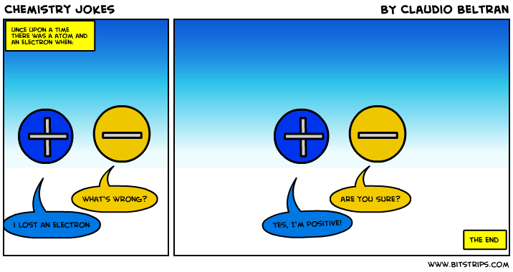
Unit 5: Atomic Hookups—Chemical Bonding
5.1
How can we distinguish
between ions and atoms?
DO NOW
In a TIEDC paragraph, please explain the meaning of this joke and its connection to our previous objective. Be sure to cite evidence to support your explanation.

Slide 4
Unit 5: Atomic Hookups—Chemical Bonding
5.2
How is the ionic radius
different from the atomic radius?
QUESTION
What is an ionic radius?
NOTES
An ionic radius is
STOP AND JOT/TURN AND TALK:
Write down your answer for 1 minute based on the words you recognize
Then turn and talk to your group for 45 seconds to share answers

Slide 5
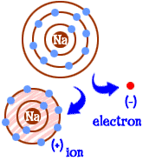
Unit 5: Atomic Hookups—Chemical Bonding
5.2
How is the ionic radius
different from the atomic radius?
QUESTION
How does the ionic radius compare to the atomic radius for Cations?
NOTES
For a cation, an ionic radius is smaller/larger (choose one) than the atomic radius.
This is because…

Slide 6
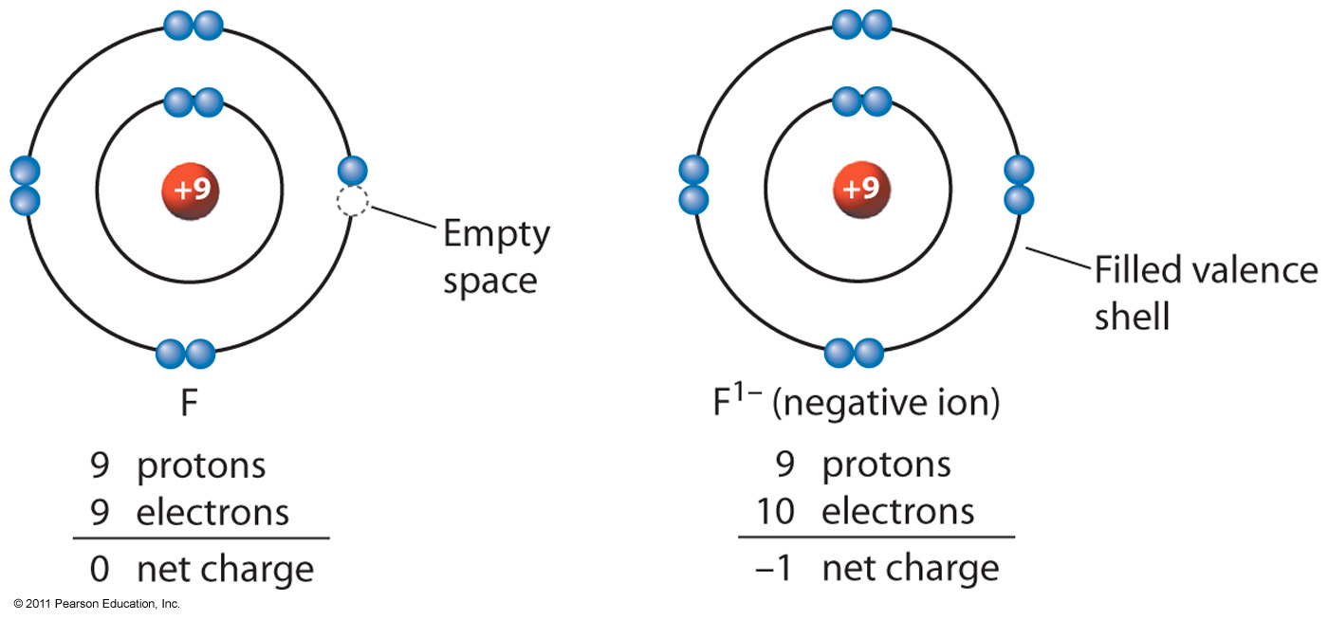
Unit 5: Atomic Hookups—Chemical Bonding
5.2
How is the ionic radius
different from the atomic radius?
QUESTION
How does the ionic radius compare to the atomic radius for Anions?
NOTES
For an anion, an ionic radius is smaller/larger (choose one) than the atomic radius.
This is because…

Slide 7
Unit 5: Atomic Hookups—Chemical Bonding
5.2
How is the ionic radius
different from the atomic radius?
YOU TRY!

Slide 8
Unit 5: Atomic Hookups—Chemical Bonding
5.2
How is the ionic radius
different from the atomic radius?
QUESTION #1:
Raise your finger corresponding to answer choice:
An ion of which element has a larger radius than an atom of the same element?
A) aluminum
B) chlorine
C) magnesium
D) sodium
Which particle has the same electron configuration as a calcium ion?
A) fluoride ion B) sodium ion C) potassium atom D) argon atom
What is the net charge of an ion that has 13 protons, 12 neutrons, and 10 electrons?
A) +1 B) +3 C) -1 D) -3
Which electron configuration is correct for a sodium ion?
2–7 B) 2–8 C) 2–8–1 D) 2–8–2
Compared to a calcium atom, the calcium ion Ca²⁺ has
more protons B) fewer protons C) more electrons D) fewer electrons

Slide 9
Unit 5: Atomic Hookups—Chemical Bonding
5.2
How is the ionic radius
different from the atomic radius?
QUESTION #2:
Raise your finger corresponding to answer choice:
Which of the following ions has the smallest radius?
A) F–
B) Cl–
C) K+
D) Ca²⁺
Which particle has the same electron configuration as a calcium ion?
A) fluoride ion B) sodium ion C) potassium atom D) argon atom
What is the net charge of an ion that has 13 protons, 12 neutrons, and 10 electrons?
A) +1 B) +3 C) -1 D) -3
Which electron configuration is correct for a sodium ion?
2–7 B) 2–8 C) 2–8–1 D) 2–8–2
Compared to a calcium atom, the calcium ion Ca²⁺ has
more protons B) fewer protons C) more electrons D) fewer electrons

Slide 10
Unit 5: Atomic Hookups—Chemical Bonding
5.2
How is the ionic radius
different from the atomic radius?
QUESTION #3:
Raise your finger corresponding to answer choice:
An atom with the electron configuration 2-8-2 would most likely
A) decrease in size as it forms a positive ion
B) increase in size as it forms a positive ion
C) decrease in size as it forms a negative ion
D) increase in size as it forms a negative ion
Which particle has the same electron configuration as a calcium ion?
A) fluoride ion B) sodium ion C) potassium atom D) argon atom
What is the net charge of an ion that has 13 protons, 12 neutrons, and 10 electrons?
A) +1 B) +3 C) -1 D) -3
Which electron configuration is correct for a sodium ion?
2–7 B) 2–8 C) 2–8–1 D) 2–8–2
Compared to a calcium atom, the calcium ion Ca²⁺ has
more protons B) fewer protons C) more electrons D) fewer electrons

Slide 11
Unit 5: Atomic Hookups—Chemical Bonding
5.2
How is the ionic radius
different from the atomic radius?
QUESTION #4:
Raise your finger corresponding to answer choice:
How does the size of a barium ion compare to the size of a barium atom?
A) The ion is smaller because it has fewer electrons.
B) The ion is smaller because it has more electrons.
C) The ion is larger because it has fewer electrons.
D) The ion is larger because it has more electrons.

Slide 12
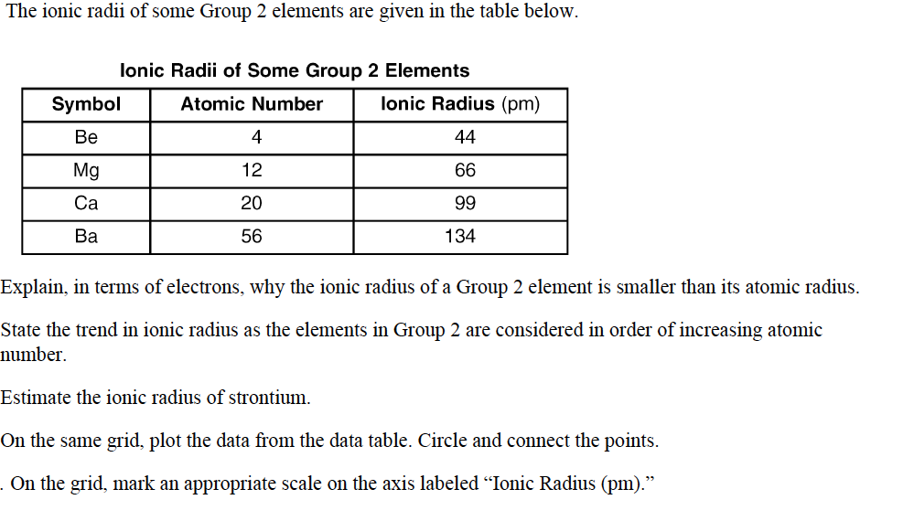
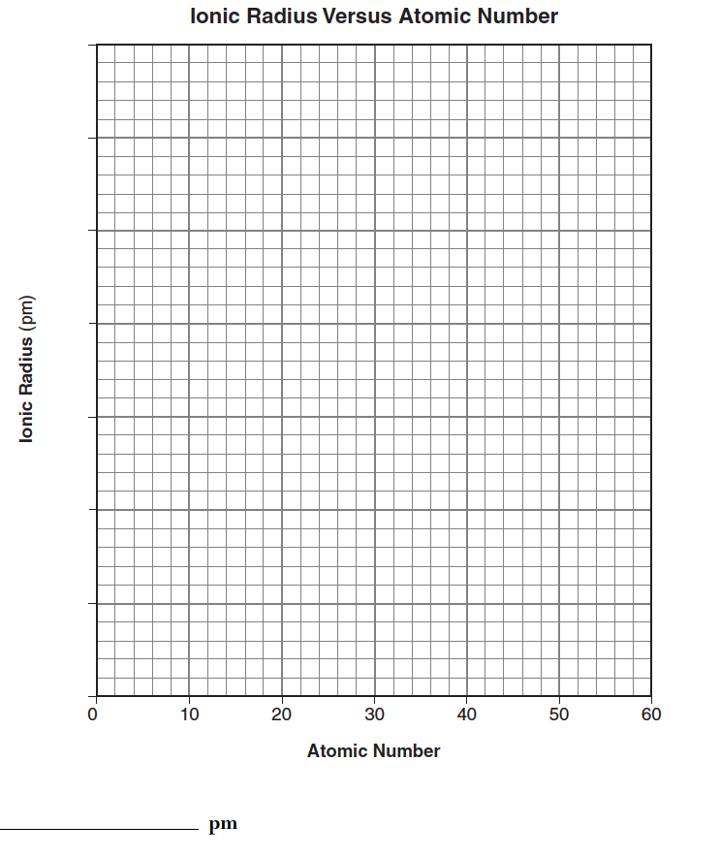
Unit 5: Atomic Hookups—Chemical Bonding
5.2
How is the ionic radius
different from the atomic radius?

Slide 13
Unit 5: Atomic Hookups—Chemical Bonding
5.2
How is the ionic radius
different from the atomic radius?
QUESTION
Two questions I have are…
NOTES
1.
2.
SUMMARY:

Slide 14
Unit 5: Atomic Hookups—Chemical Bonding
5.2
How is the ionic radius
different from the atomic radius?
HOMEWORK:
Finish classwork of 5.2
Write a summary of today’s lesson
Create two questions
Highlight important information from the lesson

Slide 15
Unit 5: Atomic Hookups—Chemical Bonding
5.2
How is the ionic radius
different from the atomic radius?
EXIT SLIP
Make sure you get your trackers checked!

