Slide 1
Unit 5: Atomic Hookups—Chemical Bonding
5.4
DATE:
TOPIC/ Objective: I will write the name and formulas for ionic compounds.
Essential question: How do we name and represent ionic compounds in a chemical formula?
AGENDA
Do Now
Introduction
Mini-Lesson
Summary
Work Period
DO NOW:
Complete Do Now Slip.
You have 5 minutes.
Exit Slip

Slide 2
Unit 5: Atomic Hookups—Chemical Bonding
5.4
How do we name and represent ionic compounds in a chemical formula?
MISSING LAB PAPER:
Period 2 | Period 4 | Period 7 | Period 8
Saleh Ahmed | Shania Baboolal | Jewel Applewhite | Genesis Morrison
Keith Alloway | Dasia Carter | Marie Cajou
Kenly Gracia | Aissatou Diallo | Jade Davis
Marlwin Hernandez | Rasheim Harris | Madison Durham
Saidou Ly | Julia Lawrence | Amadou Diop
Richard Payne | Jessica Royer | Courtney Hutchinson
Aneisha Richards | Jessy Royer | Allison Hyman
Javarie Simpson | Rodney Smokes | Dachemide Luma
 |  | Jania Nelson
 |  | Xoe Scott
 |  | Ayanna Thompson
 |  | Desron Wilson

Slide 3
Unit 5: Atomic Hookups—Chemical Bonding
5.4
How do we name and represent ionic compounds in a chemical formula?
ANNOUNCEMENTS:
Interim Assessments on Wednesday!

Slide 4
Unit 5: Atomic Hookups—Chemical Bonding
5.4
How do we name and represent ionic compounds in a chemical formula?
DO NOW

Slide 5
Unit 5: Atomic Hookups—Chemical Bonding
5.4
How do we name and represent ionic compounds in a chemical formula?
DO NOW

Slide 6
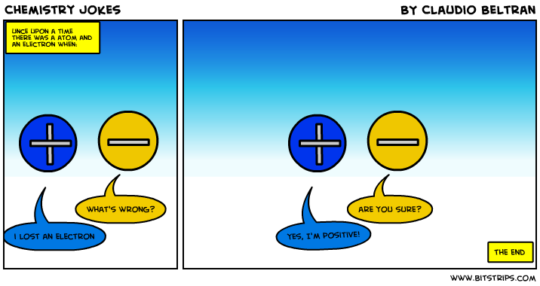
Unit 5: Atomic Hookups—Chemical Bonding
5.4
How do we name and represent ionic compounds in a chemical formula?
DO NOW
In a TIEDC paragraph, please explain the meaning of this joke and its connection to our previous objective. Be sure to cite evidence to support your explanation.

Slide 7
Unit 5: Atomic Hookups—Chemical Bonding
5.4
How do we name and represent ionic compounds in a chemical formula?
QUESTION
Why do you think the cation and anion are “bonded” together?
NOTES
I think they are bonded together because
STOP AND JOT/TURN AND TALK:
Write down your answer for 1 minute.
Then turn and talk to your group for 45 seconds to share answers

Slide 8
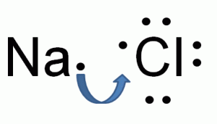
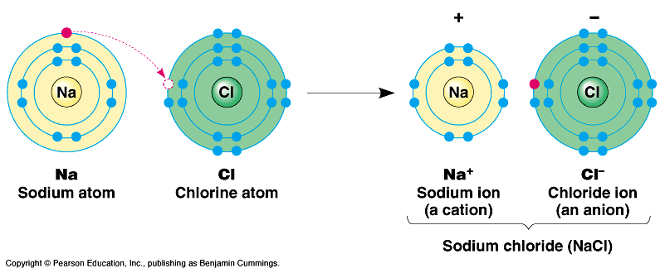
Unit 5: Atomic Hookups—Chemical Bonding
5.4
How do we name and represent ionic compounds in a chemical formula?
QUESTION
How do ionic bonds form?
(USE PICTURE TO HELP)
NOTES
An ionic bond forms by

Slide 9
Unit 5: Atomic Hookups—Chemical Bonding
5.4
How do we name and represent ionic compounds in a chemical formula?
QUESTION
How do we write formulas for ionic compounds?
EXAMPLE: Mg & Cl
NOTES
CRISS-CROSS METHOD:
1. Write down symbols of 2 elements, cation first
2. Write charge (oxidation number) of each ion
3. Switch (only numbers) and reduce the numbers to lowest multiple

Slide 10
Unit 5: Atomic Hookups—Chemical Bonding
5.4
How do we name and represent ionic compounds in a chemical formula?
YOU TRY
What is the ionic bond that is formed between Li and F?
What is the ionic bond that is formed between K and O?
What is the ionic bond that is formed between Ba and Cl?
What is the ionic bond that is formed between K and F?
What is the ionic bond that is formed between S and O?

Slide 11
Unit 5: Atomic Hookups—Chemical Bonding
5.4
How do we name and represent ionic compounds in a chemical formula?
QUESTION
How do we name ionic compounds?
EXAMPLE: NaCl
NOTES
Write Name of Metal/ Cation
Write Name of Non-metal / Anion
3. Remove ending of anion and add –ide
4. Combine both names

Slide 12
Unit 5: Atomic Hookups—Chemical Bonding
5.4
How do we name and represent ionic compounds in a chemical formula?
WRITE DOWN:

Slide 13
Unit 5: Atomic Hookups—Chemical Bonding
5.4
How do we name and represent ionic compounds in a chemical formula?
YOU TRY
BeCl₂ ___________________________________
MgBr2 ________________________________________________________
KCl ___________________________________
LiF ___________________________________
CaO ___________________________________

Slide 14
Unit 5: Atomic Hookups—Chemical Bonding
5.4
How do we name and represent ionic compounds in a chemical formula?
QUESTION
What happens with transition metals?
NOTES
Transition Metals often have the ability to lose a different number of electrons. This way they can create multiple ions with different charges.

Slide 15
Unit 5: Atomic Hookups—Chemical Bonding
5.4
How do we name and represent ionic compounds in a chemical formula?

Slide 16
Unit 5: Atomic Hookups—Chemical Bonding
5.4
How do we name and represent ionic compounds in a chemical formula?
QUESTION
How do we know which charge to use?
NOTES

Slide 17
Unit 5: Atomic Hookups—Chemical Bonding
5.4
How do we name and represent ionic compounds in a chemical formula?

Slide 18
Unit 5: Atomic Hookups—Chemical Bonding
5.4
How do we name and represent ionic compounds in a chemical formula?
Activity: Bond with a Classmate
Get an ion and figure out if it is a cation or anion
Go around the classroom and find other ions to bond with. Remember, we are making ionic bond so each bond should have ONE cation and ONE anion.
Write down the symbol and charge for each bonding cation and anion in the appropriate column.
With your partner figure out what the compound is that is formed between the two. Remember to pay attention to oxidation numbers so that there is a neutral charge overall.
With your partner write down the name of the compound you formed.

Slide 19
Unit 5: Atomic Hookups—Chemical Bonding
5.4
How do we name and represent ionic compounds in a chemical formula?
Activity: Bond with a Classmate
Fill this out for the element you received
BOND WITH A CLASSMATE!
Hello, my name is ___________________________________
My symbol is _______________________ My charge is ________________________
I am cation/ anion (circle one) I am gain/lose (circle one) this many electrons ________________
I am a metal/ nonmetal (circle one) I need/ do not need a middle name (THINK IF IT'S A TRANSITION METAL)

Slide 20
Unit 5: Atomic Hookups—Chemical Bonding
5.4
How do we name and represent ionic compounds in a chemical formula?
Activity: Bond with a Classmate

Slide 21
Unit 5: Atomic Hookups—Chemical Bonding
5.4
How do we name and represent ionic compounds in a chemical formula?
SAMPLE QUESTION #1:
Raise your finger corresponding to answer choice:
What is the correct formula for a compound of Li and F?
(1) LiF
(2) Li₂F
(3) LiF₂
(4) Li₂F₃
Which particle has the same electron configuration as a calcium ion?
A) fluoride ion B) sodium ion C) potassium atom D) argon atom
What is the net charge of an ion that has 13 protons, 12 neutrons, and 10 electrons?
A) +1 B) +3 C) -1 D) -3
Which electron configuration is correct for a sodium ion?
2–7 B) 2–8 C) 2–8–1 D) 2–8–2
Compared to a calcium atom, the calcium ion Ca²⁺ has
more protons B) fewer protons C) more electrons D) fewer electrons

Slide 22
Unit 5: Atomic Hookups—Chemical Bonding
5.4
How do we name and represent ionic compounds in a chemical formula?
SAMPLE QUESTION #2:
Raise your finger corresponding to answer choice:
What is the correct formula for a compound of Al and O?
(1) AlO
(2) Al₂O
(3) Al₃O₂
(4) Al₂O₃

Slide 23
Unit 5: Atomic Hookups—Chemical Bonding
5.4
How do we name and represent ionic compounds in a chemical formula?
SAMPLE QUESTION #3:
Raise your finger corresponding to answer choice:
In which compound have electrons been transferred to the oxygen atom?
CO₂
NO₂
N₂O
Na₂O

Slide 24
Unit 5: Atomic Hookups—Chemical Bonding
5.4
How do we name and represent ionic compounds in a chemical formula?
SAMPLE QUESTION #4:
Raise your finger corresponding to answer choice:
Which formula represents an ionic compound?
NaCl
N₂O
HCl
H₂O

Slide 25
Unit 5: Atomic Hookups—Chemical Bonding
5.4
How do we name and represent ionic compounds in a chemical formula?
QUESTION
Two questions I have are…
NOTES
1.
2.
SUMMARY:

Slide 26
Unit 5: Atomic Hookups—Chemical Bonding
5.4
How do we name and represent ionic compounds in a chemical formula?
HOMEWORK:
Finish classwork of 5.4
Write a summary of today’s lesson
Create two questions
Highlight important information from the lesson

Slide 27
Unit 5: Atomic Hookups—Chemical Bonding
5.4
How do we name and represent ionic compounds in a chemical formula?
EXIT SLIP
Make sure you get your trackers checked!

