Slide 1
Unit 5: Atomic Hookups—Chemical Bonding
5.5
DATE:
TOPIC/ Objective: I will write the name and formulas for covalent compounds.
Essential question: How do we name and represent covalent compounds in a chemical formula?
AGENDA
Do Now
Introduction
Mini-Lesson
Summary
Work Period
DO NOW:
Complete Do Now Slip.
You have 5 minutes.
Exit Slip

Slide 2
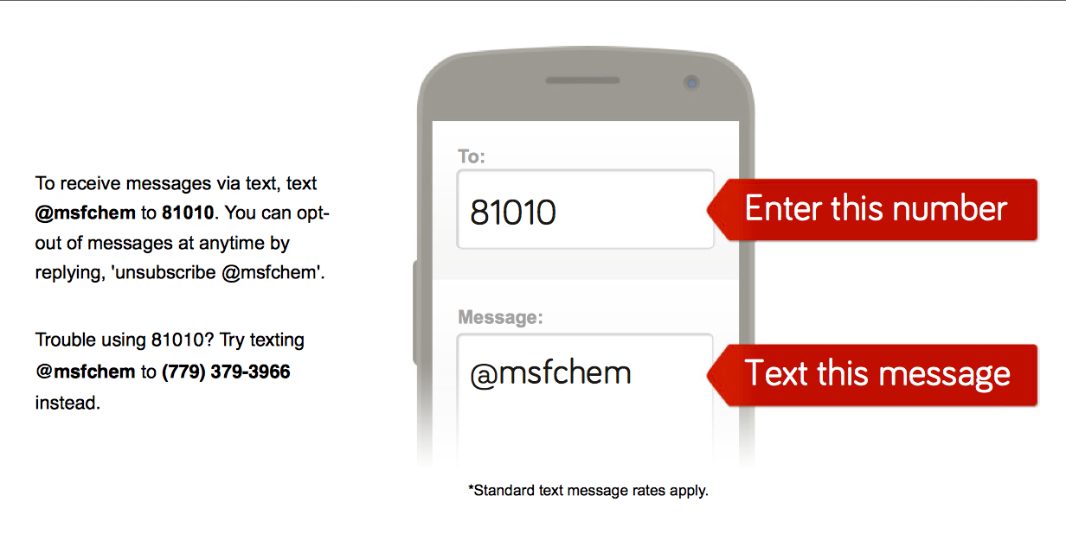
Unit 5: Atomic Hookups—Chemical Bonding
5.5
How do we name and represent covalent compounds in a chemical formula?
ANNOUNCEMENTS:
Take out phones & sign up for Remind 101

Slide 3
Unit 5: Atomic Hookups—Chemical Bonding
5.5
How do we name and represent covalent compounds in a chemical formula?
ANNOUNCEMENTS:
Due Dates:
Facebook Project—Due Wed 4/15
Email it to me at pfrancois@hs-gc.org
Quiz on 5.1-5.5—Thurs 4/16

Slide 4
Unit 5: Atomic Hookups—Chemical Bonding
5.5
How do we name and represent covalent compounds in a chemical formula?
DO NOW
On handout, using the cutables, fill out the following sheet & draw the picture.

Slide 5
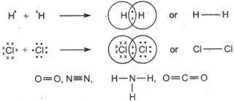
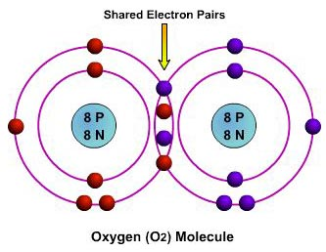
Unit 5: Atomic Hookups—Chemical Bonding
5.5
How do we name and represent covalent compounds in a chemical formula?
QUESTION
How are covalent bonds (molecular substances) formed?
(USE PICTURE TO HELP)
NOTES
A covalent bond forms by

Slide 6
Unit 5: Atomic Hookups—Chemical Bonding
5.5
How do we name and represent covalent compounds in a chemical formula?
QUESTION
How do we name covalent compounds?
EXAMPLE: CO₂
NOTES
Write name of first element
Write name of second element with –ide ending
Count how many atoms you have of each element and add prefix to the front of each name
NOTE: If there is only one of the first atom, then we do not have to write mono- in front of the element name.
NOTE: The vowels a and o are dropped from a prefix that is added to a word beginning with a vowel. (Example: monoxide vs. monooxide)

Slide 7
Unit 5: Atomic Hookups—Chemical Bonding
5.5
How do we name and represent covalent compounds in a chemical formula?

Slide 8
Unit 5: Atomic Hookups—Chemical Bonding
5.5
How do we name and represent covalent compounds in a chemical formula?
YOU TRY

Slide 9
Unit 5: Atomic Hookups—Chemical Bonding
5.5
How do we name and represent covalent compounds in a chemical formula?
YOU TRY

Slide 10
Unit 5: Atomic Hookups—Chemical Bonding
5.5
How do we name and represent covalent compounds in a chemical formula?
QUESTION
How do we write formulas for covalent compounds?
EXAMPLE: Arsenic Tribromide
NOTES
Write symbol of the 1st element + write subscript BASED FROM PREFIX
Write symbol of the 2nd element + write subscript BASED FROM PREFIX

Slide 11
Unit 5: Atomic Hookups—Chemical Bonding
5.5
How do we name and represent covalent compounds in a chemical formula?
YOU TRY
Example #1: Diphosphorus trioxide
Formula of compound: _________________________
Example #2: Carbon tetrachloride
Formula of compound: _________________________
Write the formulas for the following covalent compounds:
a) diboron hexahydride _______________________
b) nitrogen tribromide ________________________
c) sulfur hexachloride __________________________
d) diphosphorus pentoxide ____________________

Slide 12
Unit 5: Atomic Hookups—Chemical Bonding
5.5
How do we name and represent covalent compounds in a chemical formula?
QUESTION
How do the names for SO₂ and SO₃ differ?
What is incorrect about the name monosulfur dioxide for the SO₃?
NOTES
I think…
My partner thinks….
I think…
My partner thinks…

Slide 13
Unit 5: Atomic Hookups—Chemical Bonding
5.5
How do we name and represent covalent compounds in a chemical formula?
SAMPLE QUESTION #1:
Raise your finger corresponding to answer choice:
Which substance contains bonds that involved the sharing of electrons from one atom to another?
A) Calcium and iodine
B) hydrogen and nitrogen
C) barium and bromine
D) boron and bromine
Which particle has the same electron configuration as a calcium ion?
A) fluoride ion B) sodium ion C) potassium atom D) argon atom
What is the net charge of an ion that has 13 protons, 12 neutrons, and 10 electrons?
A) +1 B) +3 C) -1 D) -3
Which electron configuration is correct for a sodium ion?
2–7 B) 2–8 C) 2–8–1 D) 2–8–2
Compared to a calcium atom, the calcium ion Ca²⁺ has
more protons B) fewer protons C) more electrons D) fewer electrons

Slide 14
Unit 5: Atomic Hookups—Chemical Bonding
5.5
How do we name and represent covalent compounds in a chemical formula?
SAMPLE QUESTION #2:
Raise your finger corresponding to answer choice:
Which formula represents a molecular substance?
CaO
CO
Li₂O
Al₂O₃

Slide 15
Unit 5: Atomic Hookups—Chemical Bonding
5.5
How do we name and represent covalent compounds in a chemical formula?
QUESTION
Two questions I have are…
NOTES
1.
2.
SUMMARY:

Slide 16
Unit 5: Atomic Hookups—Chemical Bonding
5.5
How do we name and represent covalent compounds in a chemical formula?
HOMEWORK:
Finish classwork of 5.5
Write a summary of today’s lesson
Create two questions
Highlight important information from the lesson

Slide 17
Unit 5: Atomic Hookups—Chemical Bonding
5.5
How do we name and represent covalent compounds in a chemical formula?
EXIT SLIP
Make sure you get your trackers checked!

