Slide 1
Unit 5: Atomic Hookups—Chemical Bonding
5.8
DATE:
TOPIC/ Objective: I will draw Lewis Dot structures of double & triple-bonded covalent compounds.
Essential question: How do we draw Lewis Dot structures of double & triple-bonded covalent compounds?
AGENDA
Do Now
Introduction
Mini-Lesson
Summary
Work Period
DO NOW:
Complete Do Now Slip.
You have 5 minutes.
Exit Slip

Slide 2
Unit 5: Atomic Hookups—Chemical Bonding
5.8
How do we draw Lewis Dot structures of double- & triple- bonded covalent compounds?
ANNOUNCEMENTS:
Due Dates:
Facebook Project—Due Wed 4/15
Email it to me at pfrancois@hs-gc.org
Quiz on 5.1-5.5—Thurs 4/16

Slide 3
Unit 5: Atomic Hookups—Chemical Bonding
5.8
How do we draw Lewis Dot structures of double- & triple- bonded covalent compounds?
DO NOW
Draw the Lewis Dot Structure of BF₃

Slide 4
Unit 5: Atomic Hookups—Chemical Bonding
5.8
How do we draw Lewis Dot structures of double- & triple- bonded covalent compounds?
QUESTION
What is a double covalent bond?
What is a triple covalent bond?
NOTES
A double covalent bond is…
A triple covalent bond is…

Slide 5
Unit 5: Atomic Hookups—Chemical Bonding
5.8
How do we draw Lewis Dot structures of double- & triple- bonded covalent compounds?
QUESTION
How can we tell if something will be a single bond, double bond or triple bond?
NOTES
Elements with SINGLE bonds: Fluorine, Chlorine, Iodine, Bromine
How many valence electrons they have?
How many more they need to be stable?
Elements with DOUBLE bonds: oxygen, sulfur
Valence electrons:
Electrons needed:
Elements with TRIPLE bonds: nitrogen
Valence electrons:
Electrons needed:

Slide 6
Unit 5: Atomic Hookups—Chemical Bonding
5.8
How do we draw Lewis Dot structures of double- & triple- bonded covalent compounds?
QUESTION
How to draw Lewis Dot Structures for DOUBLE- & TRIPLE-BONDED covalent compounds?
NOTES
*Same steps for single bonded electrons EXCEPT add:
Move a pair of electrons from outer atom to a bond between the center & outer electron until satisfied.

Slide 7
Unit 5: Atomic Hookups—Chemical Bonding
5.8
How do we draw Lewis Dot structures of double- & triple- bonded covalent compounds?
QUESTION
Example #1: O₂
Example #2: N₃
NOTES

Slide 8
Unit 5: Atomic Hookups—Chemical Bonding
5.8
How do we draw Lewis Dot structures of double- & triple- bonded covalent compounds?
YOU TRY
Draw the Lewis Dot Structure for the following:
Hydrogen Cyanide
Carbon dioxide
Carbon Monoxide
Describe two ways that carbon dioxide and carbon monoxide differ.

Slide 9
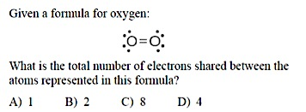
Unit 5: Atomic Hookups—Chemical Bonding
5.8
How do we draw Lewis Dot structures of double- & triple- bonded covalent compounds?
SAMPLE QUESTION #1
. Raise your finger corresponding to answer choice:

Slide 10
Unit 5: Atomic Hookups—Chemical Bonding
5.8
How do we draw Lewis Dot structures of double- & triple- bonded covalent compounds?
SAMPLE QUESTION #2
. Raise your finger corresponding to answer choice:
What is the total number of electrons shared in the bonds between the two carbon atoms in a molecule of ?
6
2
3
8

Slide 11
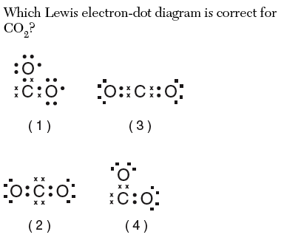
Unit 5: Atomic Hookups—Chemical Bonding
5.8
How do we draw Lewis Dot structures of double- & triple- bonded covalent compounds?
SAMPLE QUESTION #3
. Raise your finger corresponding to answer choice:
Which Lewis electron-dot diagram is correct for CO₂?

Slide 12
Unit 5: Atomic Hookups—Chemical Bonding
5.8
How do we draw Lewis Dot structures of double- & triple- bonded covalent compounds?
SAMPLE QUESTION #4
. Raise your finger corresponding to answer choice:
Which element has atoms that can form single, double, and triple covalent bonds with other atoms of the same element?
(1) hydrogen (2) oxygen
(3) fluorine (4) carbon

Slide 13
Unit 5: Atomic Hookups—Chemical Bonding
5.8
How do we draw Lewis Dot structures of double- & triple- bonded covalent compounds?
QUESTION
Two questions I have are…
NOTES
1.
2.
SUMMARY:

Slide 14
Unit 5: Atomic Hookups—Chemical Bonding
5.8
How do we draw Lewis Dot structures of double- & triple- bonded covalent compounds?
HOMEWORK:
Finish classwork of 5.8
Write a summary of today’s lesson
Create two questions
Highlight important information from the lesson

Slide 15
Unit 5: Atomic Hookups—Chemical Bonding
5.8
How do we draw Lewis Dot structures of single-bonded covalent compounds?
EXIT SLIP
Make sure you get your trackers checked!

