Slide 1
Set up for success for the new school year!
0.3
Aim: How do I organize myself for a successful school year?
Objective:
I will set up a binder and lab folder to organize myself for a successful school year.
AGENDA
Do Now
Introduction
Mini-Lesson
Summary
Work Period
Do Now:
Complete the do now sheet!
Exit Slip

Slide 2
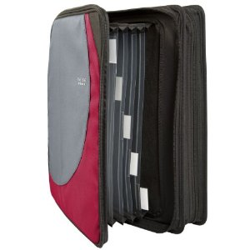
Set up for success for the new school year!
0.3
Aim: How do I organize myself for a successful school year?
Announcements:
YOU NEED ONE BINDER FOR JUST THIS CLASS—NO other class in it!
(You can get a binder +
binder dividers by paying $3)
AGENDA
Do Now
Introduction
Mini-Lesson
Summary
Work Period
Exit Slip

Slide 3
Set up for success for the new school year!
0.3
Aim: How do I organize myself for a successful school year?
Setting Up Binders
Tab 1: Classwork
Tab 2: Quizzes
Tab 3: Exams/Interims
Tab 4: Review
Tab 5: Other Handouts
Do Now
Introduction
Mini-Lesson
Summary
Work Period
Exit Slip

Slide 4
Set up for success for the new school year!
0.3
Aim: How do I organize myself for a successful school year?
At the FRONT of the binder in the section called “Other Handouts” please pick up:
1. Chemistry Reference table
2. Vocabulary Sheets (they are colored)
Do Now
Introduction
Mini-Lesson
Summary
Work Period
Exit Slip

Slide 5
Set up for success for the new school year!
0.3
Aim: How do I organize myself for a successful school year?
Lab Folder
Set up lab folder like this using the sharpie
Francois, Princess
Princess Francois
Chemistry Lab Folder
Period _____
Do Now
Introduction
Mini-Lesson
Summary
Work Period
Exit Slip

Slide 6
Set up for success for the new school year!
STAPLE LIKE THIS. Write name and period on each page. Fill in Page __ of ___
Do Now
Introduction
Mini-Lesson
Summary
Work Period
Exit Slip

