Slide 1
Lab 1: Lab Safety
Lab
1
Aim: How do I conduct a lab experiment using lab safety rules?
Objective:
I will identify lab safety rules used to conduct an experiment.
AGENDA
Do Now
Introduction
Mini-Lesson
Summary
Work Period
Do Now: (You have 5 minutes)
Complete your do now!
Exit Slip

Slide 2
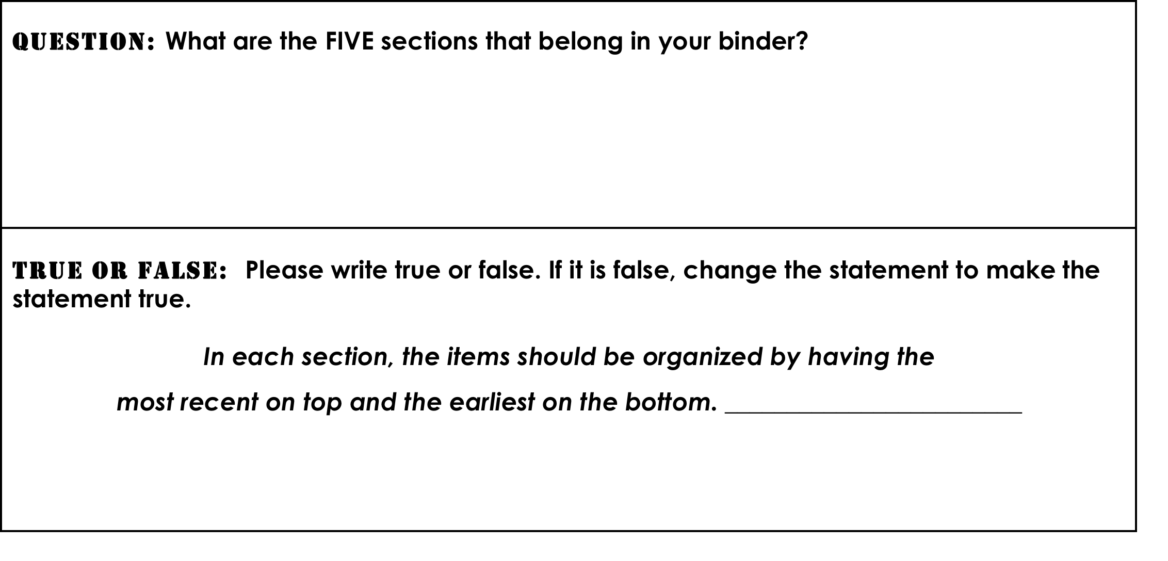
Lab 1: Lab Safety
Lab
1
Aim: How do I conduct a lab experiment using lab safety rules?
Do Now
Make sure you get your trackers checked!
Do Now
Introduction
Mini-Lesson
Summary
Work Period
Exit Slip

Slide 3
Lab 1: Lab Safety
Lab
1
Aim: How do I conduct a lab experiment using lab safety rules?
Announcements
The following was due on Monday 9/8/14
FB profile
Parent Questionaire
Course Contract
Lab Safety Contract
Binder w/ dividers or $3
Remind 101 sign up
AGENDA
Do Now
Introduction
Mini-Lesson
Summary
Work Period
Exit Slip

Slide 4
Lab 1: Lab Safety
Lab
1
Aim: How do I conduct a lab experiment using lab safety rules?
Title for lab 1
Lab Safety
question
Aim: How do I conduct a lab experiment using lab safety rules?
AGENDA
Do Now
Introduction
Mini-Lesson
Summary
Work Period
Exit Slip

Slide 5
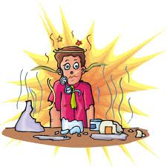
Lab 1: Lab Safety
Lab
1
Aim: How do I conduct a lab experiment using lab safety rules?
TURN AND TALK
Why do we care about lab safety rules?
AGENDA
Do Now
Introduction
Mini-Lesson
Summary
Work Period
Exit Slip

Slide 6
Lab 1: Lab Safety
Lab
1
Aim: How do I conduct a lab experiment using lab safety rules?
Pre-Lab Questions
Think-Ink : Jot down in one minute as many safety rules you can think of as possible.
Do Now
Introduction
Mini-Lesson
Summary
Work Period
Exit Slip

Slide 7
Lab 1: Lab Safety
Lab
1
Aim: How do I conduct a lab experiment using lab safety rules?
Pre-Lab Questions
Pair-Share: Share what rules you wrote down with your group. Write down here any rules that you missed that your partner remembered.
Do Now
Introduction
Mini-Lesson
Summary
Work Period
Exit Slip

Slide 8
Lab 1: Lab Safety
Lab
1
Aim: How do I conduct a lab experiment using lab safety rules?
Lab Safety Video
Please watch the following video:
https://www.youtube.com/watch?v=VRWRmIEHr3A
.
Do Now
Introduction
Mini-Lesson
Summary
Work Period
Exit Slip

Slide 9
Lab 1: Lab Safety
Lab
1
Aim: How do I conduct a lab experiment using lab safety rules?
ACTIVITY
Each group will be given strips of paper with lab safety rules and categories.
You will be expected to arrange these lab safety rules into groups and come up with.
Write your answers under each category.
Then compare your answers to what is on the board.
Do Now
Introduction
Mini-Lesson
Summary
Work Period
Exit Slip

Slide 10
Lab 1: Lab Safety
Lab
1
Aim: How do I conduct a lab experiment using lab safety rules?
ACTIVITY ANSWERS
PREPARE FOR LABORATORY WORK
Study laboratory procedures prior to class.
Never perform unauthorized experiments.
Keep your lab bench organized and free of apparel, books, and other clutter.
DRESS FOR LABORATORY WORK
Tie back long hair.
Wear shoes with tops.
Wear safety goggles during all laboratory sessions.
Do Now
Introduction
Mini-Lesson
Summary
Work Period
Exit Slip

Slide 11
Lab 1: Lab Safety
Lab
1
Aim: How do I conduct a lab experiment using lab safety rules?
ACTIVITY ANSWERS
AVOID CONTACT WITH CHEMICALS
Never taste or "sniff" chemicals.
When heating substances in a test tube, point the mouth away from people.
Never carry dangerous chemicals or hot equipment near other people.
AVOID HAZARDS
Use caution when handling hot glassware.
Turn off burners when not in use.
Do not bend or cut glass unless appropriately instructed by teacher.
Do Now
Introduction
Mini-Lesson
Summary
Work Period
Exit Slip

Slide 12
Lab 1: Lab Safety
Lab
1
Aim: How do I conduct a lab experiment using lab safety rules?
ACTIVITY ANSWERS
CLEAN UP
Consult teacher for proper disposal of chemicals.
Wash hands thoroughly following experiments.
Leave laboratory bench clean and neat.
IN CASE OF ACCIDENT
Report all accidents and spills immediately.
Place broken glass in designated containers.
If chemicals get in your eyes, wash them for at least 15 minutes with an eyewash.
Do Now
Introduction
Mini-Lesson
Summary
Work Period
Exit Slip

Slide 13
Lab 1: Lab Safety
Lab
1
Aim: How do I conduct a lab experiment using lab safety rules?
BROKEN RULES SCENARIO
The Bikini Bottom gang has been learning safety rules during science class. Read the paragraphs below to find the broken safety rules and underline each one. How many can you find? After the scenario, state the rules that were broken and what is the correct rule.
Do Now
Introduction
Mini-Lesson
Summary
Work Period
Exit Slip

Slide 14
Lab 1: Lab Safety
Lab
1
Aim: How do I conduct a lab experiment using lab safety rules?
Lab Safety Rules Scenario
Each group will be assigned a scenario below. Every person in the group will create their own mini flyer featuring the “Do” and “Don’t” of that scenario. On the top, you will state the category that the scenario refers to. On the left side, list what should be done in the scenario. On the right side, you will explain what should not be done.
At the bottom, summarize in one paragraph why is it important to follow lab safety rules, using your scenario as an example to justify your answer. Use TIEDC as the format for your paragraph.
Do Now
Introduction
Mini-Lesson
Summary
Work Period
Exit Slip

Slide 15
Lab 1: Lab Safety
Lab
1
Aim: How do I conduct a lab experiment using lab safety rules?
Lab Safety Rules Scenario
Divide the work in three:
Task Manager: __________________________________________________
Spokesperson: _________________________________________________
Record Keeper: _________________________________________________
Resource Manager _____________________________________________
Let’s Go over group rating rubric
Do Now
Introduction
Mini-Lesson
Summary
Work Period
Exit Slip

Slide 16
Lab 1: Lab Safety
Lab
1
Aim: How to create a well-formulated introduction and conclusion?
MODEL LAYOUT
Do Now
Introduction
Mini-Lesson
Summary
Work Period
Exit Slip

Slide 17
Lab 1: Lab Safety
Lab
1
Aim: How do I conduct a lab experiment using lab safety rules?
Exit Slip
Please complete group work reflection sheet and rubric on pages 6-7 and I will go around to rate your group
Do Now
Introduction
Mini-Lesson
Summary
Work Period
Exit Slip

