Slide 1
Lab 3: Design an Experiment—Density
Lab
3
Aim: How can we design an experiment to test the effect of salt water on an egg’s buoyancy?
Objective:
I will design an experiment to the effect of salt water on an egg’s buoyancy.
AGENDA
Do Now
Introduction
Mini-Lesson
Summary
Work Period
Do Now: (You have 5 minutes)
Complete the Do Now
Exit Slip

Slide 2
Lab 3: Design an Experiment—Density
Lab
3
Aim: How can we design an experiment to test the effect of salt water on an egg’s buoyancy?
MAD MINUTE MONDAY
You have 3 minutes to complete as many problems as possible
Questions you get correct gives you extra points toward your quiz.
AGENDA
Do Now
Introduction
Mini-Lesson
Summary
Work Period
Exit Slip

Slide 3
Lab 3: Design an Experiment—Density
Lab
3
Aim: How can we design an experiment to test the effect of salt water on an egg’s buoyancy?
announcements
SI Unit Comic Strip Project due Tuesday 10/14/14 (after Columbus Day)
AGENDA
Do Now
Introduction
Mini-Lesson
Summary
Work Period
Exit Slip

Slide 4
Lab 3: Design an Experiment—Density
Lab
3
Aim: How can we design an experiment to test the effect of salt water on an egg’s buoyancy?
REVIEW DO NOW
Do Now
Introduction
Mini-Lesson
Summary
Work Period
Exit Slip

Slide 5
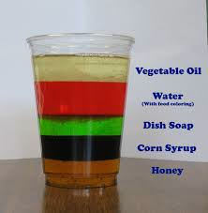
Lab 3: Design an Experiment—Density
Lab
3
Aim: How can we design an experiment to test the effect of salt water on an egg’s buoyancy?
Density coluumn
3. WRITING observations
On each post-it, write down one observation you see from the density column
I notice there are three color.
Do Now
Introduction
Mini-Lesson
Summary
Work Period
Exit Slip

Slide 6
Lab 3: Design an Experiment—Density
Lab
3
Aim: How can we design an experiment to test the effect of salt water on an egg’s buoyancy?
3-2-1 protocol
3. WRITING observations
On each post-it, write down one observation you see from the density column
I notice there are three color.
Do Now
Introduction
Mini-Lesson
Summary
Work Period
Exit Slip

Slide 7
Lab 3: Design an Experiment—Density
Lab
3
Aim: How can we design an experiment to test the effect of salt water on an egg’s buoyancy?
SHARING OBSERVATIONS
Get up, find a partner with a different color post-it from what you started with.
Read your post-it OUT LOUD to your partner and then switch post-its.
Do that two more times.
You should not have the same color you started with
Do Now
Introduction
Mini-Lesson
Summary
Work Period
Exit Slip

Slide 8
Lab 3: Design an Experiment—Density
Lab
3
Aim: How can we design an experiment to test the effect of salt water on an egg’s buoyancy?
2. creating questions
On a post-it, write down TWO questions
Share your questions to the person next to you.
Your partner chooses one question to answer
Do Now
Introduction
Mini-Lesson
Summary
Work Period
Exit Slip

Slide 9
Lab 3: Design an Experiment—Density
Lab
3
Aim: How can we design an experiment to test the effect of salt water on an egg’s buoyancy?
QUESTION STEMS
How come ____________?
Why did ______________?
What would happen if _____________?
How is _______ related to ________?
Do Now
Introduction
Mini-Lesson
Summary
Work Period
Exit Slip

Slide 10
Lab 3: Design an Experiment—Density
Lab
3
Aim: How can we design an experiment to test the effect of salt water on an egg’s buoyancy?
TURN AND TALK
Turn to the person next to you and ask your partner one of your questions. Make sure they answer one of your questions
LET’S SHARE OUT ON 3 QUESTIONS & ANSWERS
Do Now
Introduction
Mini-Lesson
Summary
Work Period
Exit Slip

Slide 11
Lab 3: Design an Experiment—Density
Lab
3
Aim: How can we design an experiment to test the effect of salt water on an egg’s buoyancy?
Science journaling
Please answer the following on looseleaf.
DO NOT STOP WRITING FOR 5 MINUTES:
Why are their different layers in the density column?
Do Now
Introduction
Mini-Lesson
Summary
Work Period
Exit Slip

Slide 12
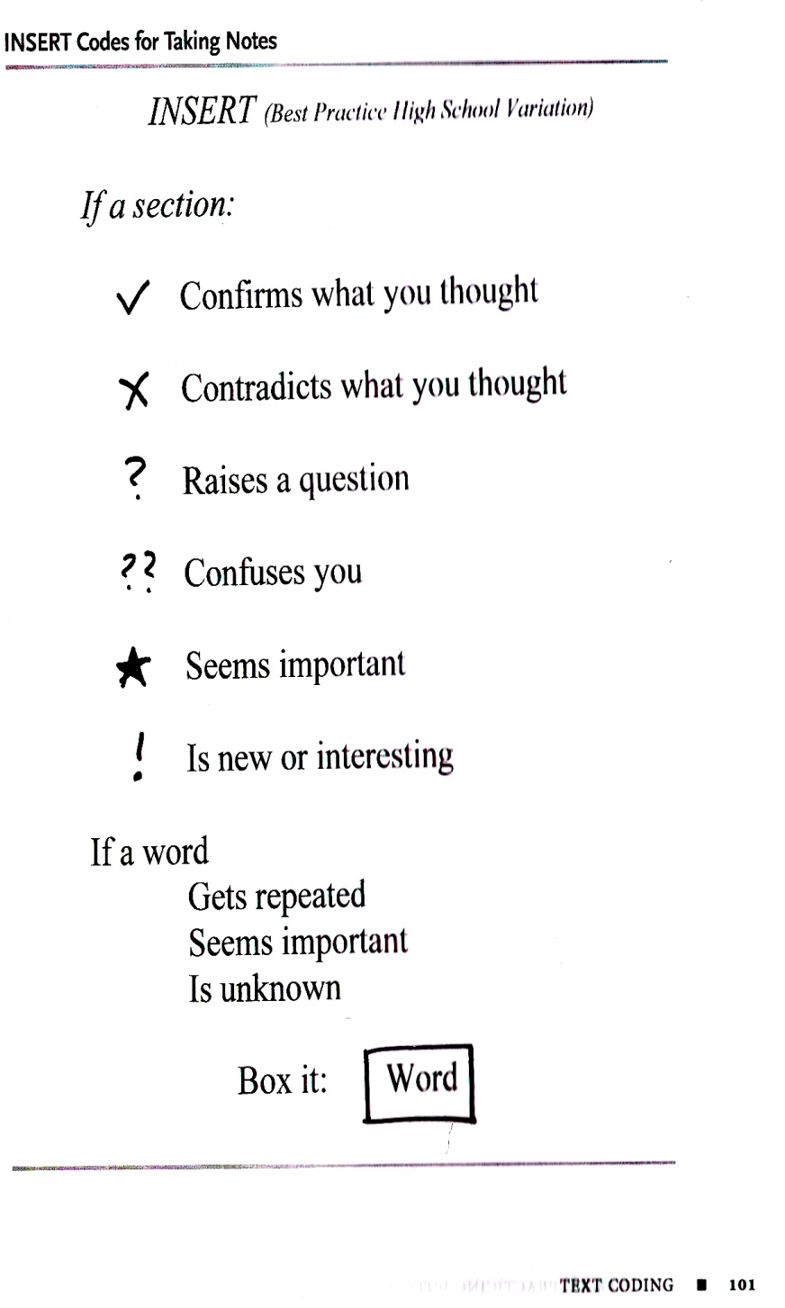
Lab 3: Design an Experiment—Density
Lab
3
Aim: How can we design an experiment to test the effect of salt water on an egg’s buoyancy?
Scientific method
Please take 7 minutes to read this sheet and ANNOTATE your text.
What does reading actively look like?
Do Now
Introduction
Mini-Lesson
Summary
Work Period
Exit Slip

Slide 13
Lab 3: Design an Experiment—Density
Lab
3
Aim: How can we design an experiment to test the effect of salt water on an egg’s buoyancy?
GROUP activity (work in 3)
You have strips of paper with the scientific method and step-by-step lab experiment
Math the step from the lab experiment to the step in the scientific method
Put it in order from the first step to the last step
Do Now
Introduction
Mini-Lesson
Summary
Work Period
Exit Slip

Slide 14
Lab 3: Design an Experiment—Density
Lab
3
Aim: How can we design an experiment to test the effect of salt water on an egg’s buoyancy?
Answer key
Do Now
Introduction
Mini-Lesson
Summary
Work Period
Exit Slip

Slide 15
Lab 3: Design an Experiment—Density
Lab
3
Aim: How can we design an experiment to test the effect of salt water on an egg’s buoyancy?
Answer key
Do Now
Introduction
Mini-Lesson
Summary
Work Period
Exit Slip

Slide 16
Lab 3: Design an Experiment—Density
Lab
3
Aim: How can we design an experiment to test the effect of salt water on an egg’s buoyancy?
Answer key
Do Now
Introduction
Mini-Lesson
Summary
Work Period
Exit Slip

Slide 17
Lab 3: Design an Experiment—Density
Lab
3
Aim: How can we design an experiment to test the effect of salt water on an egg’s buoyancy?
Answer key
Do Now
Introduction
Mini-Lesson
Summary
Work Period
Exit Slip

Slide 18
Lab 3: Design an Experiment—Density
Lab
3
Aim: How can we design an experiment to test the effect of salt water on an egg’s buoyancy?
announcements
SI Unit Comic Strip Project due Tuesday 10/14/14 (after Columbus Day)
Interim Assessment/Unit 1 Exam is Wed 10/8/14
AGENDA
Do Now
Introduction
Mini-Lesson
Summary
Work Period
Exit Slip

Slide 19
Lab 3: Design an Experiment—Density
Lab
3
Aim: How can we design an experiment to test the effect of salt water on an egg’s buoyancy?
Design your own experiment (DAY 2)
Using the graphic organizer, you will design your own experiment
Before you move on to the next step, check with me
10 minutes to create a hypothesis, fill out independent & dependent variables and control
LETS GO OVER IT
15 minutes to create a procedure/materials
LETS GO OVER IT
7 minutes to create data tables
LETS GO OVER IT
Do Now
Introduction
Mini-Lesson
Summary
Work Period
Exit Slip

Slide 20
Lab 3: Design an Experiment—Density
Lab
3
Aim: How can we design an experiment to test the effect of salt water on an egg’s buoyancy?
announcements
SI Unit Comic Strip Project due Tuesday 10/14/14 (after Columbus Day)
Interim Assessment/Unit 1 Exam is Wed 10/8/14
AGENDA
Do Now
Introduction
Mini-Lesson
Summary
Work Period
Exit Slip

Slide 21
Lab 3: Design an Experiment—Density
Lab
3
Aim: How can we design an experiment to test the effect of salt water on an egg’s buoyancy?
Conduct your experiment (DAY 3)
Gather the materials that you need
Conduct your experiment and collect data and observations
State a conclusion
Do Now
Introduction
Mini-Lesson
Summary
Work Period
Exit Slip

Slide 22
Lab 3: Design an Experiment—Density
Lab
3
Aim: How can we design an experiment to test the effect of salt water on an egg’s buoyancy?
reflection
Watch this video: https://www.youtube.com/watch?v=zszw6uCiQpc
How is this experiment is similar to yours?
How is different from yours?
Do Now
Introduction
Mini-Lesson
Summary
Work Period
Exit Slip

Slide 23
Lab 3: Design an Experiment—Density
Lab
3
Aim: How can we design an experiment to test the effect of salt water on an egg’s buoyancy?
reflection
Answer the discussion questions, reflection questions, and group rating (15 minutes)
LETS GO OVER IT
Do Now
Introduction
Mini-Lesson
Summary
Work Period
Exit Slip

Slide 24
Lab 3: Design an Experiment—Density
Lab
3
Aim: How can we design an experiment to test the effect of salt water on an egg’s buoyancy?
Science journaling
Please answer the following on looseleaf.
DO NOT STOP WRITING FOR 5 MINUTES:
How does the egg experiment relate to humans being able to float differently in a public pool versus Coney Island Beach (ocean water)?
Do Now
Introduction
Mini-Lesson
Summary
Work Period
Exit Slip

Slide 25
Lab 3: Design an Experiment—Density
Lab
3
Aim: How can we design an experiment to test the effect of salt water on an egg’s buoyancy?
Lab roles
You will work in groups of 5-6
Each member has a role:
Task Manager: In charge of leading group; Makes sure everyone is on task and delegates reading lab out loud to the group
Spokesperson: Only person allowed to speak to teacher. Everyone else must share their questions with spokesperson.
Data Collector: In charge of collecting data and making sure everyone else has the same data
Resource Manager: Gets necessary materials and cleans up lab space;
Timekeeper: Keeps track of time for the lab
AGENDA
Do Now
Introduction
Mini-Lesson
Summary
Work Period
Exit Slip

Slide 26
Lab 3: Design an Experiment—Density
Lab
3
Aim: How can we design an experiment to test the effect of salt water on an egg’s buoyancy?
Lab groups—pd 2
GROUP 1: GROUP 3:
Wens Kely 1. Keya Gill
Pamela Smith 2. Tamiann Palmer
Anbessa Sam 3. Marlwin Hernandez
Fatouma Kone 4. Saidou Ly
GROUP 2: GROUP 4:
Aneisha Richards 1. Jewel Applewhite
Emilio Lopez 2. Madison Durham
Warrell Biggs 3. Joel McCulskie
Javarie Simpson 4. Robinson Louis
AGENDA
Do Now
Introduction
Mini-Lesson
Summary
Work Period
Exit Slip

Slide 27
Lab 3: Design an Experiment—Density
Lab
3
Aim: How can we design an experiment to test the effect of salt water on an egg’s buoyancy?
Lab groups—pd 2
GROUP 5: GROUP 7
Mohamed Jalloh 1. Aissatou Diallo
Kodel Maloney 2. Brandley Pierre
Shari Blackman 3. Brandon Pierre
Marie-Michelle Cajou 4. Kenly Gracia
GROUP 6:
Brandon Hewitt
Makonenn Sam
Christa Spencer
Tasianna Joseph
Karen Owosu-Ansah
AGENDA
Do Now
Introduction
Mini-Lesson
Summary
Work Period
Exit Slip

Slide 28
Lab 3: Design an Experiment—Density
Lab
3
Aim: How can we design an experiment to test the effect of salt water on an egg’s buoyancy?
Lab groups—pd 4
GROUP 1: GROUP 3:
Makeeda Alexander 1. Nathifa Delisser
Mackenson Desty 2. Joseph Greenwood
Dante Mitchell 3. Jada McFarlane
Odane Potts 4. Julia Lawrence
GROUP 2: GROUP 4:
Omari Blount 1. Jania Nelson
Rodney Smokes 2. Juan Lopez
Kimmornie Sylvester 3. Jessy Royer
Saleh Ahmed 4. Jessica Royer
Dequon Banner
AGENDA
Do Now
Introduction
Mini-Lesson
Summary
Work Period
Exit Slip

Slide 29
Lab 3: Design an Experiment—Density
Lab
3
Aim: How can we design an experiment to test the effect of salt water on an egg’s buoyancy?
Lab groups—pd 4
GROUP 1:
Brianna Christopher
Sashell Francis
Keino Harris
Bartolo Osario
AGENDA
Do Now
Introduction
Mini-Lesson
Summary
Work Period
Exit Slip

Slide 30
Lab 3: Design an Experiment—Density
Lab
3
Aim: How can we design an experiment to test the effect of salt water on an egg’s buoyancy?
Lab groups—pd 7
GROUP 1: GROUP 3:
Miquasha Menner 1. Desron Wilson
Jade Davis 2. Naquarn Charlemagne
Tyriek Craddock 3. Ayanna Thompson
Amadou Diop 4. Inchez Devalsaint
Emmanuel Blackman 5. Justin Williams
GROUP 2: GROUP 4:
Jameeka Beauvil 1. Tracy Peprah
Ragina Regis 2. Zaire Leon
Vanessa Jean-Baptiste 3. Genesis Morrison
Dachmeide Luma 4. Robens Innocent
Lamore Weems 5. Keith Alloway
AGENDA
Do Now
Introduction
Mini-Lesson
Summary
Work Period
Exit Slip

Slide 31
Lab 3: Design an Experiment—Density
Lab
3
Aim: How can we design an experiment to test the effect of salt water on an egg’s buoyancy?
Lab groups—pd 7
GROUP 5:
Johnnie Gaitlin
Naheim Fuller
Angel Carlisle
Shyann Brooks
GROUP 6:
Dasia Carter
Rasheim Harris
Xoe Scott
Richard Payne
AGENDA
Do Now
Introduction
Mini-Lesson
Summary
Work Period
Exit Slip

